Slide 1
Boards of Education and Superintendents
Suggestions for Success

Slide 2
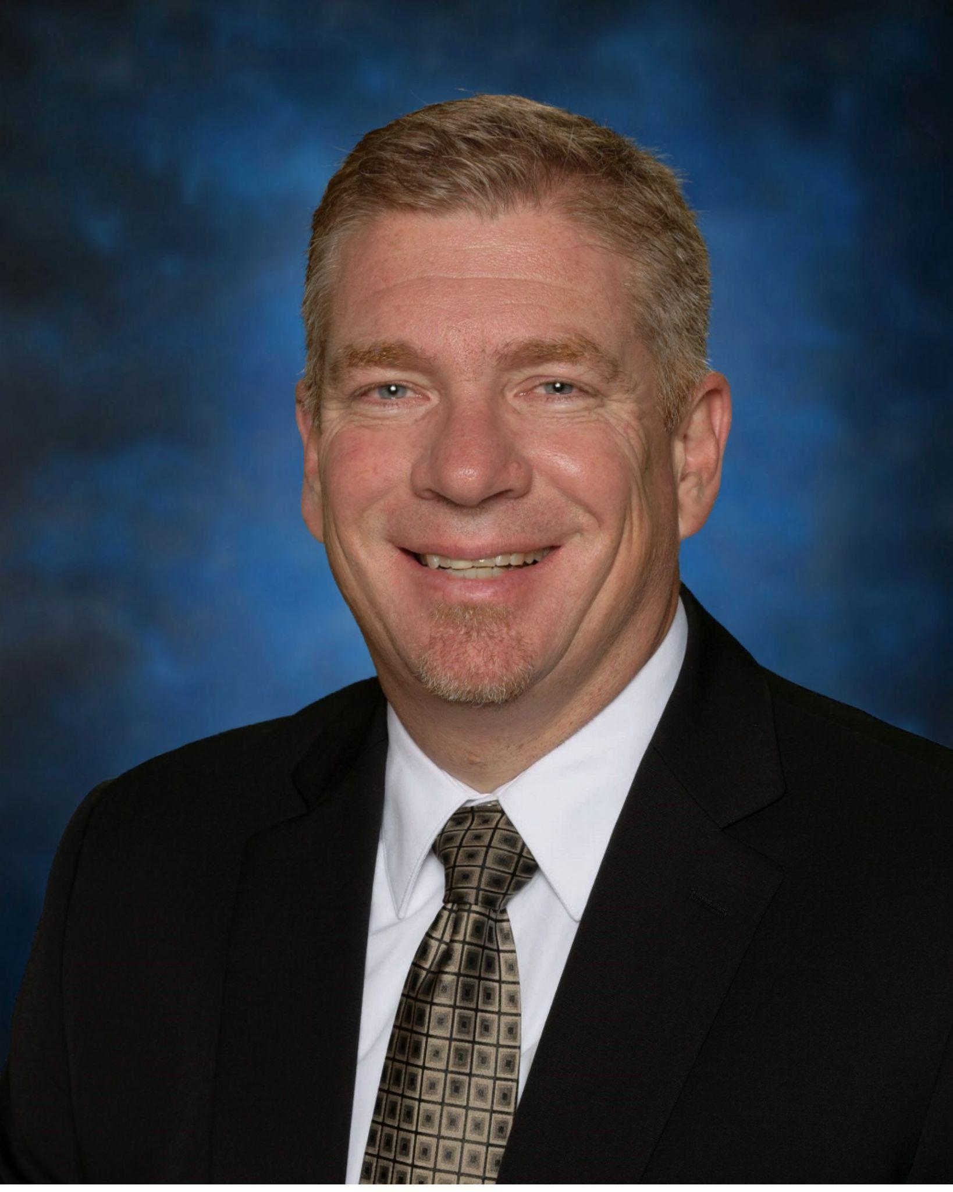
MO School Expertise, LLC
Dr. Kyle Kruse
32 years in MO Public K-12 education
20 years as Superintendent of Schools
www.moschoolexpertise.com
Specializing in School Finance, Assistance and Support for New and Early Career Superintendents, Board/Superintendent Relations, School Facilities and Bond Issues

Slide 3
What do you want this session to address?
What will help you the most?
What is already working well for you?

Slide 4
Please Know…
This session won’t necessarily give you “THE ANSWERS”
We hope it gives you things to think about and suggestions you can start using right away.

Slide 5
Common Areas of Interest
Duties/responsibilities of the Board and of the Superintendent
Efficient and Effective Board Meetings
Working Together on a Daily/Weekly basis
Appropriate and Timely Communication
Other?

Slide 6
Duties / Responsibilities
Board of Education
Set policy
Hire the Superintendent
Review/approve budget
Review/approve expenditures as per policy
Review/approve hiring/termination of personnel as per policy
Keep the Superintendent informed of matters brought to their attention
Superintendent
Responsible for all day-to-day operations of the District
Preparation of the budget, monitor and enact all aspects of budget, recommend budget amendments
Responsible for all personnel issues
Keep the BOE informed of matters that could result in Board review/action

Slide 7
Duties/Responsibilities (contd.)
So, in the real world, what does the division of responsibilities look like when…
Something “big” happens at school?
A parent contacts a board member?
An employee contacts a board member?
A board member wants to change an aspect of school operations?
Other?

Slide 8
Efficient and Effective Board Mtgs.
Pre-Meeting
Agenda creation
Agenda review
What kind of items “rise to the level of Board action?”
The Meeting
Closed session timing (before or after?)
Public comment (?)
Questions, discussions, other topics
Post-Meeting
Communication, media, action

Slide 9
Efficient and Effective Board Mtgs (contd.)
What things commonly have negative effects, or simply slow down, meetings?
Not enough information before the meeting?
Varying from the agenda?
Informality? (Is parliamentary procedure in use?)
Reports from Admin and others?
Items that do not “rise to the level of Board action?” (At least not yet?)
Other?

Slide 10
Working Together on a Daily/Weekly Basis
What should the relationship look like?
Meetings with board members?
Having items placed on the agenda?
Board members visiting buildings? (Why are they visiting?)
At school functions?
Social gatherings?
Avoiding the possibility of “meetings” that are not Sunshine Law compliant
Other?

Slide 11
Appropriate and Timely Communication
A good rule of thumb for everyone…
NO SURPRISES

Slide 12
Appropriate and Timely Communication
When should the Superintendent send information to the Board?
Board meeting preparation
When major school events will take place (graduation,etc.)
When something big happens that a Board member will probably be asked about. The Board member shouldn’t have to find out from the public.*
*This area is a little foggy…. Timing of events and nature of events will have an effect. A gas leak, a homecoming queen controversy, and a social media post are not all the same. You have to find the level the BOE and Supt. are comfortable with.
Other?

Slide 13
Appropriate and Timely Communication
When should a Board member relay information to the Superintendent?
When the situation is likely to get to Central Office.
When someone has contacted the Board member, and he/she directed them to the chain of command.
When it seems likely to cause a “stir” in the community.*
*This area is also a little foggy. The BOE and Supt. have to find the level they are comfortable with.
Other?

Slide 14
Questions?
What else is on your mind?
Any advice you’d like to share with me or your fellow Board members?

Slide 15
THANK YOU!
MO School Expertise, LLC
Dr. Kyle Kruse
32 years in MO Public K-12 education
20 years as Superintendent of Schools
www.moschoolexpertise.com
Specializing in School Finance, Assistance and Support for New and Early Career Superintendents, Board/Superintendent Relations, School Facilities and Bond Issues

