Slide 1
Elections Happen
Legal Issues for Board Members & School Leaders in an Election Year
2024

Slide 2
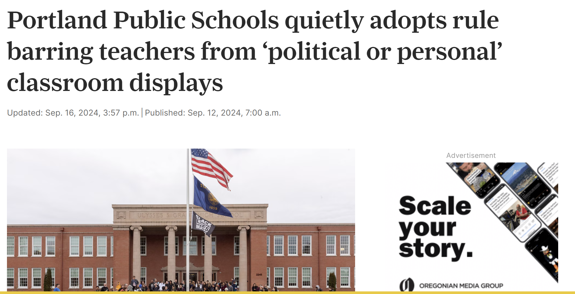
Employee Political Speech

Slide 3
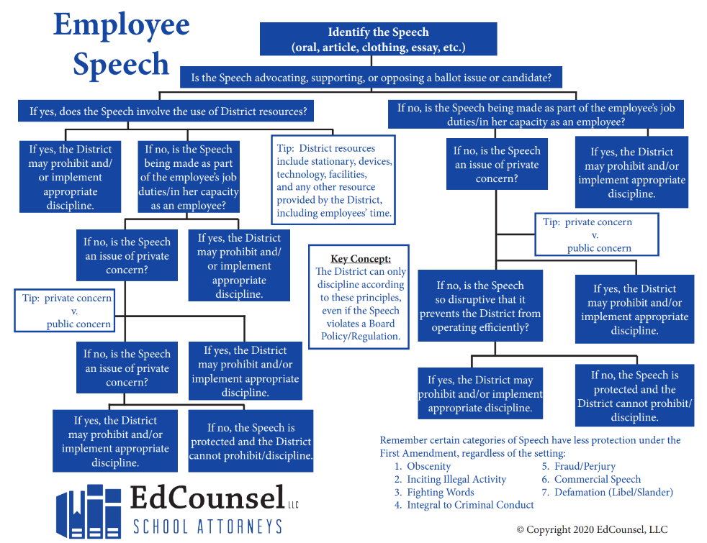
Employee Political Speech

Slide 4
Employee Political Speech
Staff cannot wear buttons, wristbands, or shirts supporting or opposing an election issue while on duty.
Staff cannot distribute any information in support of or against an election issue while on duty. This includes newsletters or information not prepared by the staff member but given to the staff member to hand out.
Staff cannot use school time or resources to promote or oppose an election issue or candidate (computers, chromebooks, ipads, school email, school mail, copy machines, phones, cell phones, school internet, etc.).
Staff cannot use any school devices at home to support or oppose an election issue or candidate.
Staff cannot use their personal devices when logged into district internet to support or oppose an election issue or candidate.
Staff cannot take part in the management of the campaign for the election or defeat of a candidate for the Board by which they are employed.

Slide 5
Student Free Speech in an Election Cycle

Slide 6
Student Free Speech in an Election Cycle
Districts are more likely this school year to encounter situations involving students expressing their political opinions and beliefs through various forms of speech.
Keep in mind that students maintain some First Amendment rights even when in school.
Determining whether certain speech can be prohibited or disciplined will require a careful review of the facts involved.

Slide 7
Student Free Speech in an Election Cycle

Slide 8
Ballot Measures/Candidates
Best Practices, Sunshine Law Requests, Criminal Liability

Slide 9
The Law
Whether it is a referendum, bond or levy issue, or a school board or presidential election, state law restricts the use of district resources to support or oppose a ballot issue or a candidate for public office.
§ 115.646, RSMo.
“No contribution or expenditure of public funds shall be made directly by any officer, employee or agent of any political subdivision, including school districts and charter schools, to advocate, support, or oppose the passage or defeat of any ballot measure or the nomination or election of any candidate for public office,”
Does not prohibit any public official of a political subdivision from making public appearances or issuing press releases concerning ballot measures.
A purposeful violation is a class four election offense. It is a criminal violation – a misdemeanor carrying up to a year in jail and/or up to a $2,500 fine.

Slide 10
What You Cannot Do
Use school time or resources to promote or oppose an election issue or candidate (computers, chromebooks, ipads, school email, school mail, copy machines, phones, cell phones, school internet, etc.).
Use any school devices at home to support or oppose an election issue or candidate.
Use your personal devices when logged into district internet to support or oppose an election issue or candidate.
Except on election day when school facilities are used as polling places, erect or display political signs inside or outside District facilities when the information clearly or implicitly advocates, supports, or opposes any ballot measure or candidate for public office.

Slide 11
What You Cannot Do, Continued
This applies even if the sign is printed or purchased with non-District funds and constructed or displayed by volunteers or staff working outside of hours for which the staff are paid.
Signs placed on election day can only be placed at polling places, must be placed in compliance with sign placement rules provided by the election bureaus, and must be removed after polls close that same day.
Distribute any information in support of or against an election issue while on duty.
Wear buttons, wristbands, shirts, etc. supporting or opposing an election issue while acting as a school official or school employee.

Slide 12
Sunshine Law
Considerations
In the wake of elections, or even leading up to them, it’s not uncommon for one group or another to start submitting Sunshine Law requests for records related to an election.
Often they are looking for evidence of a violation of the law.
Remember that if a record is created and the District retains it, it is a public record that may need to be disclosed.
This includes emails, text messages, etc. that are sent through District devices or accounts, even if personal in nature.

Slide 13
Use of School Buildings as Polling Places
A local election authority may designate a building owned by a public school district to be used as a polling place for any election.
The District cannot refuse to permit use of the building for election purposes.
The election authority has the right by statute to choose the location of the polling place within such buildings.

Slide 14
Voting Leave for Employees

Slide 15
Voting Leave for Employees
On election day: 3 hours of absence between poll opening and closing
No discipline
No reduction in pay
Request must be made prior to the day of the election
Does not apply if polls are open for 3 consecutive hours when employee is not assigned to work
District may specify which 3 hours may be taken during the work-day

Slide 16
School Apparel at Polls

Slide 17
School Shirts
Exit polling, surveying, sampling, electioneering, distributing election literature, posting signs or placing vehicles bearing signs with respect to any candidate or question to be voted on at an election on election day inside the building in which a polling place is located or within twenty-five feet of the building's outer door closest to the polling place, or, on the part of any person, refusing to remove or permit removal from property owned or controlled by such person, any such election sign or literature located within such distance on such day after request for removal by any person;

Slide 18
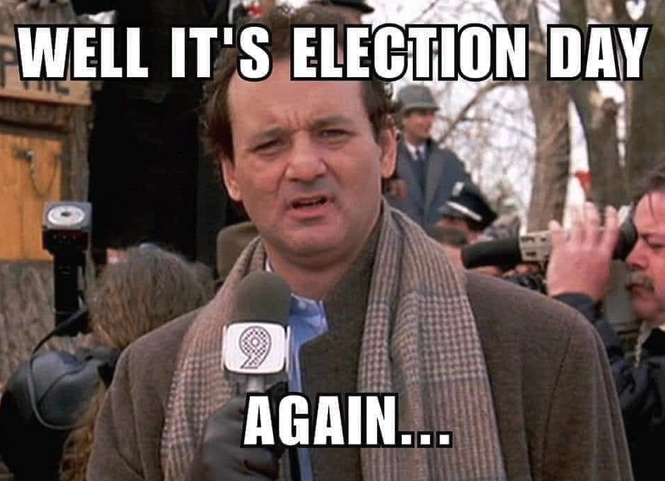
Campaign Signs on School Property

Slide 19
Campaign Signs on School Property
Except on election day when school facilities are used as polling places, staff cannot erect or display political signs inside or outside District facilities when the information clearly or implicitly advocates, supports, or opposes any ballot measure or candidate for public office. This prohibition applies even if the sign is printed or purchased with non-District funds and constructed or displayed by volunteers or staff working outside of hours for which the staff are paid. Signs placed on election day can only be placed at polling places, must be placed in compliance with sign placement rules provided by the election bureaus, and must be removed after polls close that same day.

Slide 20
Thank you

