Slide 1


District Purchasing Card Program – MARE Partnership with UMB
10/20/2021
Cherie Figge – Commercial Card Sales
Dennis Wegner - SVP Product Manager

Slide 2
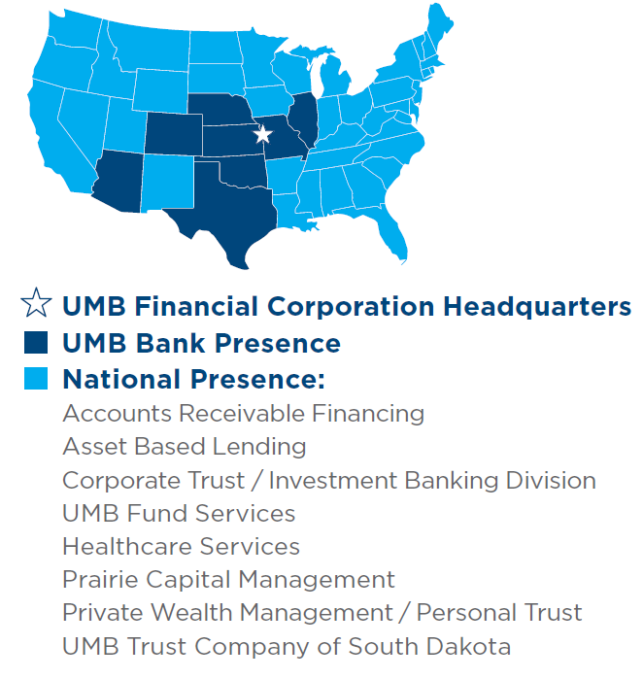
UMB Facts
UMB Bank
More than 100 years in business
91 locations in eight states - Missouri, Illinois, Colorado, Kansas, Oklahoma, Nebraska, Arizona and Texas
3,591 Employees across eight states
UMB Financial Corporation and subsidiaries have total assets of
  $33.1 billion
Processed $1.5 Billion through Paycheck Protection Program (PPP)
Commercial Card
Card issuer since 1969
16th largest purchasing card provider in the U.S.
Five state programs
377 School District programs
Education Plus partner since 2014
Our Footprint
We serve customers across the entire country.

Slide 3






The UMB Commercial Card Program
Simplify and Power Your Business
Improve Cash Flow
Better Data Analysis
Reward Programs
Lower
Administrative Costs
Reduce
Risk of Fraud
Improve Supplier & Employee Experience

Slide 4



Commercial Credit Card Benefits
Automation & Efficiency
Efficiency is critical to commercial banking. UMB’s comprehensive card solutions help you access real-time reporting, pay invoices faster and improve productivity.
Comprehensive program
management
Fraud reduction
Contactless payment
Customized controls
Account reconciliation
Float funds
Rebate and rewards
Reporting capabilities
Desktop and Mobile
Integrated solutions
We help you build an integrated set of solutions to manage the complexities of today’s payables.
Innovative technology
UMB’s technology and online solution is designed with the cardholder and company in mind—an easy-to-use solution for control and visibility.

Slide 5




Card Program Overview
Services
Diverse program offerings
A full suite to meet any business need:
Corporate Cards
Purchasing cards
Full use Commercial cards
Other niche variates
Payables and virtual
Full suite of Payables functionality:
Ghost accounts
Dynamic limit accounts
Single use accounts
Fully Integrated Payables
Realtime self-service
Online program management solution:
Manage cardholders
Manage other users
Real-time connectivity
Expense management
Industry-leading, expense management solution:
Desktop and Mobile access
Receipt capture
Detailed reporting
Visibility is critical to any commercial card program. Our data solutions range from:
Data integration
Scheduled reports
Adhoc reporting

Slide 6
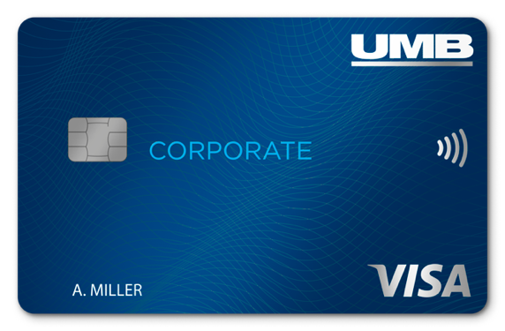

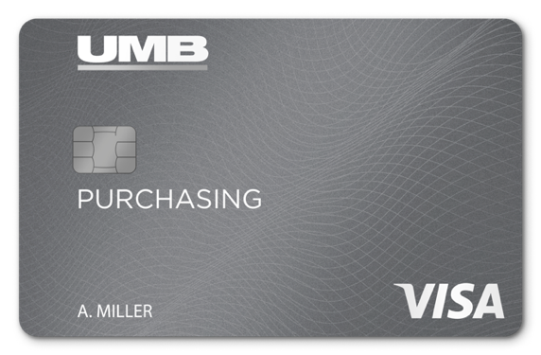

Commercial Credit Cards
Commercial Cards
For businesses with diverse purchasing needs.
A powerful suite of cards with tools to manage the needs
of businesses and public entities of all sizes.
Program Management Capabilities
Visibility and control of users and transactions to achieve your program goals
CONFIGURABLE
From card controls to user rights
integrated
Two-way integration options with your ERP and HR systems

Slide 7




Commercial Credit Cards
Virtual
For businesses who want to integrate or consolidate card payments into their existing AP solutions.
For centralized and high-dollar purchases, used in Accounts Payable, Purchasing or Travel using existing business purchasing and accounts payable platforms.
Integration options
Suite of solutions from fully integrated into your AP system to virtual AP or ghost accounts for one-time payments
Transaction security
Tokenization of payment data to reduce fraud
VIRTUAL Token
Account controls
Single Use Accounts and Exact Match rules to eliminate vendor payment errors

Slide 8



Commercial Card Platform
Features and functionality to meet your program goals.
Account & User Management
Manage all aspects of your program from accounts to users in real time. in our highly configurable platform.
Manually enter or auto-create through file integration with your HR system.
User management is fully controlled by you, including access rights from “view only” to full administration.
Reporting
Data and visibility is critical for a successful program.
The platform has a suite of predefined reports based on transactions and cardholders that are parameter driven.
A report builder allows users to create, save and schedule reports based on hundreds of retained data elements.
Expense Management
Managing expenses to your General Ledger is the core of our highly configurable platform.
Accommodates a wide range of needs to mirror your existing processes:
Complex business rule for expense code dependencies
Work order management with approval workflow
Integration with 3rd party solutions
Mobile
Designed for cardholders and approvers on the move.
Allows cardholders to build expense reports and capture receipts on the go, eliminating saving and handing over receipts to Accounts Payable.
Capable of auto-capturing critical data and reading receipts.
Expenses can be submitted through our App to managers who can view, edit and approve from their mobile devices.

Slide 9





Why UMB
Support Centered Around You
    Account Executive
    Program
    Advisory Team
YOU
    Implementation
    Specialist
    Commercial Card
    Service Center

Slide 10
UMB Consortium Program
UMB Missouri Capital Asset Advantage Treasury Consortium
UMB and MOCAAT have partnered to create a Purchasing Card Consortium that aggregates the spend of all participants to maximize each participant’s rebate.
Consortium Partners:
The Missouri Association of Rural Education (MARE)
Education Plus
The Cooperating School Districts of Greater Kansas City
The Greater Ozarks Cooperating School District

Slide 11
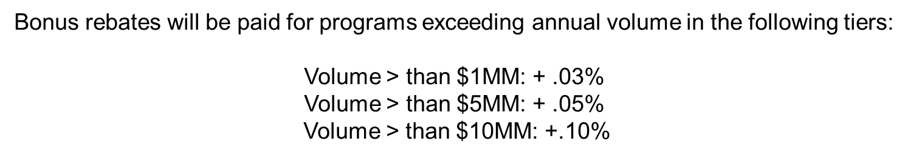
Revenue Share
Rebates Are Comprised of 3 Pricing Elements:
• Standard Interchange @ grid
• Large Ticket Interchange @ 50bps - Large Ticket – Reduced interchange for higher value transactions.
• Negotiated Interchange @ 50bps - Negotiated- (aka VPP) Direct interchange agreements with Visa for very large merchants
Total annual charge volume determine pricing level for which standard interchange rebate is calculated.
Notes:
Maximize Your Potential

Slide 12

Different by Design
Financial Freedom
Count on more from your commercial credit cards – more options, flexibility and control.
Service Experts
From robust purchasing and travel card programs to advanced payment solutions
we have experts dedicated to the success of your program.
Consulting
We are committed to delivering comprehensive banking, asset management,
institutional asset management, and payment solutions to commercial, institutional
and personal clients across the United States.
True Partners
We are committed to an unparalleled level of client satisfaction.
Flexible
Tailored program without the complexity of a “big bank” service model.
Relationships
With both our clients and partners.
Data driven approach
Metrics to shape your program to ensure it is designed specifically with your
business objectives in mind.
Notes:
Possibly reduce or

Slide 13
Contact Information
Cherie Figge
Commercial Card Sales
(816) 843-2842
Cherie.Figge@umb.com
Amanda Eisenmann
Account Executive
(816) 860-3018
Amanda.Eisenmann@umb.com
Marty Buehler
Treasury Sales Officer
(314) 612-8220
Martin.Buehler@umb.com

Slide 14



