Slide 1
The Chaos Continues: Seeing Around Current Legal Corners
October 20, 2021
Emily Omohundro & Duane Martin

Slide 2
Follow us on social media!
EdCounsel Insights Podcast

Slide 3
Legal Issues Associated with Staffing Shortages
Material Objections
Transgender Student Matters
Current Masking Litigation
Extra Compensation

Slide 4
Legal Issues Associated with Staffing Shortages
Teacher late resignations
Board release
FMLA/ADA issues
Liquidated damages
Termination process
Certification discipline
Contracts for Services

Slide 5
Material Objections
Records requests
Sunshine Law
Statute pertaining to instructional materials
Objections to media and instructional materials
Library books
Online materials used in the classroom
Know your process for response to complaints
First Amendment issues

Slide 6
Transgender Student Matters
State of the litigation landscape
Federal guidance changes
So far this year: - Bathroom requests - sex-segregated class issues - dress code matters - parent and student concerns/complaints - bullying/harassment complaints taken up by OCR/DOJ

Slide 7
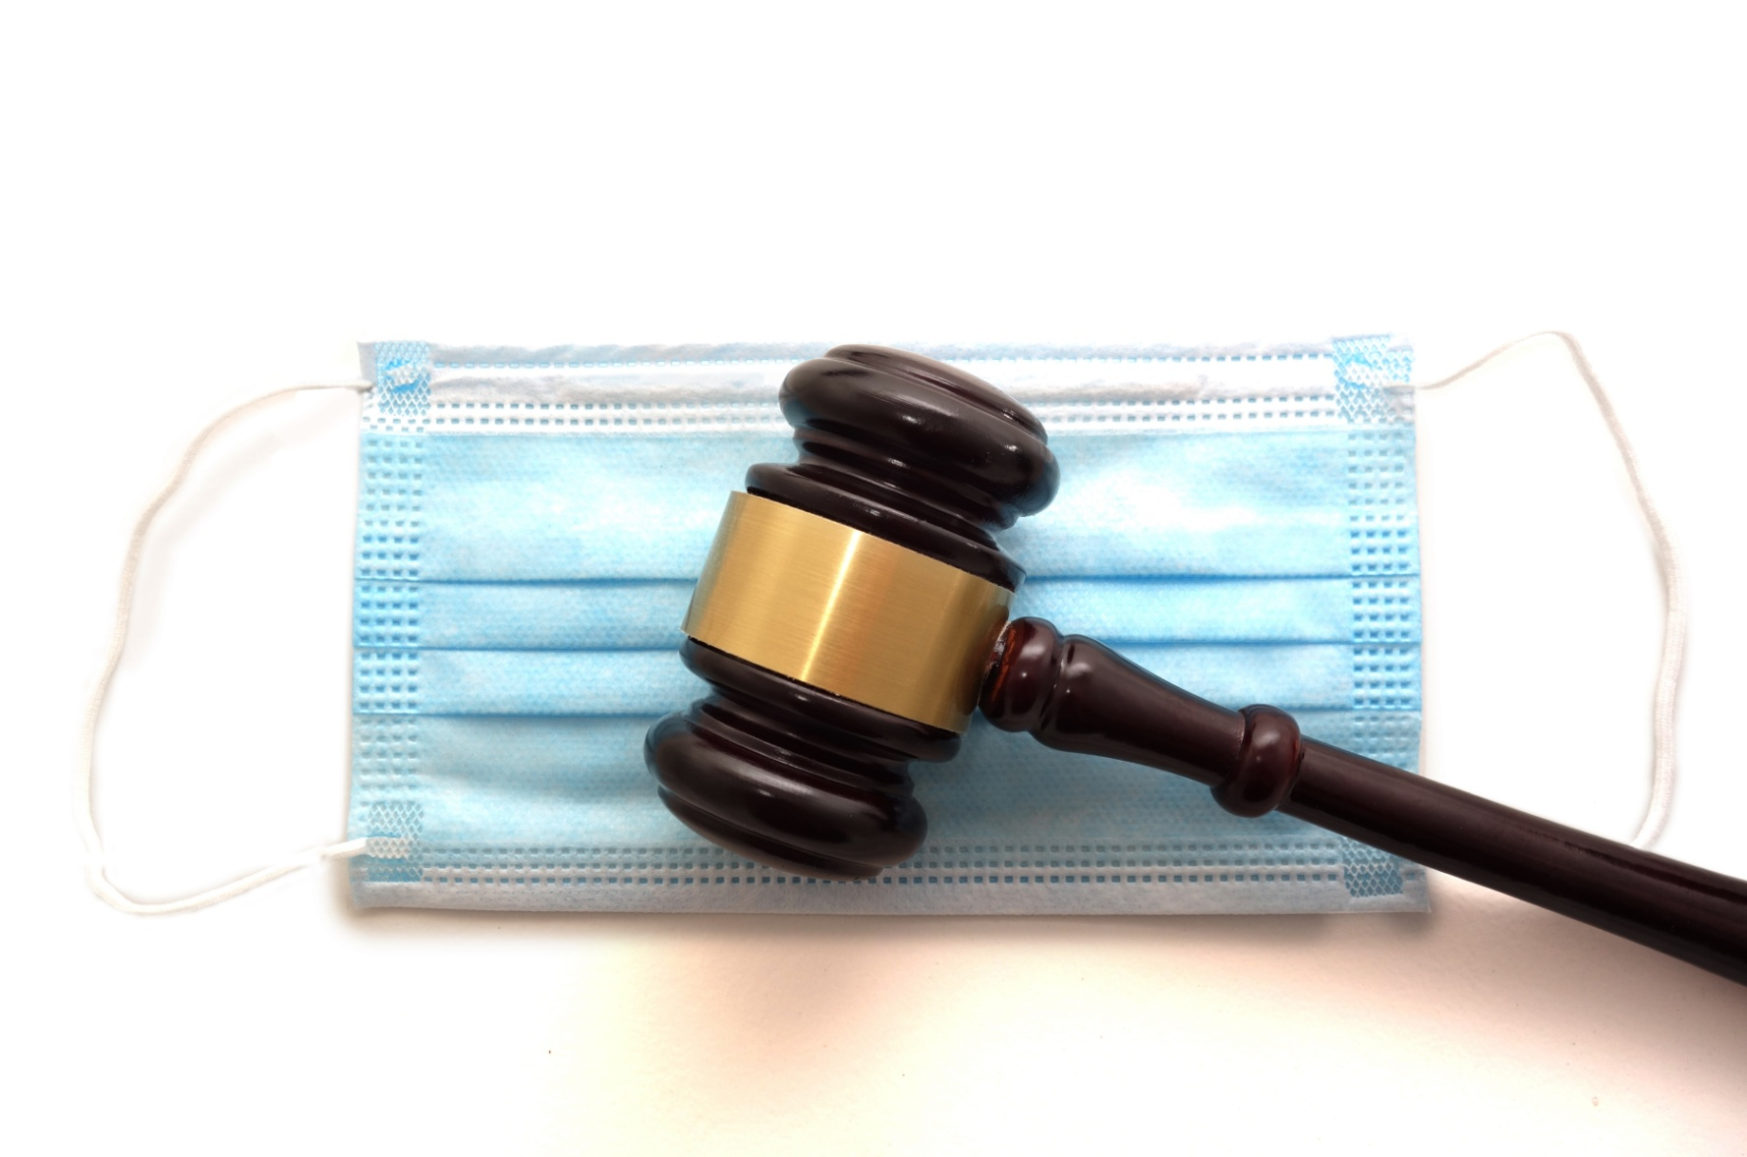
Current Masking Litigation

Slide 8
State of Missouri v. Columbia Public Schools
Filed against Columbia Public Schools
Sought class certification against all schools
Sought a preliminary injunction against all schools
Claims masking requirements are arbitrary and capricious
Claims masking requirements are subject to HB 271

Slide 9
Court’s Initial Ruling
EdPlus, GOCSD, CSDGKC and MASA filed an amicus brief requesting that the court deny class certification
Certification was denied
Preliminary injunction denied
CPS filed motion to dismiss- this motion was denied.
Case continues - AG stated intent to file new motion for preliminary injunction

Slide 10
AG’s Claims
Arbitrary and capricious
District did not consider all the scientific information
Cites studies/data regarding low child death rates
Does not address data regarding Delta variant
Violations of HB 271 (RSMo § 67.265)
Masking requirement = a “public health order”?
Requirement must be put before the Board every 30 days?
Is specific school district subject to the law?

Slide 11
Northland Parent Association v. Excelsior Springs School District et al
Filed against 7 school districts and 2 cities in federal court
21 separate claims
Similar in some respects to AG’s claims
Additional claims based upon students with disabilities
Includes claims regarding religious exemptions

Slide 12
Due Process Claims
Claims that school must adopt a masking requirement to provide a free appropriate public education to a particular student or students with disabilities
Allegations include that moving students to homebound or virtual denies them education in their least restrictive environment (in-seat)
Courts in other jurisdictions have ruled that universal mask mandates are not an unreasonable accommodation for a student with a disability

Slide 13
Extra Compensation
Certified Staff
Coverage for subs
Online Learning coverage/planning
“Sign on” bonuses
Classified Staff
Hiring Bonuses
Referral Programs
Attracting substitute teachers

Slide 14
The Chaos Continues: Seeing Around Current Legal Corners
October 20, 2021
Emily Omohundro & Duane Martin

