Slide 1
Time to Take Notes: Practical Guidance and Updates for Leave and Accommodation Issues for Educators
October 21, 2021

Slide 2

Presented by
Stephanie cohan
Associate
Littler – St. Louis
314-659-2009
SCohan@littler.com

Slide 3
Agenda
ADA
  Basics
  Job Descriptions
  Leave as an Accommodation
FMLA
  Basics
  Late Forms
  Incomplete/Insufficient Doctor’s Notes
  Leave Abuse

Slide 4
Tracking COVID-19 Labor & Employment Litigation
Since March 12, 2020, there have been at least 3,784 lawsuits filed against employers nationwide due to alleged labor and employment violations related to the coronavirus.
While Missouri only has had 39 cases, litigation related to COVID-19 has only continued to rise
Medical issues (FMLA, ADA, FFCRA, etc.) have been a popular topic
These are just the lawsuits we can actually track—does not include administrative matters (DOL, EEOC, OSHA and beyond)

Slide 5
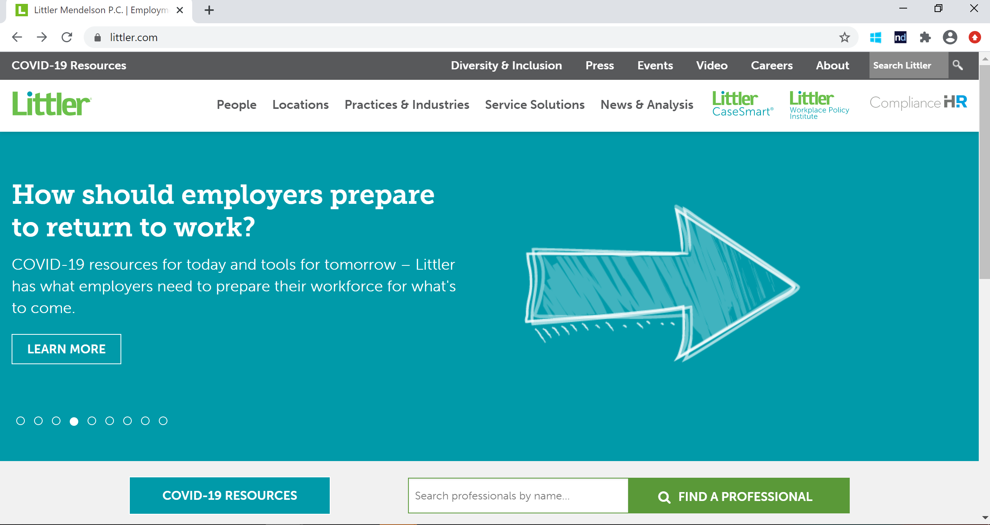
Littler’s COVID-19 Resources:

Slide 6

ADA Basics and the COVID-19 Pandemic
The ADA prohibits discrimination because
of a disability (or a history of a disability,
or because someone is perceived as
having a disability)
Employers must also reasonably accommodate qualified individuals with disabilities unless it poses an undue hardship
Requires interactive dialogue with the employee (and healthcare provider)
Highly individualized, fact-specific analysis
(the interactive process)

Slide 7

Accommodation Obligations
There are generally three types of ADA accommodations:
  Ergonomic (equipment, work space)
  Job changes (such as schedule changes or task modifications)
  Leaves of absence (intermittent or block)
The burden is on the employer to respond when the need
for accommodation arises
The importance of the interactive process

Slide 8

Considering Different Documentation
Than You Normally Do?
You may need to be flexible on exactly what you are getting for awhile—substance over form—e.g., telemedicine visits?
But this does not mean that you cannot request appropriate documentation in support of an accommodation

Slide 9

The ADA and the Limited Scope of Medical Exams and Disability-Related Inquiries
The general rule is that an employer may make disability-related inquiries and
require medical examinations only if they are job-related and consistent with business necessity
  Per the EEOC, this means that an employer has a reasonable belief, based on objective evidence, that an employee’s ability to perform the essential job functions will be impaired by a medical condition; or that the employee may pose a “direct threat” due to a medical condition

Slide 10
So When Can You Ask for Medical Documentation?
Someone indicates a need for leave or another workplace accommodation
You observe that an individual is having difficulty meeting the expectations of the job and you have reason to believe that the issues are medical in nature
You have reason to believe someone poses a “direct threat”— but tread carefully

Slide 11

Questions Employers Can Always Ask – A Reminder
How the disability creates a limitation;
How the requested accommodation will effectively address the limitation;
Whether another form of accommodation could effectively address the issue; and
How a proposed accommodation will enable the employee to continue performing the essential functions of his position (that is, the fundamental job duties).

Slide 12

Employer Homework
To position your organization to address the situations we will discuss today, the groundwork needs to be complete in the following areas:
Job descriptions
Hiring communications
Pre-employment paperwork
Good forms and letters
Strong policies
Attention to interaction among different policies
Did we say job descriptions?

Slide 13

Job Descriptions
First line of defense (and offense)
Focuses future accommodation issues on job, not the employee
  Schedule, location, equipment, health/safety, conduct, abilities
  E.g. lifting, sitting, standing

Slide 14
In Case You Thought Job Descriptions Don’t Matter…
Applicant for job as Delivery Driver could not lift more than 20 pounds with his right arm, but was free to lift as much as he could with his left arm. Using both arms, he could lift up to 50 pounds.
Job required an ability to do equal work with both arms.
But that’s not what the job posting and description said. They just said that employee needed to be able to lift up to 50 pounds.
Summary judgment denied!
Evangelista v. Auto-Wares, LLC, 2016 U.S. Dist. LEXIS 48071 (E.D. Mich. 4/11/16)
Other comments about the job description you may be using

Slide 15

Testing Your ADA IQ: Abby
Abby has anxiety and asks for leave of absence,
but other accommodations are available and
effective (e.g., quieter environment, removing
marginal job functions). Abby refuses,
insisting on leave.
Do we have to provide Abby the
leave she wants?

Slide 16

Not EVERYTHING is reasonable…
Employers do not have to:
  Provide indefinite leaves of absence
  Reassign essential job duties
  Create new jobs
  Change an employee’s supervisor
  Bump another employee from his/her position
  Reduce conduct or performance expectations when the employee is at work
  Furnish items for an accommodation primarily for the employee’s personal use (hearing aids, glasses, service animals, etc.)
  Excuse misconduct, even if caused by the disability
  Maintain equivalent pay if assigned to a different job

Slide 17

Stop the
Oversharing Supervisor!

Slide 18

The Manager Said WHAT?
Brenda, 15-year employee; needs leave for hysterectomy
Boss: “Not a good time to take leave," urges her to read the book titled, No More Hysterectomies
During leave, Brenda learns partner has cancer
HR calls Brenda: RIF’d b/c client contract lost
  Termination might be a “blessing in disguise” . . . “would not be able to give 100% to her job anyway”
    Drew v. Quest Diagnostics (S.D. Ohio 2012)

Slide 19

The Manager Said WHAT? [Part II]
Your employee receives a leave request that may be protected by the FMLA/ADA.
In response, your supervisor:
  Sighs. Cimino v. Magee-Women’s Hospital (W.D. Pa. 2017)
  Says, “You know . . . you’ve missed a lot of work.” Coleman v. AmeriHealth Caritas (E.D. Pa. 2017)
  Responds that the employee has taken “too many days off.” Troiano v. Cty. of Allegheny (W.D. Pa. 2017)
  Makes comments about the insurance costs related to the leave. Yeger v. Inst. of Culinary Educ., Inc. (S.D.N.Y. 2017)

Slide 20
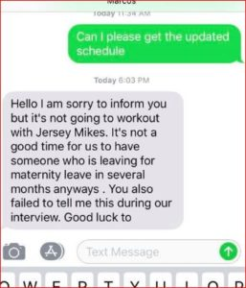
The Manager Said WHAT? [Part III]
Jersey Mikes’s:
Pregnant candidate, hired
Days after she starts, she tells her manager
that she’s pregnant
Manager responds with this text:
https://komonews.com/news/local/marysville-woman-claims-pregnancy-lead-to-firing-from-restaurant-job

Slide 21

COVID-19 and Confidentiality of Medical Information
The ADA requires that all medical information about a particular employee be stored separately from the employee's personnel file, under lock and key, and shared only on a need-to-know basis
Narrow exceptions only

Slide 22

So What COVID Information Must Be Kept Confidential?
All of it!
An employee's statement that they have the disease or
suspect they have the disease, or the employer’s
notes or other documentation from questioning
an employee about symptoms
Temperature check results
Symptom screening results
COVID-19 testing results

Slide 23

When May an Employer Make a Disclosure?
An employer may disclose the name of an employee who is diagnosed with COVID-19 to a public health agency
https://www.eeoc.gov/wysk/what-you-should-know-about-covid-19-and-ada-rehabilitation-act-and-other-eeo-laws
In other words, not to other employees (even if practical realities make it obvious)

Slide 24

ADA to FMLA:
What happens when these statutes overlap?

Slide 25

Let’s Start with the Bad News
ADA leave is THE primary issue when FMLA leave is exceeded or not available
Leave from work is one form of reasonable accommodation (this is not new)
There is no set period of time that will always be enough because the ADA requires an individualized assessment of the employee’s circumstances and requested leave
Clearly defined lines are frowned upon by the EEOC—and no level of generosity gets you a free pass
The EEOC has not yet provided current and comprehensive guidance

Slide 26
But the Courts Like Us Better than the EEOC Does
Employer wins when it provides eight months of total leave and employee provides continuous moving target for his return to work date. Gardenhire v. Johns Manville, No. 17-3048, -- F. App’x -- (10th Cir. Feb. 7, 2018).
Multiple doctor’s notes extending leave provided as an accommodation rendered estimates unreliable. Ruiz v. Paradigmworks Grp., Inc., No. 16-CV-2993-CAB-BGS, 2018 WL 1010475 (S.D. Cal. Feb. 22, 2018).
Minter v. D.C., 809 F.3d 66 (D.C. Cir. 2015) – good “enough is enough” case citing EEOC’s 2002 enforcement guidance re: six months is more than a “reasonable amount of time” for an employer to retain a nonperforming worker. [opinion by SCOTUS nominee Merrick Garland]
Severson v. Heartland Woodcraft, Inc., 2015 U.S. Dist. LEXIS 153872 (E.D. Wis. 11/12/15) – employee who needed 2 more months after FMLA to recover from back surgery was not able to perform essential functions of his job.
Robert v. Board of County Commissioners, 691 F.3d 1211 (10th Cir. 2012) - a reasonable leave of absence is one where the estimated date of return is in the near future.
Hwang v. Kansas St. Univ., 753 F.3d 1159 (10th Cir. 2014) – it doesn’t take that much more than FMLA to be enough. Great pro-employer quotes in this case.

Slide 27

A proactive love letter…
At FMLA Week 10, phone call with follow-up correspondence:
  FMLA leave will be exhausted as of [date]
  Based on current information, we anticipate that you will
  return to work on [date]
  We want to help you in any way we reasonably can
  If you are not able to return to work by [date], please contact me.
  If you believe you could return to work, but may need assistance, or if
  there is any other information about your return to work that you wish
  to call to our attention, please contact me as soon as possible
  Before returning to work, you will be required to provide a return-to-work certification from your health care provider confirming that you are able to perform the essential duties of your position with or without a reasonable accommodation

Slide 28
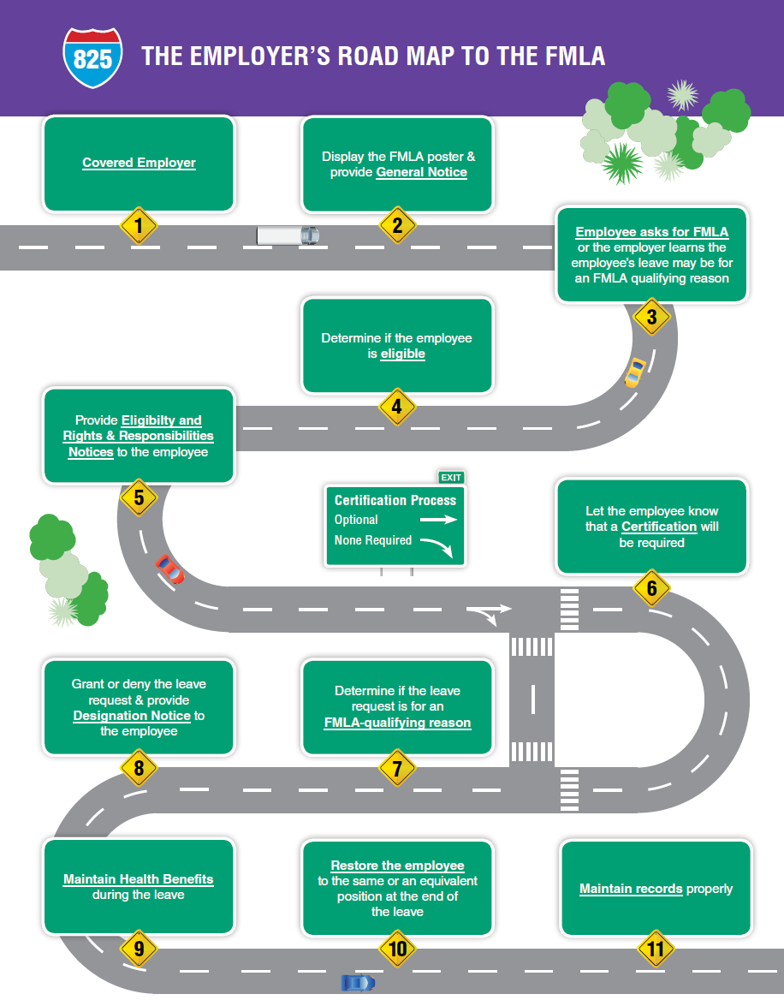
FMLA ROADMAP

Slide 29
Family and Medical Leave Board Policy
Board Policy PF 4321
  The Board of Education recognizes that leaves of absence are occasionally necessary due to family or medical reasons or in certain circumstances associated with servicemembers' service in the Armed Forces. The District has adopted detailed procedures to ensure compliance with the Family and Medical Leave Act of 1993 (FMLA). As provided by District regulations, eligible employees are entitled to use up to twelve (12) workweeks of unpaid leave for family and medical reasons (up to 26 workweeks for covered events related to those serving in the Armed Forces). The Board of Education has designated a District administrator to act as FMLA Compliance Officer. As part of its compliance program, the District will notify each employee of the name, address and telephone number of the District's FMLA Compliance Officer and will provide a statement of commitment to adhere to FMLA regulations. The FMLA Compliance Officer will regularly evaluate the District's FMLA compliance to ensure fair and equitable opportunities for all eligible employees.

Slide 30

Family and Medical Leave Act Basics
Who does it apply to?
Specific requirements for schools
50-employee coverage does not apply
  But needs to have 50 employees within 75 miles
  within same employer (school board)
Who is eligible for FMLA?
Employees who:
  Worked at least 12 months for the company
  Worked at least 1250 hours during the
  12 months before FMLA leave
    Measure from the date leave begins
    Actual hours worked

Slide 31

Family and Medical Leave Act Basics
What does it entitle?
12 weeks of unpaid leave
  Intermittent leave could be an option
  It may run concurrently with paid leave
Continuing paid health benefits
Job Protection/restoration

Slide 32

Family and Medical Leave Act Basics
What can it be used for?
Serious Health Condition
  For employee
  OR employee’s immediate family members
Bonding with a child (both men and women are eligible)
  Birth of a child
  Adoption of a child
  Placement of a foster child
  *Must be within 12 months of the birth or
  placement of the child

Slide 33
Family and Medical Leave Act Basics – Instructional Employees
Special rules apply to public school boards and elementary and secondary schools under their jurisdiction, and private elementary and secondary schools.
Instructional employees are those whose principal function is to teach and instruct students in a class, a small group, or an individual setting.
  Covers teachers, coaches, special education assistants. 29 CFR § 825.600
  Intermittent leave
    If intermittent leave is needed and would be more than 20% of days over the leave period. Can ask employees to either take consecutive days off or transfer to another position to better accommodate recurring periods of leave
  Leave near the end of the semester
    Maybe required to stay on leave if leave is taken within the last five weeks of a term
  Counting FMLA leave

Slide 34

Is That Really a Serious Health Condition?

Slide 35

Fred’s Bad Back
Fred calls into his manager before his shift to report off work
  Reports that he has been dealing with a bad back and won’t be in today
  Next day: Calls off sick again (says it’s the “same thing as yesterday”)
  He reports to work the following day
Is the two-day absence covered by the FMLA?

Slide 36

The General Serious Health Condition Mindset
“The FMLA does not list conditions which satisfy the serious health condition definition. Rather, the FMLA regulations broadly define ‘serious health condition’ as an illness, injury, impairment, or physical or mental condition which involves inpatient care or continuing treatment by a healthcare provider.”
https://hrsimple.com/blog/fmla-leave (emphasis added)

Slide 37
Employer’s Duty to Inquire Further
“The Employer may find it necessary to inquire further to determine if the leave is because of a serious health condition . . .” 29 C.F.R. 825.302(c)
Fairly broad right to talk directly to employee, have right to know:
  Medical facts:
    What is reason for absence?
    Treatment or unplanned absence?
    Have you previously taken leave for this reason?
    Time periods involved (start and expected return)
Questionnaire/script: Discuss intake during training (and introduce form?)

Slide 38

Pregnancy: Reminders
Employee is pregnant
Doctor says she will need:
  Intermittent time off – specially rules may apply
  Must you provide these accommodations?
Only 4 months into the pregnancy, doctor puts employee on bed rest

Slide 39

I’m frustrated!
Is there anything
I can do about
the late medical certification forms?

Slide 40
Kimberly’s Panic Attacks
Your employee, Kimberly, claims she is suffering from job-induced panic attacks
She has missed five days already this month and two more this week
Kimberly tells you, “my head is just not right,” and makes it clear that she will be on and off work for the foreseeable future as a result of the stress she’s dealing with
You wisely observe this as a potential FMLA situation, so you issue the Notice of Eligibility and medical certification
However, Kimberly doesn’t return the certification within the 15 days
Deny leave at this point?

Slide 41
The 15-Day Standard & Employer’s Obligation
The Standard: The employee must provide the certification to the employer within 15 calendar days after the employer's request, unless “it is not practicable under the particular circumstances to do so despite the employee's diligent, good faith efforts.” 29 CFR § 825.305(b).
The Employer’s obligation: To provide written notice, in the Rights & Responsibilities form, that the certification must be returned in 15 calendar days or the request for FMLA will be denied. 29 CFR § 825.305(d).
What Does “Not Practicable” Mean?
The best decisions addressing this issue have focused on the employee’s efforts and whether he/she has requested an extension of the 15-day period. Brookins v. Staples Contract & Commercial, Inc., 2013 U.S. Dist. LEXIS 18590 (D. Mass. Feb. 12, 2013).

Slide 42
Calculating Unexcused Absences
Two general rules
Rule 1: Can delay/deny FMLA for the leave following the expiration of the 15-day time period until a sufficient certification is provided
  Example: If employee does not provide certification for 45 days w/o sufficient reason, employer can deny FMLA protections for the 30-day period following the expiration of the 15-day time period, if the employee takes leave during such period (§825.313(a))
  But does this really apply?
  Rule 2: If the employee doesn’t produce the certification, the leave is not FMLA leave (§825.313(b))

Slide 43

What do we do
with overreaching doctors’ notes?

Slide 44

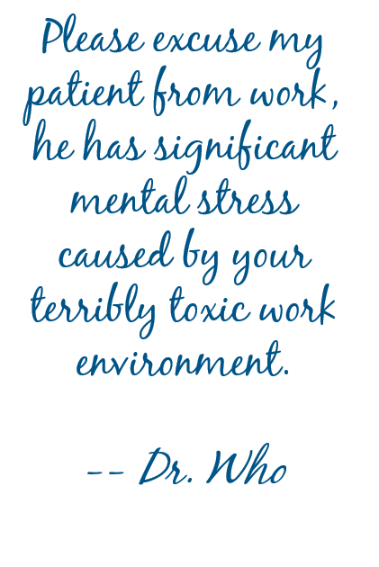
More Information Please
Please excuse my patient from work, he has significant mental stress caused by your terribly toxic work environment.
-- Dr. Who
Doctor’s Note reads as follows:
Where do you start?

Slide 45
Time to Get Cozy with this Employee and the Doctor
FMLA
  Get a complete and sufficient certification—put in writing what is lacking, seven-day cure period, make the employee do it, describe consequences (29 CFR § 825.305(c))
  Authenticate—easy, no employee involvement, sanctioned by the Regulations (29 CFR § 825.307(a))
  Clarify—contact the provider to understand handwriting or “the meaning of a response.” Id.
  Second opinions and the “doubt the validity” standard (29 CFR § 825.307(b))
ADA
  Forms and letters that seek specifics about limitations, duration and accommodations.
  Remember – still individualized process.

Slide 46

Oops! We missed it: is there anything
we can do?

Slide 47

Retroactively Designate FMLA Whenever You Can
The standard: employers can retroactively designate FMLA leave so long as it does not cause “harm or injury” to the employee. 29 CFR § 825.301(d)
How this works and what you should send the employee
One-off incidents versus systemic problems

Slide 48

Can I contact an employee while out on FMLA leave?

Slide 49

Employees Are Not as “Off Limits” As You May Think
Manager insists employee’s email access and company cell phone (employee’s only phone) be turned off during employee’s leave. Response?
“Fielding occasional calls about one’s job” while on FMLA leave does not violate the FMLA, nor does asking the employee to participate in an investigation. See, e.g., Krause v. Eihab Human Services, Inc., 2015 U.S. Dist. LEXIS 101820 (E.D.N.Y. 2015).

Slide 50

Can I make an employee talk to a real person instead of leaving a message when they call out?

Slide 51
Yes, If It Is Company Policy
“In general, an employer may require that employees comply with the employer’s usual and customary policies for requesting leave, unless unusual circumstances prevent the employee from doing so.” DOL’s “The Employer’s Guide to the FMLA,” p. 14 (4/16)(emphasis added); see also 29 CFR 825.302(d) & .303(c).
Requiring employees to call a designated number. 29 CFR § 825.302(d) & .303(c).
Requiring employees to call a specified person. Id.
Requiring employees to speak to a supervisor, rather than leave a message.
Chappell v. Bilco Co.,675 F.3d 1110 (8th Cir. 2012)

Slide 52

Can I make
an employee
pinky-swear they are using the days for real FMLA reasons?

Slide 53

Yes. And You Should.
An employer may not require a doctor’s note for each intermittent absence. Oak Harbor Freight Lines, Inc. 998 F. Supp. 2d 968 (D.Or. 2014).
BUT an employer can require an employee to fill out a personal certification form that the employee was absent due to the condition for which he or she has intermittent leave (as long as the employee knows the process). See Sconfienza v. Verizon PA Inc., 307 Fed Appx. 619 (3rd Cir. 2008) - affirming summary judgment in No. 3:05-cv-272 (M.D. Pa. 2007).
Require an employee to certify and acknowledge that:
  Absence(s) used are for FMLA
  Understand consequences of improper use of FMLA
Policy for Requesting Leave” Include?

Slide 54
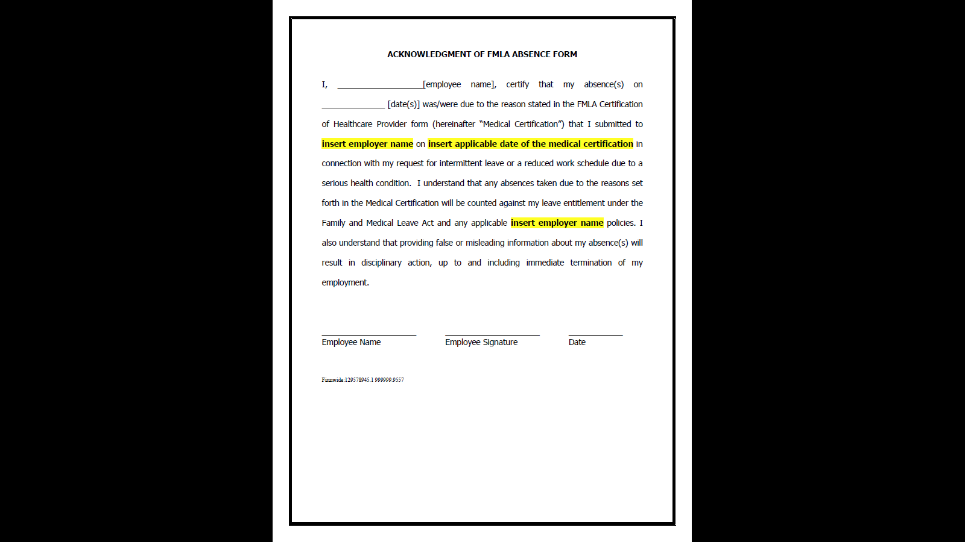
Sample Personal Certification Form

Slide 55

Can I investigate
an employee’s
FMLA Abuse?

Slide 56

Really? That’s What You’re Going With???
Flight attendant flew to Taipei less than 12 hours before she would have to return to Denver for a shift and failed to return.
She claimed she had a migraine, and took FMLA.
Investigation revealed plaintiff never researched or attempted to purchase a timely return flight.
Rowe v. United Airlines, Inc. 608 Fed. Appx. 596 (10th Circ. 2015)
Policy for Requesting Leave” Include?

Slide 57

Tackling Leave Abuse
Homemade “Surveillance”
  Be careful how you get the information
Private Investigator?
  Only with the help of HR/Legal
Be sure we’re acting on information that
is credible and that is inconsistent with
the reason for leave
Confront the employee

Slide 58

Can an employee save himself with
an eleventh-hour FMLA request?

Slide 59
The News May Be Better Than You Think
“An employee has no greater right to reinstatement or to other benefits and conditions of employment than if the employee had been continuously employed during the FMLA leave period.” 29 CFR § 825.216.
We can terminate employees for legitimate grounds before an FMLA leave – particularly when the wheels were in motion before the leave request.

Slide 60
But Only If We Have Done Our Job First
Krutzig v. Pulte Home Corp., 602 F.2d 1231 (11th Cir. 2010) – employee’s right to commence FMLA leave is not absolute and he can be discharged before the leave starts if he would have been discharged anyway.
Reilly v. Cox Enters., 2016 WL 843268 (D.R.I. 2016) – good case for employer where, utilizing the “temporal proximity alone is not enough” concept, the court granted MSJ where employer terminated plaintiff shortly after she disclosed need for hip surgery where there was a HR recommendation to terminate on the table at that time.

Slide 61

What if an employee doesn’t want to take
FMLA leave?

Slide 62
Employers can be proactive!
We always thought the Regulations said to designate it anyway
Now finally from the DOL directly: May not decline FMLA leave once the absence qualifies as FMLA leave
“An employer is prohibited from delaying the designation of FMLA-qualifying leave as FMLA leave. Once an eligible employee communicates the need to take leave for an FMLA-qualifying reason, neither the employee nor the employer may decline FMLA protection for that leave.”
Initial client feedback: does it require a wholesale change?
DOL Opinion Letter FMLA 2019-1-A (3/14/19)

