Slide 1
Welcome!

Slide 2
Our Theme Women leaders coming together to discuss how we can best work together to meet the unique needs of women leading in rural schools

Slide 3
Progress we have made.

Slide 4
Strengths of Women in Leadership
What are the many strengths women bring to leadership in rural schools?
Let’s see how many we can identify.

Slide 5
Small Group Discussions
Please discuss and make a list of the unique needs of female leaders in rural districts.
Be ready to report out in 5 minutes.

Slide 6
Sharing Out
Time to share your thinking with your colleagues

Slide 7
Work-Life Balance
Special thanks to Jacinda H. Conboy General Counsel
NYS Council of School Administrators

Slide 8
Can Balance Really Be Achieved

Slide 9
Believe in Balance

Slide 10
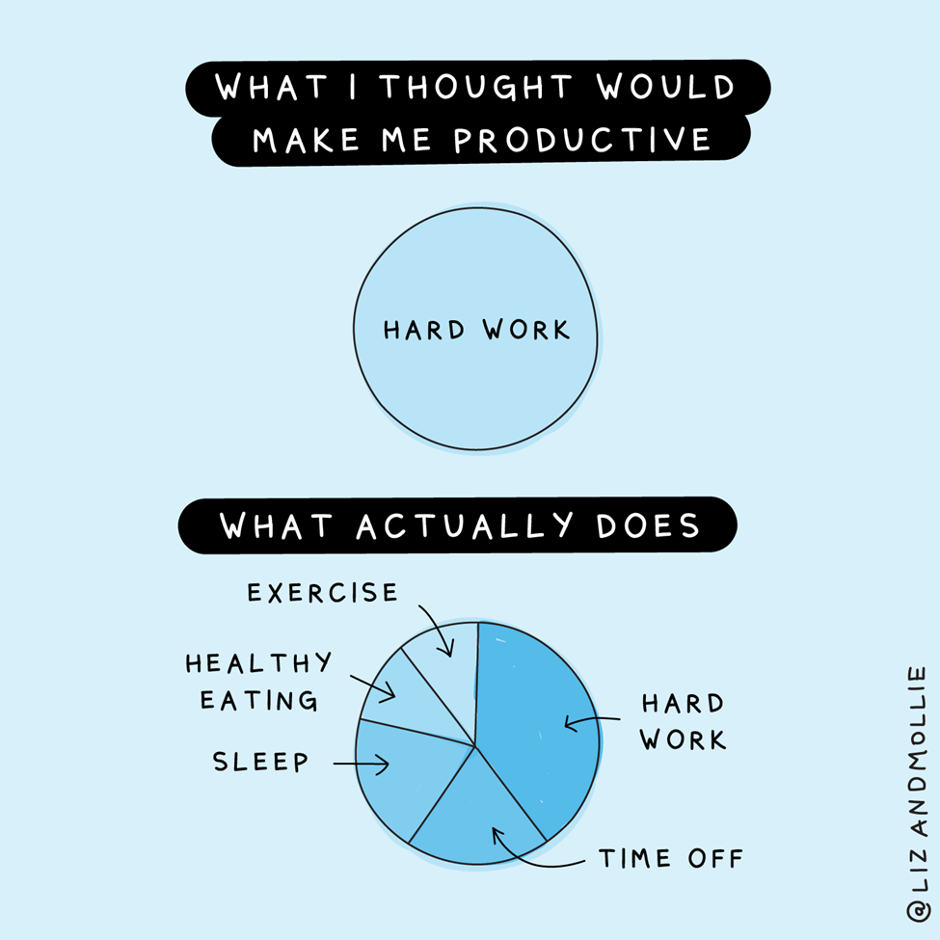

Slide 11
How do I achieve Balance?
Sleep
Exercise
Time
Help
Fun
This Photo by Unknown Author is licensed under CC BY-SA-NC

Slide 12
Sleep Deprivation
Heart Disease
Kidney Disease
High Blood Pressure
Diabetes
Stroke
Obesity
Depression

Slide 13
How to Get More Sleep
Schedule
Temperature
Caffeine
Alcohol
Screen Time
Exercise

Slide 15
TIME
This Photo by Unknown Author is licensed under CC BY-SA

Slide 16
What can you combine?
Exercise & Friends
Exercise & Work
Driving & Work
Reading & Kids
Charity & Social Life
Others?

Slide 17
What can you hire someone else to do?
House Cleaning
Trainer
Meal service
Grocery Delivery
Landscaping/Lawn Care
Others?

Slide 18
HELP
This Photo by Unknown Author is licensed under CC BY-NC-ND
This Photo by Unknown Author is licensed under CC BY-SA

Slide 19
Overwork Results
Stress
Impaired sleep
Depression
Drinking
Diabetes
Impaired Memory
Heart disease
This leads to absenteeism, turnover, and rising health insurance costs.

Slide 20
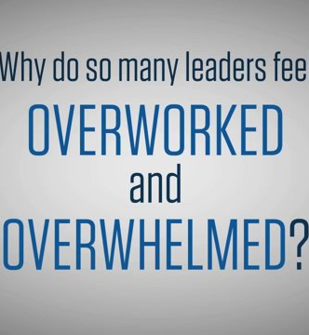
Overwork
If your job relies on interpersonal communication, making judgement calls, reading other people’s faces, or managing your own emotional reactions; researchers have found that overwork (and its accompanying stress and exhaustion) can make all these things more difficult.
This Photo by Unknown Author is licensed under CC BY

Slide 21
Vacation & Work Week
82% of small business owners experienced an increase in job performance as a result of vacation;
Boosts organizational morale;
Contributes to employee wellness; and
Results in higher employee retention.

Slide 22
What did you learn?
What steps will you take to create balance in your life?
Write this on your notecard.
This Photo by Unknown Author is licensed under CC BY-NC

Slide 23
Give One Get One
Write down 5 pieces of advice for women leading in rural areas.
Please stand when you are finished.
This Photo by Unknown Author is licensed under CC BY-SA-NC

Slide 24
Staying connected!
Please consider joining a regional network by contacting Sarah Riss at sarah.riss@mcsa.org
Mark you calendar for the MASA Women in Leadership Summit on March 5, 2021!

Slide 25
Stay Connected
Write you name, email, and phone number on the card provided.
Write one thing you are going to challenge yourself to do.
Exchange the card with someone you met today or earlier in the conference.
Next week, contact the person on the card to see how they are doing and how you might be of support to them.

Slide 26
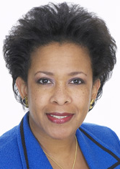
Loretta Lynch, Former Attorney General
“I think sometimes women face the very real risk of not being seen, and not being heard, and so that’s why I always tell young women, make yourself seen, and make yourself heard – this is your idea, this is your thought. Own it, express it, be the voice that people hear.”

Slide 27
Our Sponsors
American Fidelity
EdCounsel
Mickes O’Toole, LLC
Tueth Keeney Mohan & Jackstadt

Slide 28
You made today happen!

Slide 29
What is your takeaway and staying connected?
Please write on your piece of paper one take away from today and one action you will take.
Please include your name and email address.
Please stand up when you are completed.

Slide 30
Snowball Fight!

