Slide 1

Monday Academy
New Bloomfield R-III
Sarah Wisdom
swisdom@nb.k12.mo.us
573-491-3700

Slide 2
Purpose
The purpose of Monday Academy is to provide remediation and enrichment for students.
Students for remediation by invitation only
January of 2020 NB Board voted to move to a 4-day school week for the 20/21 school year.
This plan was put together to add 96 hours of remediation to the 20/21 school year for struggling students and provide enrichment classes and programs at the high school level.

Slide 3
Logistics
16 Monday’s (two a month, all but December)
Time is 8am – 2pm
Transportation is provided, two routes (north and south)
Breakfast and Lunch is available
Teachers are on a rotation basis and work one Monday a school year doing a set remediation plan for each student who qualifies. This teacher work day is added into the teachers contract.
Non-certs will be on a rotation basis to open the HS Library (for ITV, research, homework help, credit recovery), preschool and office help

Slide 4
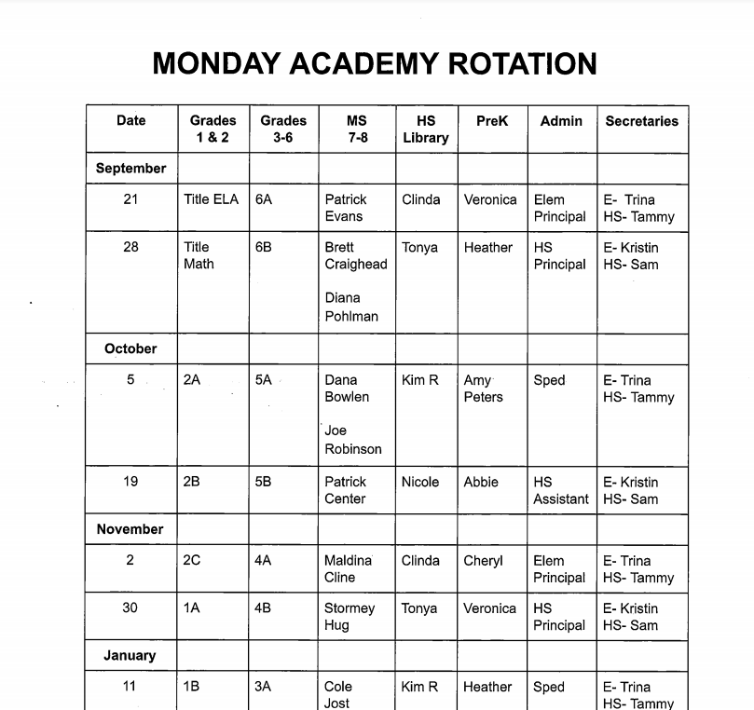

Slide 5
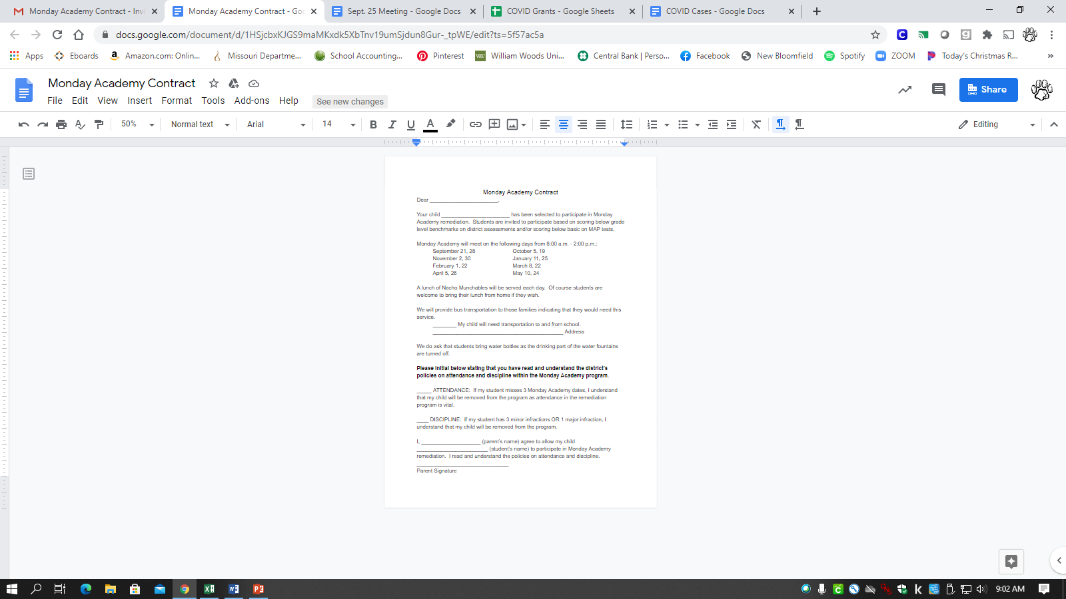

Slide 6
ADA and How Students Qualify
Only students who qualify will be invited for remediation. Parents and students will sign an agreement upon entering the program.
Qualifying Factors (according to DESE)
  Condition for promotion to the next grade level
  Below Basic on MAP or EOC
  Grades 1-8 reading improvement if they are not meeting district benchmarks

Slide 7
Data Data Data!
What was Used
Elementary: DIBELS, DRA, Teacher Notes
Middle School: Lexile Scores, Teacher Notes
What will Show Growth
Each classroom teacher must write a SMART goal of each of their students in Academy. These goals will be talked about with the student each week and progress measured by the above testing procedures that will be given throughout the year. Once a child reaches his/her SMART goal they can graduate from Academy and another student is placed in the group.

Slide 8
Attendance and Discipline
Discipline
  Three infractions or one major infraction equals removal
  SRO will be onsite
  Attendance
    3 absences then removal

Slide 9
Opportunity for Enrichment
We see areas of growth with this model that will allow enrichment to be added.
  SPED- Transition Services with Callaway County and Vocational Rehabilitation.
  ACT Prep courses will now be on Mondays
  Advanced placement courses could be added on Monday’s in the future.
  A+ hours on Monday’s for tutoring MS/HS, Elem and Prek classrooms ( would open up an hour of class during students schedule)
  Drivers Education
  Teachers offering tutoring
  Internship Program for Jr and Sr students

Slide 10
Workforce Development
  Monday’s will now be opportunities for internships and hours toward our Flex Plan.
  FFA project day
  College and Career visits
  Training opportunities on campus (CPR, Welding…)
  Internship program on Monday’s ( working with local Chamber of Commerce and Local Businesses)

Slide 11
Internship Program
Working with Callaway County Chamber of Commerce to place students in internship programs on Mondays
  Obtain job training
  Workforce preparation and development
    Student will fill out an application and go through an interview process
  Work experience
    Work log and reflection journal

Slide 12
What it looks like in the Elementary?
40 students
1 Teacher for 1-3 grades
1 Teacher for 4-6 grades
Remediation only- MUST qualify under at least 1 of the 4 factors
96 hours of remediation for the school year
Instruction: goal based individualized work, small group or one on one, IXL
FTA volunteers three hours each Academy day to pull students for sight word and spelling word work.

Slide 13
What it looks like in the Middle School?
20 Students (7-8th grade)
1 teacher
Remediation only- MUST qualify under at least 1 of the 4 factors
96 hours of remediation for the school year
Instruction: IXL, individual help

Slide 14
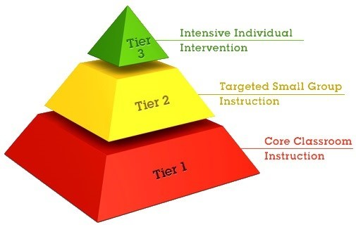
RTI at Its Best

Slide 15
What it looks like at the High School
Open Library
  Computer and research access
  Homework assistance
  Credit recovery students can work on class
  ITV students can come in for class, on other days they will be able to log in from home to watch live class
  Paraprofessional on rotation

Slide 16
Teacher Feedback
“I was amazed at how hard the students worked!!! I had 2 sixth graders that truly exceeded my expectations.”
“I feel like some kiddos got that extra "love" they needed to be successful.”
“I enjoyed working with 3rd grade on their spelling words ~ makes a teacher's heart sing!!”
“A few of the assignments/links left on the computers did not work ~ I loved the hard copy assignments!! That was clear and easy for the students and me!”
“BEAUTIFUL!! Very well coordinated!!”
“It was nice to work one on one with the students ~ they got the extra attention that is sometimes needed!!”
“Very impressed with the first day!”

