Slide 1


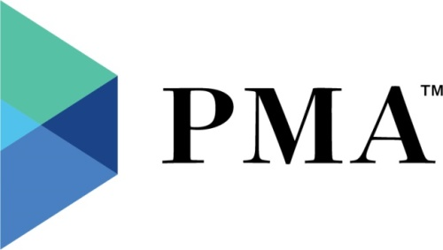
Missouri Capital Asset Advantage Treasury
Moving Forward for Missouri Communities
October 21, 2020

Slide 2



Agenda & Team
  The Opportunity
  PMA Overview
  Why Local Government Investment Pools
  MOCAAT Overview & Service
  Service to Missouri Schools
Michele Wiberg
Chief Sales &
Marketing Officer
mwiberg@pmanetwork.com
Dan Klus
Senior Vice President,
Customer Solutions
dklus@pmanetwork.com
Pat Harris
Vice President,
Customer Solutions
pharris@pmanetwork.com

Slide 3



The Opportunity
Create a new Local Government Investment Pool (LGIP) for Missouri schools and public entities – a new option for schools
Partner with Associations across the State
Provide a full-service Fund and education for School & public entity investing

Slide 4
Serving the Public Sector for over
35 Years
Work almost exclusively with public funds
$28.2 billion in Assets Under Administration (AUA)*, with over $12 billion in investment advisory assets under management (AUM) (as of 6/30/20)
Collectively, the PMA companies serve over 3,200 public entities in 14 states: AZ, CA, FL, IA, IL, MI, MN, MO, NE, NY, OK, PA, SD, WI
The PMA companies collectively have 130+ employees to meet the ongoing needs of our clients
Strong financial resources and management structure
PMA Overview
Leading provider of LGIP services
Investment Advisor: 8 Programs
Fund Administration: 11 Programs
Distribution/Marketing/Program Support: 9 Programs
Other program services – Fixed Term Investments, Cash Flow Planning and Bond Proceeds Management
  *Total assets under administration include both money market pool assets for which the PMA Companies serve as fund administrator/accountant, marketer/distributer, fixed income program provider (brokerage services), and/or investment advisory, or separate institutional accounts.

Slide 5
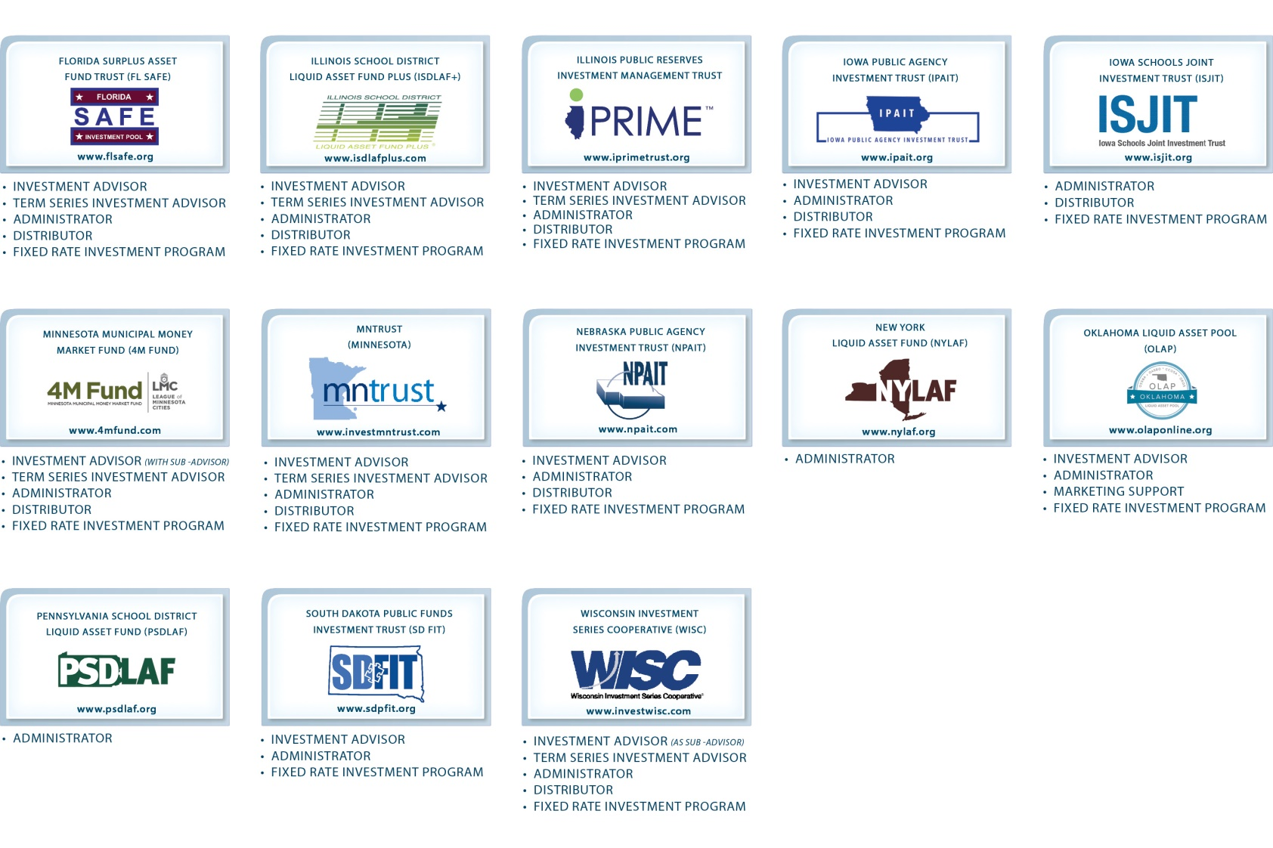
PMA LGIP Programs – Growth & Service

Slide 6
Why LGIPs at All?
Buying Power – Benefits of investing together
Enhanced Options – Additional tools to meet the needs of school districts
Safety – Oversight of products and policies by a board of local officials
Efficiency – Transaction and reporting products that SAVE TIME
Performance and Partnership

Slide 7
Fund Structure & Services
Missouri Law authorizes cooperative investing programs
The Fund is designed and governed by a Participant/Sponsor Board of Trustees
Fund Services:
  Liquid Fund – Daily Liquidity
  Online Reporting & Transactions
  Fixed Rate Services
  Bond Proceeds Management
  Cash Flow Analysis

Slide 8
Investment Approach
Protection of Public Funds – Safety, Liquidity, Yield
Quality Investment Options – Strict Compliance with Statutes
S & P Rating and Stress Testing
Credit Research – LGIP Approved List
Asset/Liability Matching – Know Your Participants
Value-Added Performance through Sector/Security Selection

Slide 9
Investment Advisor – PMA Asset Management
Growing institutional asset management platform
Focus on school districts and public entities
Fixed income expertise in cash, ultra short and longer-term investments – experience in challenging markets
Senior Portfolio Managers average 25+ years experience
Team of 17 Professionals supporting research, trading and portfolio management
Strong performance
Over $12 billion AUM as of 6/30/20

Slide 10
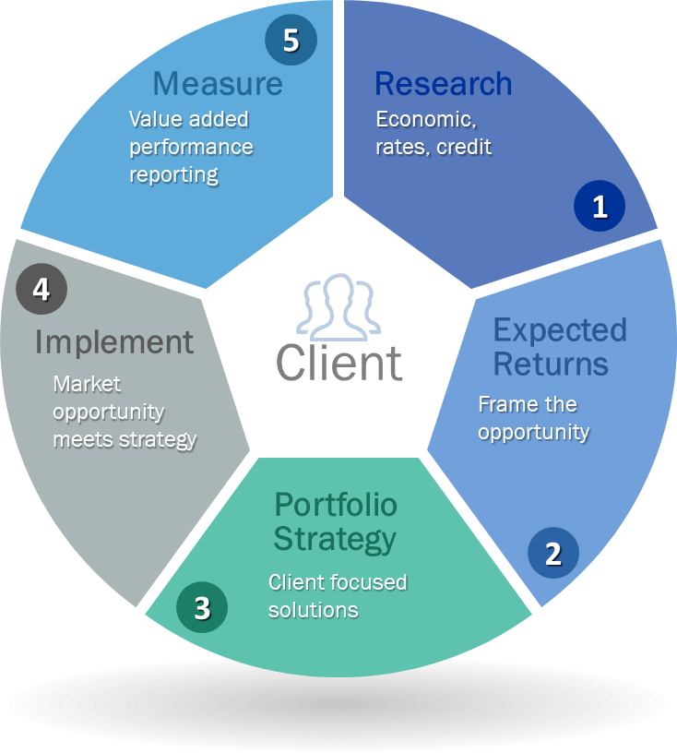
Investment Process

Slide 11
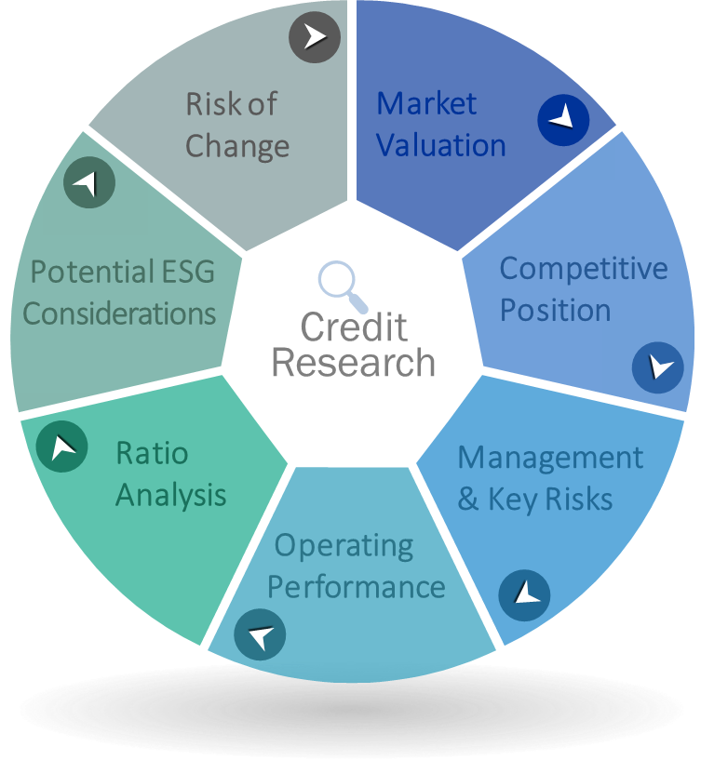
Credit Process

Slide 12
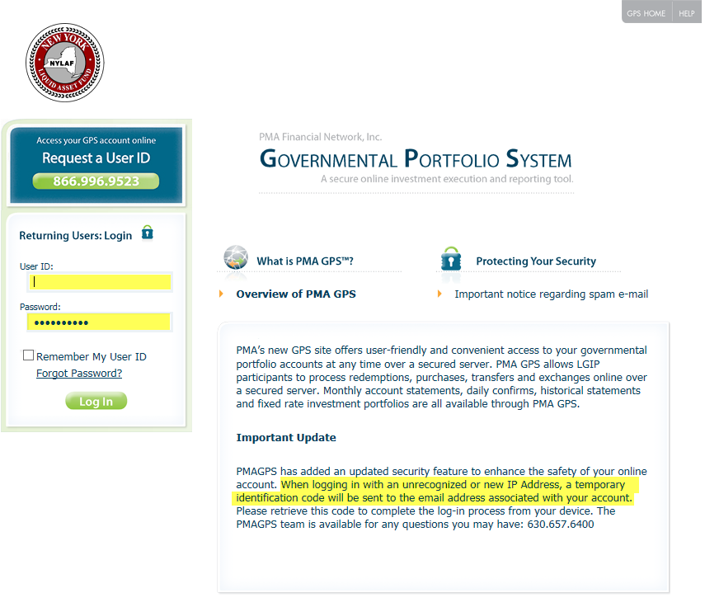


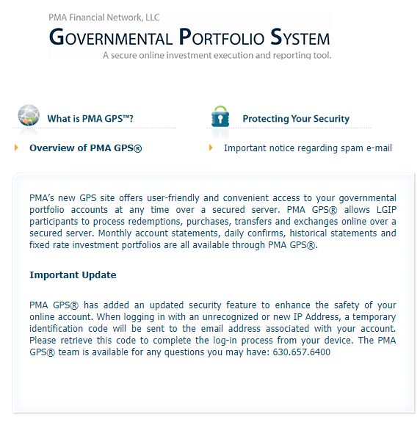
Fund Reporting and Access
Secure Online Access – Functionality:
  Execute transactions
  Reporting
  View activity
  View account information
  Fund information
  Fund documents
  Export to Excel for many of the GPS reports
Dedicated Service Team
  Committed Call Center service team
  MOCAAT toll-free number

Slide 13
Fixed Term Services
Offer a wide range of Fixed Term investments
PMA Bank Funding – use local banks
Service programs that provide value and efficiency for the Participant’s overall investment process
  Cash Flow Management and Bond Proceeds Management
  No additional fee for these services
  Fully consolidated reporting for Participants

Slide 14
Bank Analysis
Understanding credit quality
  Is the bank "well capitalized"?
  What type and quality of loans are made?
  How profitable is the bank and what is the trend?
  Does the bank face liquidity challenges?
Other considerations
  Does this investment hold undue headline risk?
  Has the institution or management faced regulatory issues?
Ongoing surveillance of credit quality is critical
  How is performance changing at the bank?
  What trends are developing in the banking industry?

Slide 15
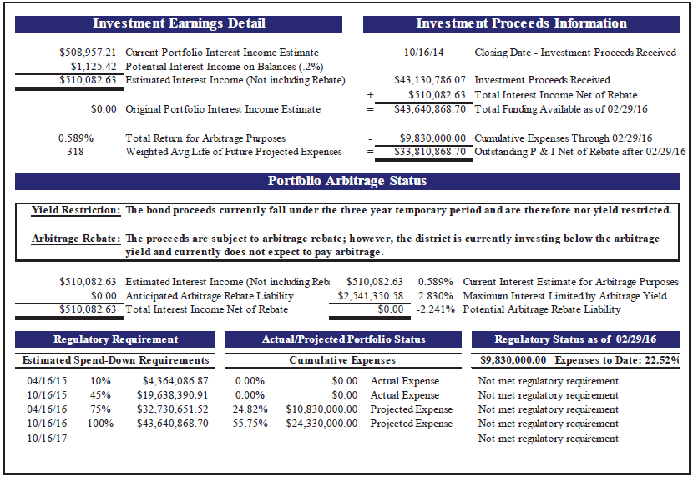
Bond Proceeds Management Program

Slide 16
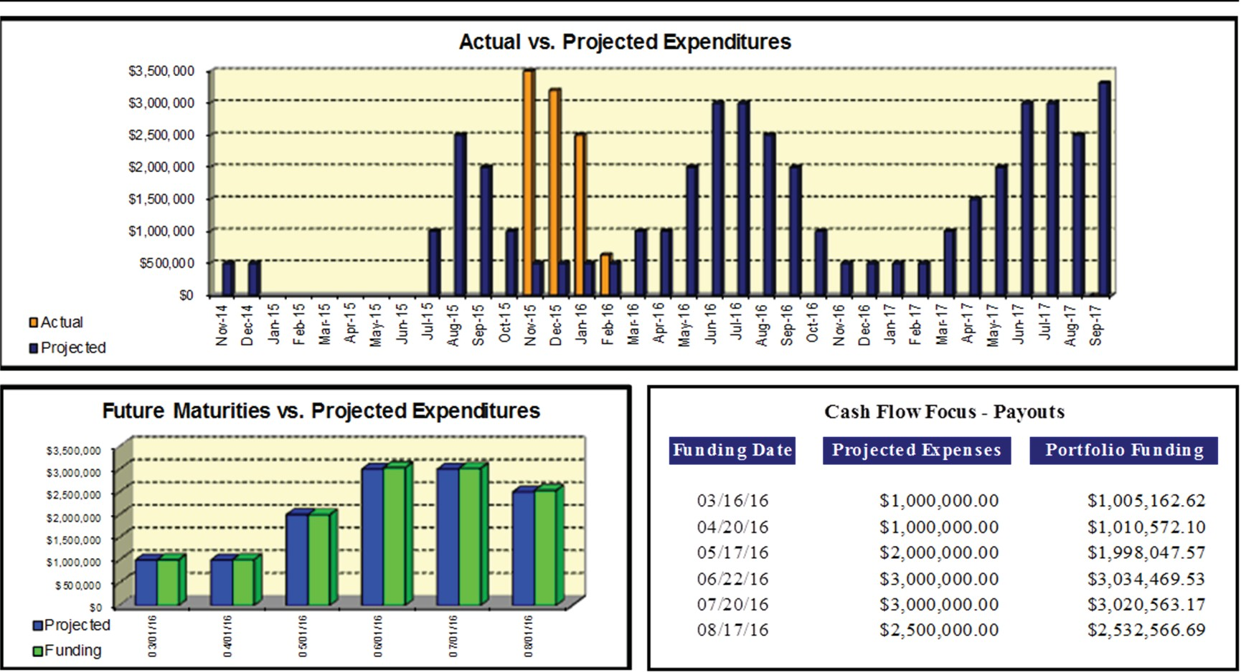
Bond Proceeds Management Program

Slide 17
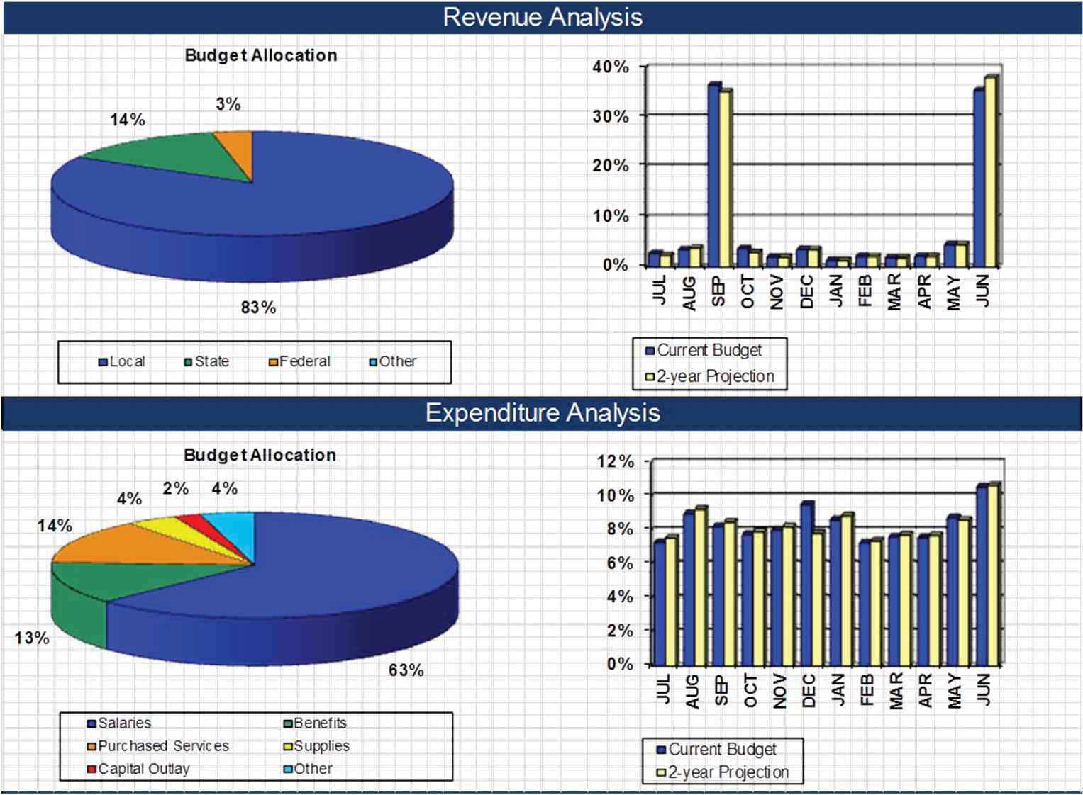
Cash Flow Analysis & Investment Plan

Slide 18
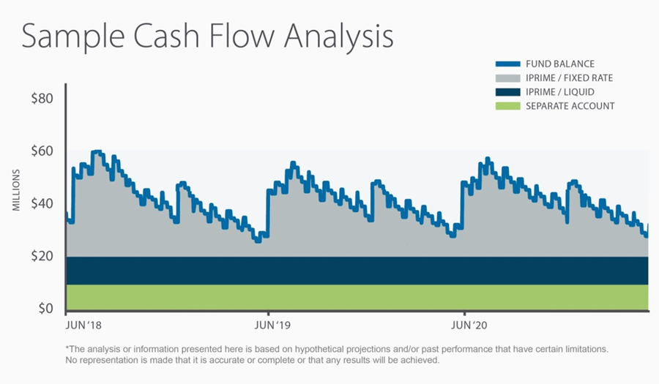
Cash Flow Analysis & Investment Plan

Slide 19
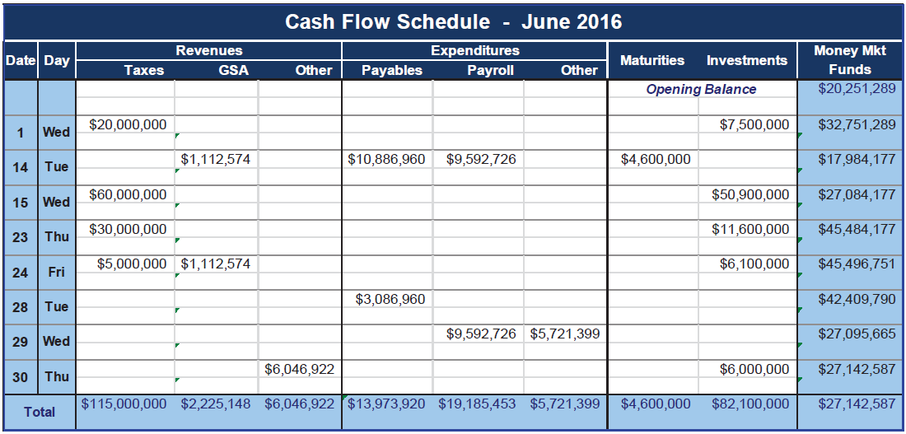
Cash Flow Analysis & Investment Plan

Slide 20

Supporting Missouri Communities
Local Office in Saint Louis
Missouri Office – Missouri Team
UMB Bank – HQ in Kansas City, branches throughout Missouri
Fund Counsel in Saint Louis - Armstrong-Teasdale
Partnership with school associations
“Local Values. Trusted Advantage”

Slide 21
Service to Missouri Public Entities
Competitive product for Missouri public entities
Inclusion of MO banks throughout the State – PMA Bank Funding Program
Fixed Term services including consolidated reporting with the Fund
Additional products – Cash Flow Planning and Bond Proceeds Management
Secure, online access and reporting
MOCAAT Philosophy: Partnership

Slide 22

Thank You!
Questions?
Disclaimer
Securities, public finance services and institutional brokerage services are offered through PMA Securities, LLC. PMA Securities, LLC is a broker-dealer and municipal advisor registered with the SEC and MSRB, and is a member of FINRA and SIPC. Prudent Man Advisors, LLC, an SEC registered investment adviser, provides investment advisory services to local government investment pools. All other products and services are provided by PMA Financial Network, LLC. PMA Financial Network, LLC, PMA Securities, LLC and Prudent Man Advisors, LLC (collectively “PMA”) are under common ownership.
Securities and public finance services offered through PMA Securities, LLC are available in CA, CO, FL, IL, IN, IA, MI, MN, MO, NE, OH, OK, PA, SD, TX and WI. This document is not an offer of services available in any state other than those listed above, has been prepared for informational and educational purposes and does not constitute a solicitation to purchase or sell securities, which may be done only after client suitability is reviewed and determined. All investments mentioned herein may have varying levels of risk, and may not be suitable for every investor. PMA and its employees do not offer tax or legal advice. Individuals and organizations should consult with their own tax and/or legal advisors before making any tax or legal related investment decisions. Additional information is available upon request.
For more information visit www.pmanetwork.com
©2020 PMA Financial Network, LLC
22

