Slide 1
Financing your Energy Efficiency Projects with the
Energy Loan Program
Craig Redmon & Rob Mock

Slide 2
Energy Loan Program History
The Energy Loan Program has awarded 622 loans since 1989:
Totaling over $118 million
Saving more than $214 million cumulatively
Zero loan defaults

Slide 3
Purpose
Helps fund energy efficiency improvements to facilities:
    Schools (K-12, colleges and universities)
    Hospitals (public & private not-for-profit)
    Local governments
Helps finance upgrades on new construction encouraging energy efficiency design
Helps finance renewable energy projects
Improvements increase occupants’ comfort and make facilities more efficient

Slide 4
Project Examples
Lighting
HVAC
Boiler Upgrades
Chiller Upgrades
Renewable Energy Projects
Process Equipment
Insulation Upgrades
Compressed Natural Gas Fleet
Combined Heat and Power

Slide 5
FY2021
Loan Cycle
$4.5 million available
Application deadline – October 30, 2020
1.75% interest rate
1% administrative fee
Up to 10-year loan repayment
“Energy savings repay the loan financing.”

Slide 6
FY2021
Loan Cycle
Who can apply?
Public schools (K-12)
Public colleges and universities
Local governments
Public and private not-for-profit hospitals

Slide 7
FY2021
Loan Cycle
How much can you apply for?
$10,000 - $1,000,000
Projects greater than $1,000,000 will be considered if funds remain
How much can you be approved for?
The project cost or 9.072 x Energy Cost Savings, whichever is lower

Slide 8
FY2021
Loan Cycle
Timeframe | Activities
August 3 – October 30, 2020 | Application Cycle Open
January, 2021 | Loan award announcement/loan documents (including loan agreements) will be emailed to recipients. After the loan agreement has been fully executed, recipients may submit reimbursement requests. *
* Reimbursement request process requires approximately 14-30 days. Invoices
dated on/after August 3, 2020 are reimbursable.

Slide 9
Benefits
Free up your budget for other capital improvements
Low-interest loans compare favorably to bonds or commercial loans
Loans are not considered to be debt and do not need voter approval
After the loan is paid off, energy savings go into your pocket
Job creation

Slide 10
Application
Application process is user friendly
    Online Excel Spreadsheet Application
Auto-calculating worksheets
Energy audit calculations and reports

Slide 11
Reimbursement and Loan Repayment
Once the project is complete, recipients submit their Reimbursement Request, Final Project Cost Report, invoices, and canceled checks to the Division of Energy for review and reimbursement
The first payment is typically due 120 days from the date of reimbursement and loan recipients repay the Division of Energy in semi-annual payments
Loans are repaid from the savings that are generated by the energy-efficiency projects

Slide 12
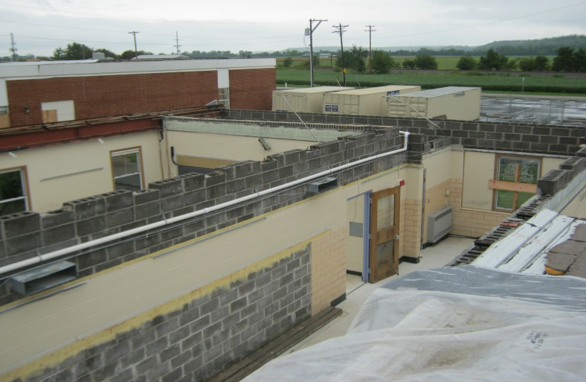
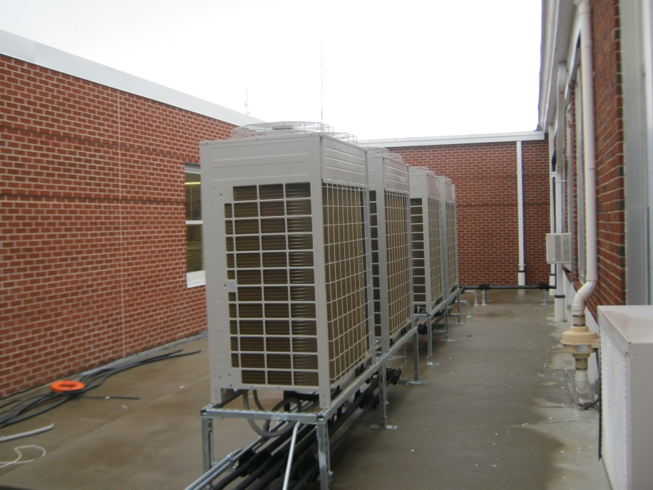
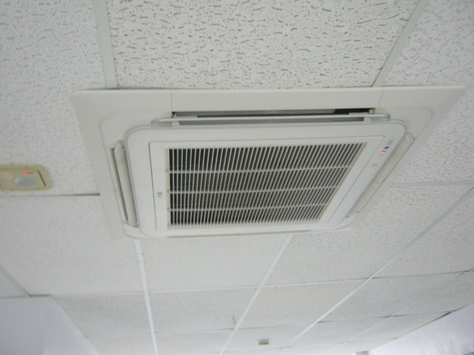
Orrick R-XI School District
Emergency Loan
Loan Amount: $358,250
Project: HVAC System
Est. Annual Savings: $39,691
Loan Repayment: 10 years

Slide 13
For More Information
Visit our website: http://energyloan.mo.gov/
Energy Loan Program Contact Information:
Rob Mock Daniel Dahler Tracy Parker
Administrative Manager Project Manager Energy Loan Program Clerk
(573) 751-5955 (573) 5322-3371 (573) 526-9544
Rob.Mock@dnr.mo.gov Daniel.Dahler@dnr.mo.gov Tracy.Parker@dnr.mo.gov

Slide 14
Questions?

