Slide 1
To Speak or Not to Speak: Handling Employee Speech Issues in Politically Charged Times
Michelle Basi
Mike Hodge
October 24, 2019

Slide 2
Today’s Agenda
Review sources of law regarding employee First Amendment free speech rights
Revisit key court decisions regarding the First Amendment
Consider controversial First Amendment issues and practical guidance
Your questions!

Slide 3
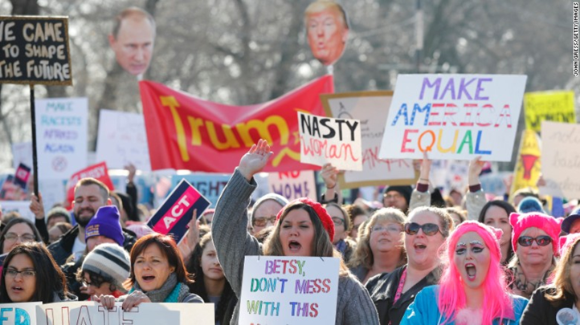
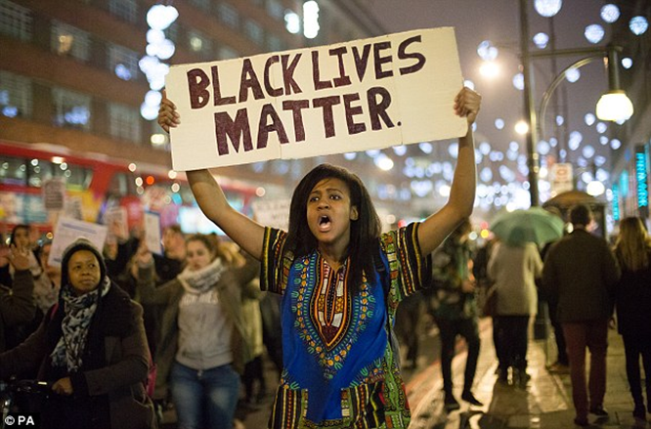
Freedom of Speech

Slide 4
Sources of Law and Guidance
United States Constitution
Missouri Constitution
Federal and state laws and regulations
Case law
Board policies

Slide 5
First Amendment
“Congress shall make no law respecting an establishment of religion, or prohibiting the free exercise thereof; or abridging the freedom of speech, or of the press; or the right of the people to peacefully assemble, and to petition the government for a redress of grievances.”

Slide 6
Missouri Constitution, Article I § 8 – Freedom of Speech
“That no law shall be passed impairing the freedom of speech, no matter by what means communicated: that every person shall be free to say, write or publish, or otherwise communicate whatever he will on any subject, being responsible for all abuses of that liberty…”

Slide 7
First Amendment Lawsuits
42 U.S.C. § 1983
Who are the typical defendants?
School Districts
Boards of Education
Individual Board Members
Superintendents
Principals
Other individuals who are acting under the color of state law

Slide 8
Teacher Expression
Issues:
Local school board has broad power to adopt curriculum.
The speech of teachers at school usually bear the school’s imprimatur
A teacher’s speech as part of his/her official duties is typically not protected by the First Amendment.
The above factors shape the school’s authority to regulate the speech of its employees.

Slide 9
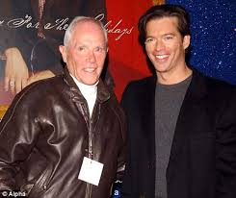
Freedom of Speech – Public Concern
Pickering v. Board of Education, 391 U.S. 563 (1968)
Public employees have a First Amendment right to speak on matters of “public concern”
Balancing test
Connick v. Myers, 461 U.S. 138 (1983)
To determine whether an employee’s speech is a matter of public concern, courts examine the “content, form, and context” of a given statement
Notes:
Pickering v. Bd of Education
School district dismissed a teacher for writing to the local newspaper a letter attacking a number of the district’s policies and actions
After letter was published, school board terminated the teacher, claiming that his letter was “detrimental to the efficient operation and administration of the schools of the district.”
School district argued that the letter not only disrupted the district’s operations, but also that the statements made in the letter were false
Supreme Court:
Dismissal was unlawful
Weighed the interests of the school district in promoting the efficiency of the public services it provides against the teacher’s interest in commenting on matters of public concern
Court found no evidence that the teacher’s letter “impeded the teacher’s proper performance of his daily duties in the classroom or…interfered with the regular operation of the schools generally
Connick v. Myers
After a transfer, ADA created a questionnaire for colleagues, distributed it around the office – addressed office morale, confidence in superiors, and pressure to work on political campaigns
Terminated in part for the distribution of the questionnaire
Supreme Court:
Questionnaire dealt mostly with matters that were not of public concern
Employee’s actions occurred while at work, supporting her employer’s “fears that the functioning of his office was endangered”
Due to disruptive nature of the speech, did not satisfy balancing test

Slide 10
Freedom of Speech – Official Duty Speech
Garcetti v. Ceballos, 547 U.S. 410 (2006)
First Amendment protections do not apply when the employee is speaking pursuant to his or her official duties
Some courts have applied this rule to teachers, but the Garcetti court specifically held that question open
See Lee-Walker v. N.Y.C. Dep’t of Educ. (S.D.N.Y. 2016)
Notes:
Garcetti v. Ceballos
ADA claimed he was passed on a promotion because he had criticized the legitimacy of a warrant
Supreme Court:
“when public employees make statements pursuant to their official duties, employees are not speaking as citizens for First Amendment purposes, and the Constitution does not insulate their communications from employer discipline.”
See Lee-Walker v. N.Y.C. Dep't of Educ., 220 F. Supp. 3d 484 (S.D.N.Y. 2016)
Motion to Dismiss granted on First Amendment retaliation claim
Lee-Walker planned to include as part of her ninth grade English curriculum a critical look at the Central Park Five case, which she hoped would highlight "an American societal tendency to rush to adverse legal conclusions against black males.“
After observing the class, Assistant Principal Yarmy allegedly instructed the plaintiff to be "way more balanced" in discussing the case because he "feared that it would unnecessarily 'rile up' black students." Id. ¶ 6(g). The plaintiff argued in response that students — black students in particular — should be "riled up," and that a "good, engaged education" would necessarily encourage students to "re-examine old assumptions and to challenge orthodoxy, even whilst presenting a balanced view of the facts." Id. ¶ 6(h). She also argued that including the case in her lesson plan would allow students to "contextualize" Miranda warnings and understand their role in civil society. Id. ¶ 6(i).
In a meeting with the principal, the principal expressed disapproval of the plaintiff's use of the short story "Nilda," by Junot Diaz, questioning its appropriateness given its use of a racial epithet. Id. ¶ 6(s). When the plaintiff argued that the story would "necessarily incite students to re-examine old assumptions and to challenge existing orthodoxy," Noonan suggested that she was naïve and ordered her to remove the story from her lessons.
Plaintiff received poor performance evaluations, and was ultimately informed that her probationary teaching appointment would end
Court:
It thus remains "an open question in this Circuit whether Garcetti applies to classroom instruction," but the plaintiff's claim fails if the Garcetti standard is applied.
The content and context of the plaintiff's conversation with Noonan and Yarmy as alleged makes plain that it was not a personal disagreement between co-workers. Rather, the plaintiff alleges a disagreement between herself and her supervisors regarding the content and tone of a lesson to be given to her ninth grade English class. She spoke "only to several school administrators rather than to the public," and her concerns regarded her own lesson plans, "for which there is no relevant citizen analogue." Massaro v. N.Y.C. Dep't of Educ., 481 Fed. Appx. 653, 655-56 (2d Cir. 2012)(summary order). Although the lack [**17] of a citizen analogue is not dispositive, it reinforces the conclusion that the plaintiff's speech was in furtherance of her duties as a public school teacher. See Weintraub, 593 F.3d at 204. Therefore, pursuant to the standard articulated by the Supreme Court in Garcetti, the plaintiff's speech was the speech of a public employee pursuant to her official duties and is not entitled to First Amendment protection.

Slide 11
First Amendment Analysis
1.) Is the employee speaking as a citizen or pursuant to official duties?
2.) Is the speech relating to an issue of public concern based on content, form, and context? Or, is the speech related to the employee’s private concern?
3.) If the speech is “protected,” balance the employee’s interests against those of the school.

Slide 12
First Amendment Analysis
1.) Is the employee speaking as a citizen or pursuant to official duties?
For employee to be speaking as a private citizen, speech itself cannot have been made in the course of the employee’s ordinary duties
Does the speech relate to the employee’s job duties?
Was the speech made while on or off duty?
“Chain of command speech,” speech made by an employee to his superiors, is typically “employee” speech

Slide 13
First Amendment Analysis
2.) Is the speech relating to an issue of public concern based on content, form, and context? Or, is the speech related to the employee’s private concern?
Connick – touches on aspects of “political, social, or other concern in the community”
Personal issues and grievances do not typically constitute issues of public concern
Focus on identifying speech that may implicate broader public issues and current events

Slide 14
First Amendment Analysis
3.) If the speech is “protected,” balance the employee’s interests against those of the school.
Do the interests of the employee as a private citizen in commenting on matters of public concern outweigh the interests of the public employer in promoting the efficiency of the public services it performs?

Slide 15
First Amendment - Balancing Analysis
Considerations:
Need for harmony in the work place;
Whether the government’s responsibilities require a close working relationship to exist between the employee and co-workers when the speech in question has caused or could cause the relationship to deteriorate;
Time, manner, and place of the speech;
Context in which the speech arose;
Degree of public interest in the speech;
Whether the speech impeded the employee’s ability to perform his or her duties

Slide 16
Hypothetical #1
Suzie Smith is an eighth grade history teacher. While conducting a lesson on Ellis Island in class, a student asks Ms. Smith, “What do you think about the wall that is going to be built between the United States and Mexico?” Ms. Smith replies, “I think it’s a great thing we are keeping all of those people out of the country. Mexicans are criminals. We should kick all of them out, not just build a wall.” Several students in the classroom are of Mexican descent and were upset by her comments. You receive many phone calls from angry parents, demanding that their children be removed from Ms. Smith’s class.
Is this protected speech? What if Ms. Smith posted this on her personal Facebook instead?
Notes:
See Loeffelman v. Board of Education of the Crystal City School District, 134 S.W.3d 637 (Mo. App. E.D. 2004):
An African-American student posed a series of questions to the teacher regarding interracial relationships
Students said that they heard the teacher say that interracial couples should be fixed so that they could not have children.
Mixed children are “racially confused”
A parent of a biracial student called the teacher to discuss the comments,
Teacher stated that she opposed interracial relationships and that whites should marry whites and blacks should marry blacks
“Biracial children come to school with “dirty little faces and their hair never combed properly,” and that they are “misfortunate” and never accepted by society
Teacher was terminated
Court:
Comments did not address a matter of public concern
Her comments expressed a private opinion regarding interracial relationships and biracial children
Her comments, responding to a student’s questions, occurred during class time when teacher was supposed to be conducting class
Comments were not part of a lesson plan
Even if considered a matter of public concern, the school district’s interest in promoting the efficiency of public services outweighed the interests of the teacher in commenting on the matter
Comments caused a serious disruption to the school setting for several weeks
Testimony that students were agitated in the hallways, worried to attend the teacher’s class again
Negatively affected the specific students involved, as well – self esteem damaged, distracted
irreparably damaged teacher’s rapport with students
What if she posted this on her Facebook?
Even if speaking as a private citizen, remember balancing test
See Czaplinski v. Board of Education of Vineland, 2015 U.S. Dist. LEXIS 38349 (D.N.J. Mar. 26, 2015)
Security guard posted “Praying hard for the Philly cop shot today by another black thug…maybe all white people should start riots and protests and scare the hell out of them” after a local police officer was killed in the line of duty by an African American assailant
District terminated security guard – deemed Facebook comments to be inflammatory
Court:
Security guard was speaking as a private citizen
First Amendment not violated – security guard failed to show that “her interest in free speech likely outweighs Defendant’s interest in avoiding a perception of racial bias and maintaining security”
District had significant interest in ensuring that its employees, particularly security guards whose positions require dispute resolution and maintenance of the peace, are respected and do not appear to be biased against certain groups of people

Slide 17
Hypothetical #2
A large fight occurred in the parking lot after the school day concluded. Carol Brown, the School Resource Officer, responded to the scene and tried to break up the fight. Police also arrived to the scene, and one of the students was taken to the ground and arrested. Believing the arrest was excessive, Ms. Brown stated that the arrest was “bogus,” shouted “police brutality!” and told students to get out their phones and record the arrest. An investigation ensued regarding Ms. Brown’s conduct, and it was recommended that she be terminated.
Is this protected speech?
Notes:
See Toney v. Atterberry, 2017 U.S. Dist. LEXIS 28267 (E.D. Cal. Feb. 28, 2017)
Court applied Pickering balancing test – employee’s right to engage in speech and employer’s right to protect its own legitimate interests
1.) Is this a matter of public concern?
Arguably yes – case law supporting the proposition that police brutality is a matter of public concern
2.) Was she speaking as a private citizen or in her official duties?
Her job included “patrolling the campus,” “maintaining order and security,” “communicating with students,” “responding to calls of disturbance”
Analogizes to a teacher for Pickering purposes – placed in a “position of trust and authority” over students
Because facts showed that she acted “in a capacity students might reasonably view as official” during the incident, finds in favor that the spoke as a public employee
Because she spoke as a public employee during the incident, her speech was not protected under the First Amendment

Slide 18
Hypothetical #3
Ms. Smith, a middle school math teacher, wore a button to school that said “War is Not the Answer” and made comments about the President being an “idiot.” She also made negative comments about the military. A large percentage of students in her class had parents in the military. One parent, Colonel Johnson, called the superintendent to complaint.
Is this protected speech?
Notes:
Calef v. Budden, 361 F. Supp. 2d 493 (South Carolina 2005)
Balancing test – balance the interests of the employee, as a citizen, in commenting upon a matter of public concern and the interests of the District, as the employer, in promoting efficiency of the public services it performs
Government may impose restrains on 1st Amendment activities of its employees that are job-related, even if such restraints would be unconstitutional if applied to the public at large
“Inescapable conclusion” that school district was justified in halting her activities – detrimental impact on her relationships with students in her class

Slide 19
Hypothetical #4
Mr. Lee, a Spanish teacher, had several posters in classroom, including a National Day of Prayer poster that featured George Washington kneeling in prayer, an article called “The God Gap” about religious differences between presidential candidates, and an article about White House staffers gathering for Bible study sessions. A parent complaint that his student felt uncomfortable because of the religious nature of the postings.
Is this protected speech?
Notes:
Lee v. York County School Division, 484 F.3d 687 (4th Cir. 2007)
Curricular speech, not a matter of public concern
Bears the imprimatur of the district
Not related to the curriculum

Slide 20
Hypothetical #5
Mr. Jones, a school counselor, published a book entitled “It’s Her Fault,” that included sexually provocative themes and sexually explicit language. In the book’s Introduction, Mr. Jones explains that he is qualified to give advice because he was a girls basketball coach, he works in an office in which he is the only male, and he talks to female high school students every day. School because aware, and Mr. Jones was fired.
Is this protected speech?
Notes:
Craig v. Rich Township High School District, 736 F.3d 1110 (7th Cir. 2013)
Book was on a matter of public concern
Employee argued higher level of scrutiny in balancing test because this was speech outside the scope of his employment – BUT he explicitly linked it to his employment
Reasonable prediction of disruption
Students – especially female – would not want to come to him

Slide 21
Practical Considerations
When disciplining employees, consider whether the employee has engaged in protected activity or protected speech.
Carefully consider the impact of the employee’s speech on the operations and/or mission of the school.
Document reasons for taking action.
Don’t let your personal beliefs influence your decision.

Slide 22
Questions?

Slide 23
Michelle Basi
mbasi@tuethkeeney.com
Mike Hodge
mhodge@tuethkeeney.com
Follow us on Twitter! @tuethkeeney

