Slide 1

Missouri’s Opioid Crisis:
What’s being done and how you can help
Rachel P. Winograd, PhD
Missouri Institute of Mental Health, University of Missouri-St. Louis
In partnership with
The Missouri Department of Mental Health, Division of Behavioral Health

Slide 2


Slide 3
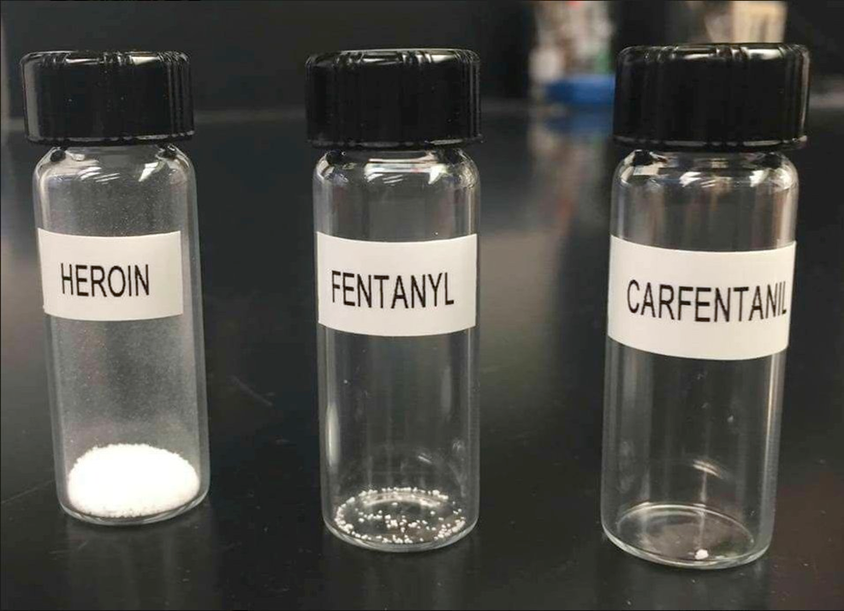
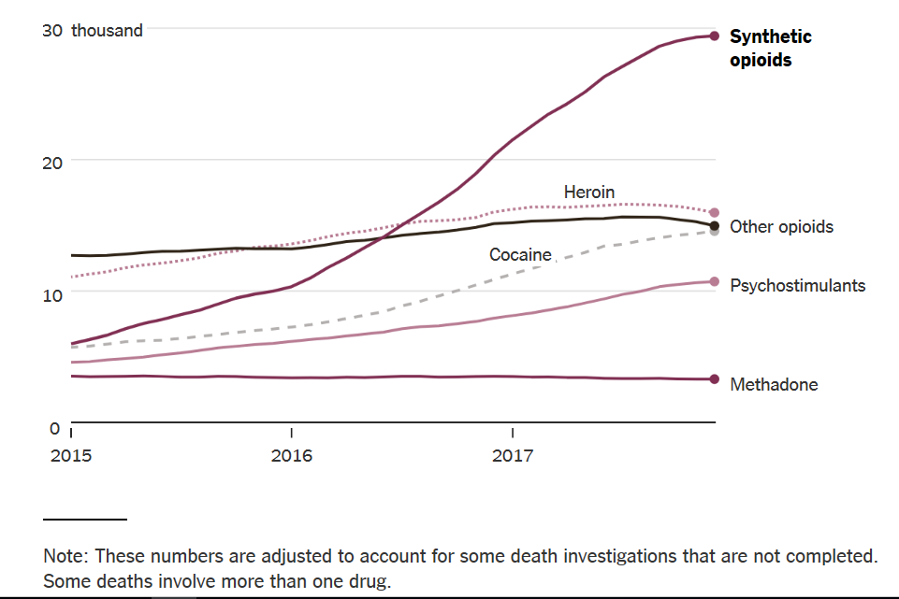
Nationally, Synthetic Opioids Are Driving Up the Overdose Rate
Overdose deaths in thousands in preceding 12 months
Notes:
Drugs Involved in U.S. Overdose Deaths* - Among the more than 72,000 drug overdose deaths estimated in 2017*, the sharpest increase occurred among deaths related to fentanyl and fentanyl analogs (synthetic opioids) with nearly 30,000 overdose deaths. Source: CDC WONDER
https://www.nytimes.com/2018/08/15/upshot/opioids-overdose-deaths-rising-fentanyl.html

Slide 4
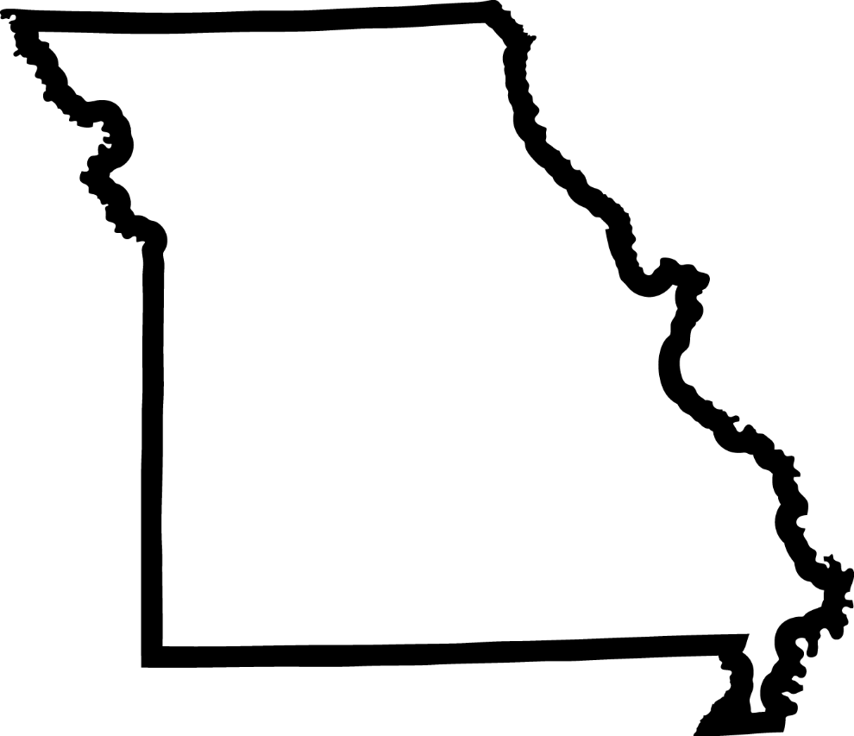
Total Number of
Opioid-Related
Overdose Deaths in 2016
35%
increase
from
2015
to
2016
908
Source: DHSS, 2017
Notes:
2015 opioid-related overdose deaths: 672

Slide 5
Total Number of
Opioid-Related
Overdose Deaths in 2017
4.7%
increase
from
2016
to
2017
951
Source: DHSS, 2018
Notes:
2015 opioid-related overdose deaths: 672

Slide 6
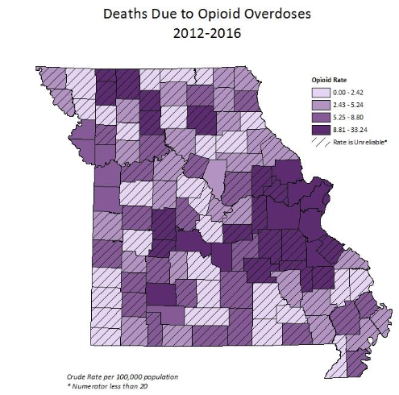
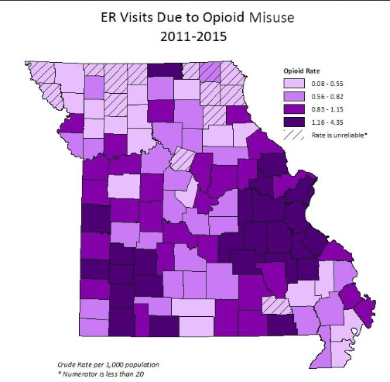
Notes:
The Eastern region is the epicenter of overdose deaths and ER visits. Counties with fewer than 20 deaths, like Randolph county, are based on fewer than 20 deaths therefore data is unreliable to report the mortality rate. However, neighboring counties in the region show high rates of ER visits due to opioid misuse and high rates of opioid overdose deaths.

Slide 7
A Focus on Heroin & Fentanyl in
St. Louis
70% of Opioid deaths in 2017 were in Eastern Region
St. Louis City has the 6th highest overdose rate of US cities – why?
Increased purity, potency, injection, combining drugs → higher risk
Notes:
The most deadly of the fentanyl analogues is carfentanil, an elephant tranquilizer 5,000 times stronger than heroin. An amount smaller than a few grains of salt can be a lethal dose.
geographic variation may reflect a historical divide in the nation’s heroin market between the powdered heroin generally found east of the Mississippi River and the Mexican black tar heroin found to the west.

Slide 8
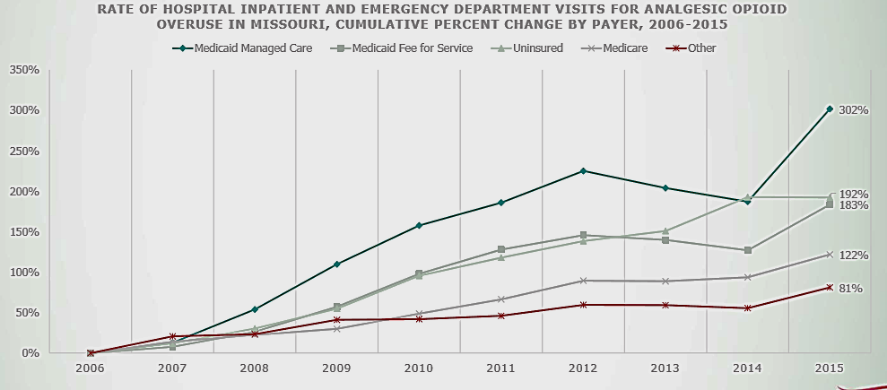
Who is affected – Payer Source

Slide 9
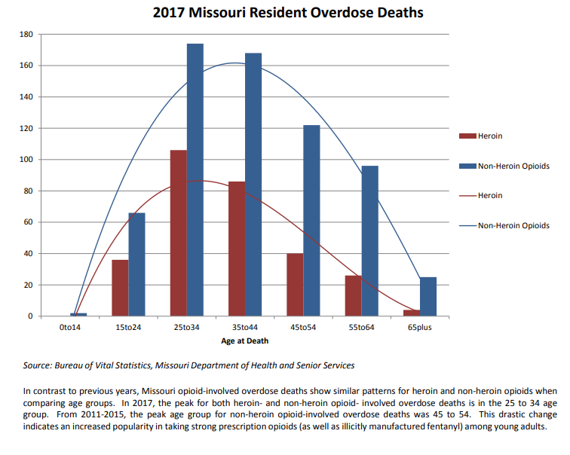

Slide 10
**Ethnicity is separate from race, these individuals are also included somewhere in the race counts
*Data sources: Department of Health and Senior Services (2016), Bureau of Vital Statistics(2016), Missouri Census Data Center (2016)
Notes:
Either 19 or 20

Slide 11

What’s being done around the world to address the epidemic
Prevention
  Prescription drug monitoring
  Mental health parity laws
  Prescribing guidelines
  Alternative pain treatments
Treatment
  Expanded access to medical treatment for OUD
Harm Reduction
  Syringe access
  Safe consumption sites
  Good Samaritan laws
  Increased access to overdose education and naloxone
Recovery
  Peer support, Community, Domains of health and wellness
Notes:
Harm reduction source: http://onlinelibrary.wiley.com/doi/10.1080/09595239800187011/epdf
MAT has been shown in multiple studies to reduce overdose deaths

Slide 12
Missouri’s Opioid Use Prevention Efforts

Slide 13
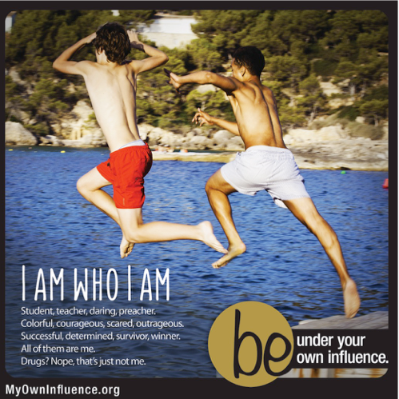
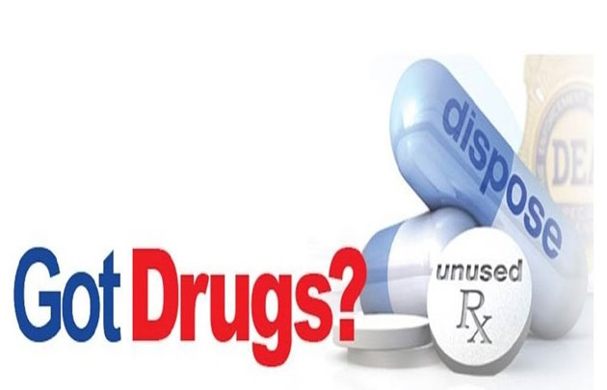
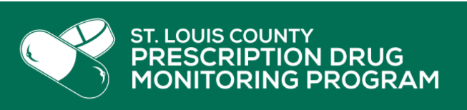
MHA’s promotion of CDC Rx guidelines
Partnerships for Success Grant:
“Be under your own influence” campaign
DMH Prevention Resource Centers
Curiosity+Heroin Campaign

Slide 14
What can you do related to opioid use prevention?
Comprehensive Drug Education for kids, not fear-mongering
Lock up and dispose of Rx meds
Avoid initiating Rx opioid therapy for chronic pain
“Start low, go slow”
Don’t stop abruptly or encourage anyone else to
Advocate for accessible and affordable non-narcotic options for pain

Slide 15
Missouri’s Opioid Use Treatment Efforts

Slide 16
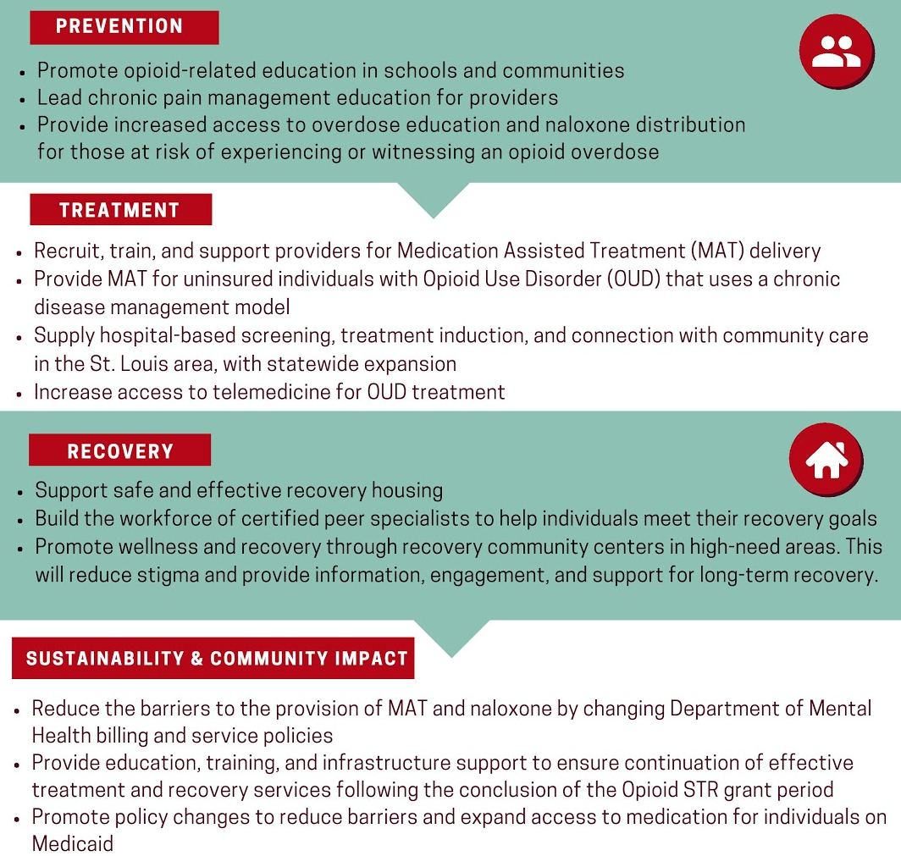
Missouri’s State
Targeted Response
(Opioid STR & SOR)
“Combined with coordinated collaboration and sophisticated evaluation,
The Opioid STR project aims to transform the system of care for OUD in Missouri.”

Slide 17
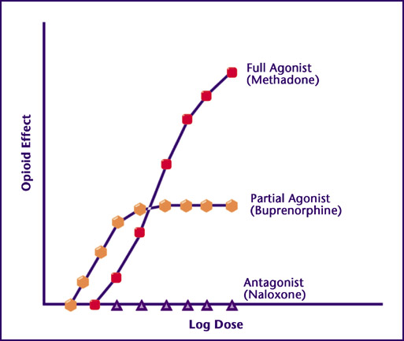



(Naltrexone)

Slide 18
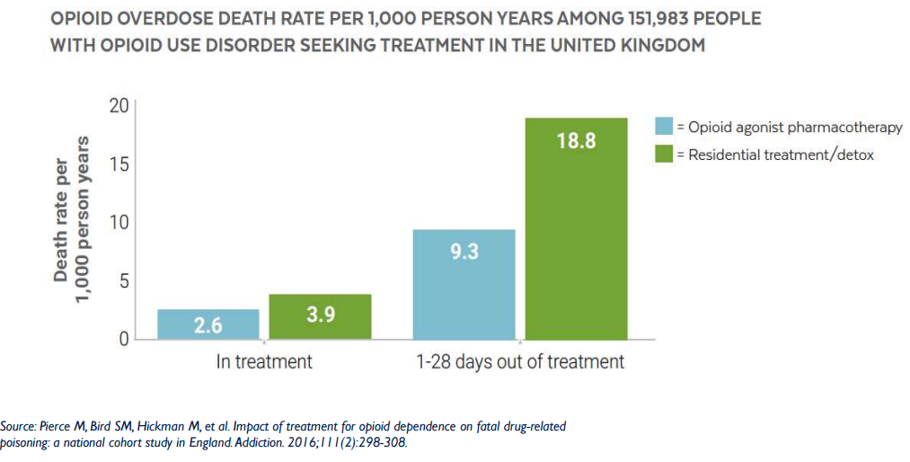

Slide 19

Agonist therapy helps with more than “just” mortality
Office-based Suboxone maintenance treatment →
  More likely to report AA affiliation (homegroup, sponsor, meeting attendance)
  More likely to be employed
  Less likely to report:
    Damaging a close relationship
    Doing regretful or impulsive things
    Hurting family
    Experiencing negative personality changes
    Failing to do things expected of them
    Taking foolish risks
    Being unhappy
    Having money problems
  Less likely to use other substances
  Less likely to use heroin
Parran, T. V., Adelman, C. A., Merkin, B., Pagano, M. E., Defranco, R., Ionescu, R. A., & Mace, A. G. (2010).

Slide 20

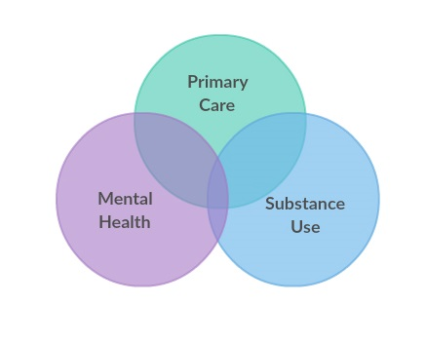

Treatment in Opioid STR/SOR: Big Picture
*More buprenorphine prescribers
*OUD treated across care settings, bi-directional referrals
*Changing the standard of OUD care in state-funded SUD settings
Notes:
PFH jeff city
McCaimbridge
Phoenix
Burrell
Compass Health
Turning Point

Slide 21
What can you do related to treatment?
Educate yourself on the evidence base of different treatment modalities
Contact your community Substance Use Treatment providers to ensure medical treatment is available
Know your rights in the court system – Federal and State law prohibit basing program participation off medication status
If you’re a physician, NP, or PA – get waivered to prescribe buprenorphine!
Support people who are finding success with medication
Advocate for easier, broader access to treatment

Slide 22
Missouri’s Harm Reduction Efforts

Slide 23


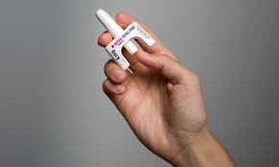
(Missouri Opioid & Heroin Overdose
Prevention and Education)
DMH + NCADA + MIMH www.mohopeproject.org

Slide 24

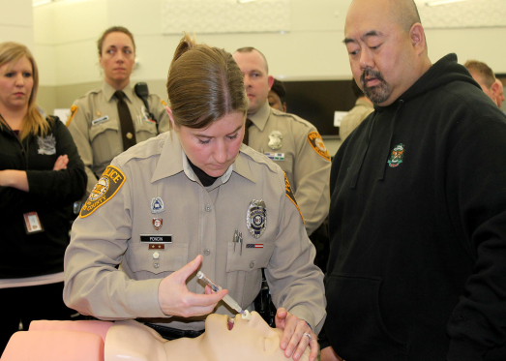
Overdose knowledge and response trainings
Emergent Use
  Responders (police, fire…)
Take-home Use
  Substance Use Disorder treatment providers (therapists, physicians…)
  People who use drugs, their families, and associates

Slide 25
What can you do related to naloxone and harm reduction?
Learn about overdose prevention, recognition, and response
Distribute naloxone to people and places at highest risk
Carry naloxone
Make sure your local pharmacies are stocking it and are dispensing through Missouri’s Standing Order
Publicize the 911 Good Samaritan Law
Teach people about harm reduction strategies

Slide 26
Genetics
Isolation
Childhood trauma
Sexual abuse
Poverty
Lack of housing
Unemployment
Chronic pain
Hopelessness
Cycles of incarceration
…the list goes on

Slide 27
So where does that leave us?
How do we manage the opioid crisis?
Differently than we have been
In ways that benefit and include everyone who lives with addiction
Using methods to keep people alive, first and foremost

Slide 28
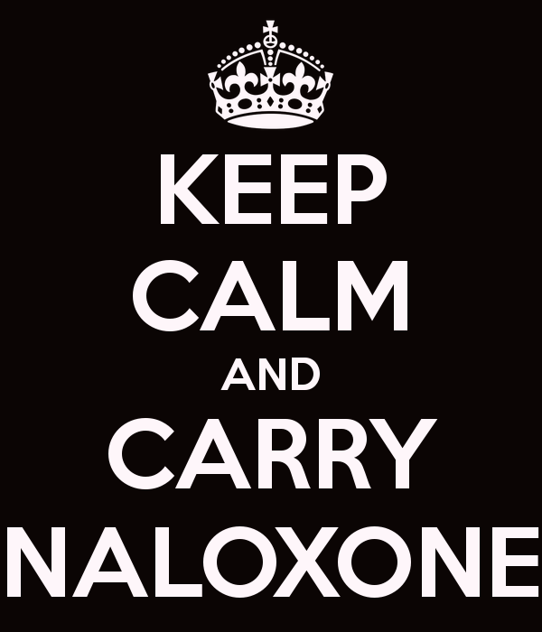
Visit www.missouriopioidstr.org to learn more and sign up for our statewide listserv

