Slide 1
Z-Lock
DK Safety Solutions
Classroom lockdown device designed to save lives.

Slide 2
Complacency
Easy to become complacent
There have actually been 142 school shootings since 2013
17 year old committed suicide by shooting herself at Lee’s Summit High School on September 29th of this year.
Shootings on soft targets- schools, churches, concerts etc. on the rise
November 14th 2017, Shooting in Rancho Elementary in California. Tragedy averted because shooter couldn’t get in rooms, shot through walls but only one student was injured
December 7th 2017, Two students plus the gunman were killed at Aztec High School in New Mexico.
January 23rd 2018, Kentucky High School, 2 dead 15 shot
February 1st 2018, Salvador B. Castro Middle School, 2 shot, female shooter
February 15th, 2018 Parkland, Florida HighSchool. 17 students dead

Slide 3
What is the Z-Lock
The Z-Lock is a classroom lockdown device designed to save lives by:
STRENGTH
SECONDS to engage
SIMPLE to use
AFFORDABLE
Teachers can visually see the lock is engaged in a stressed situation.

Slide 4
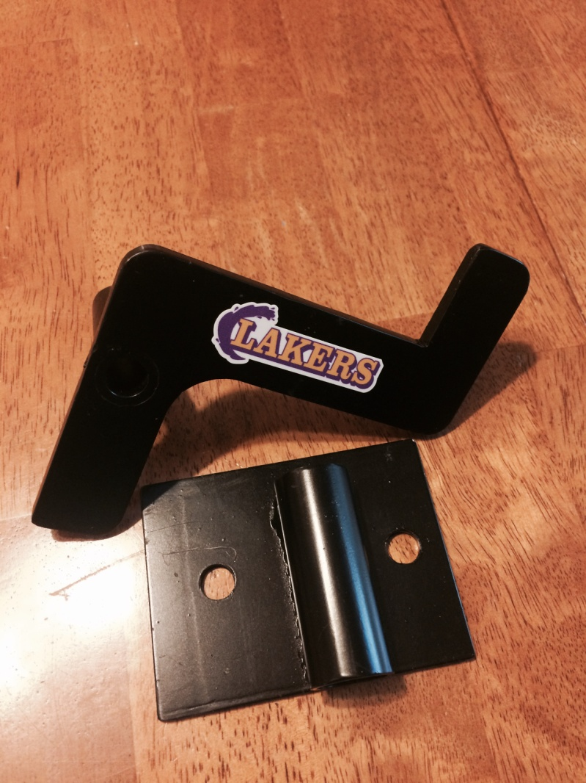
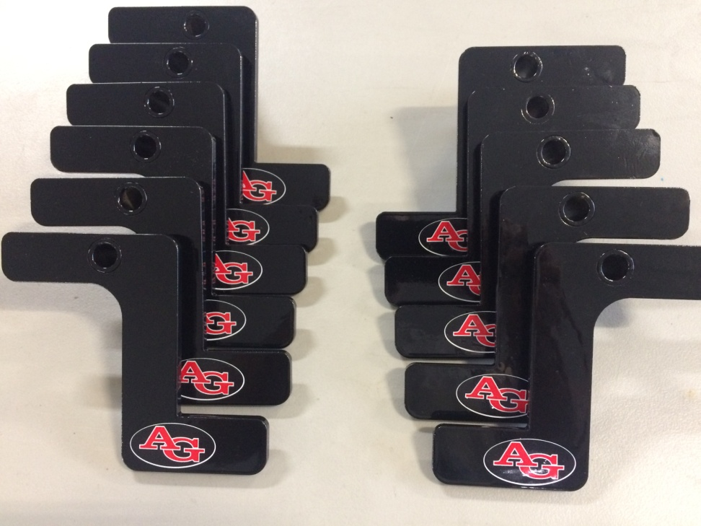
Customized to your school

Slide 5
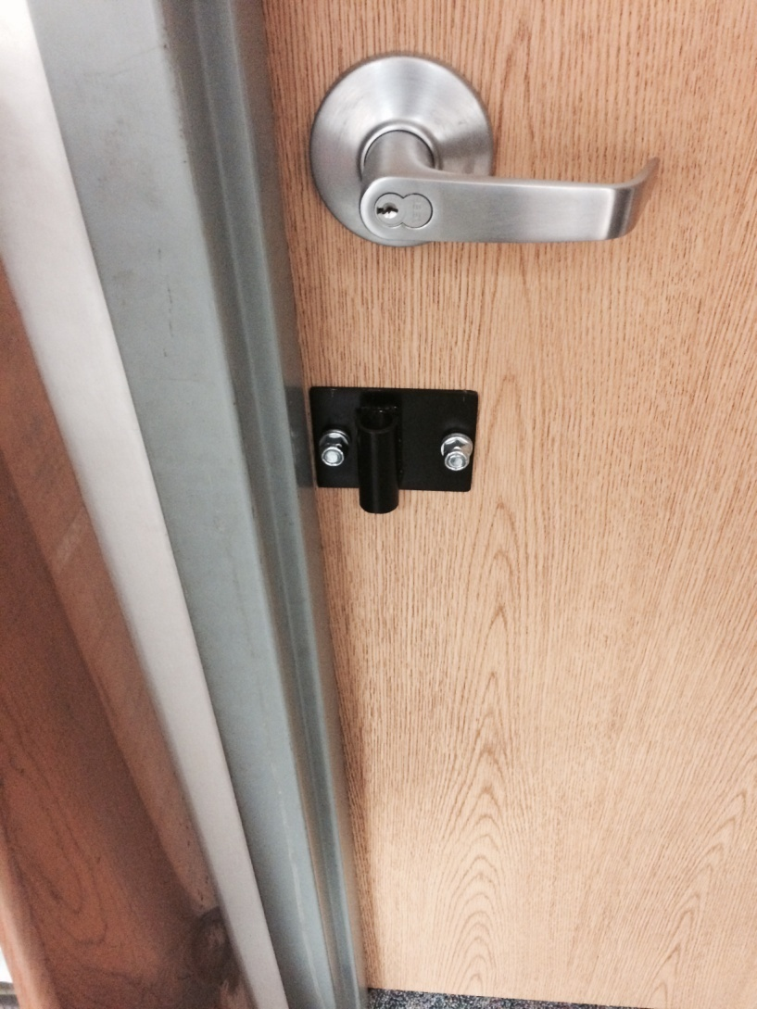
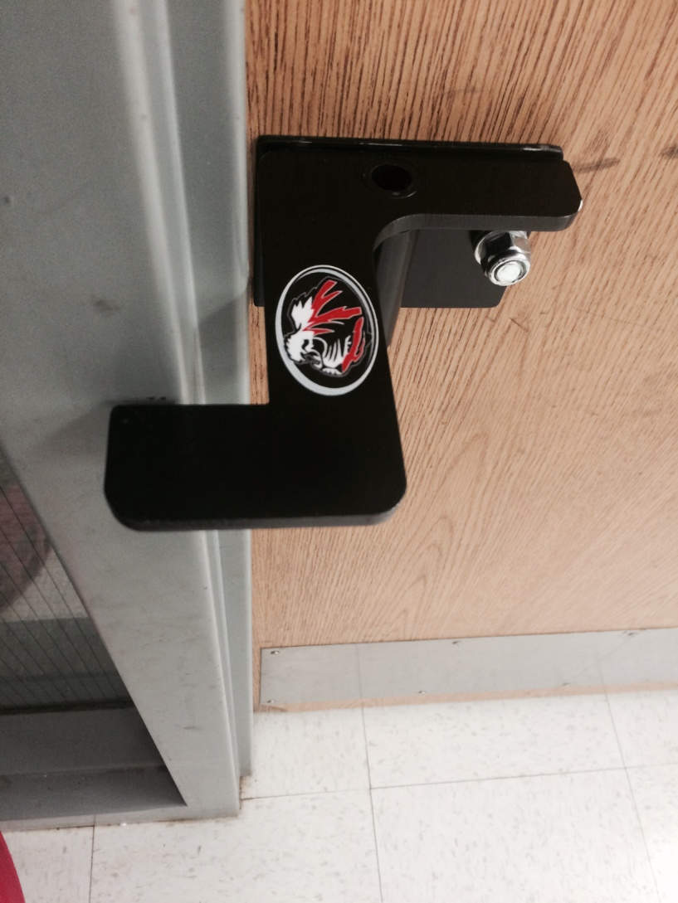
Z-Lock on Door

Slide 6
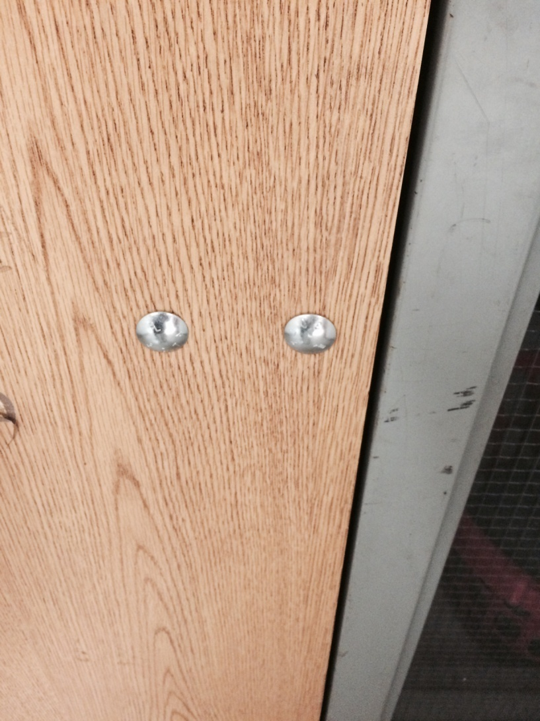
View from backside of door

Slide 7
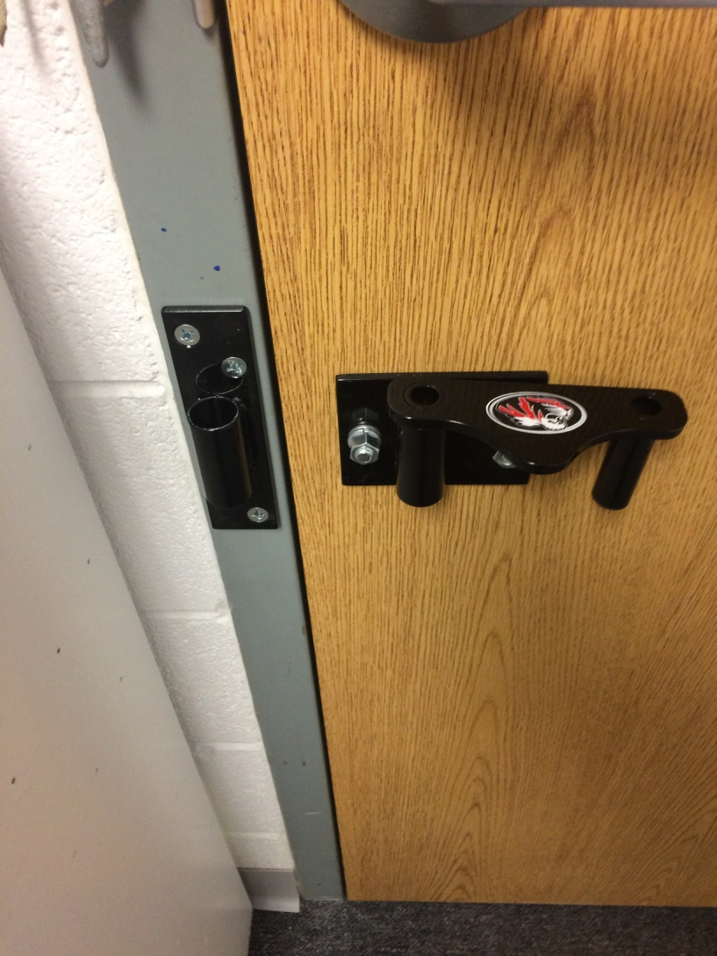
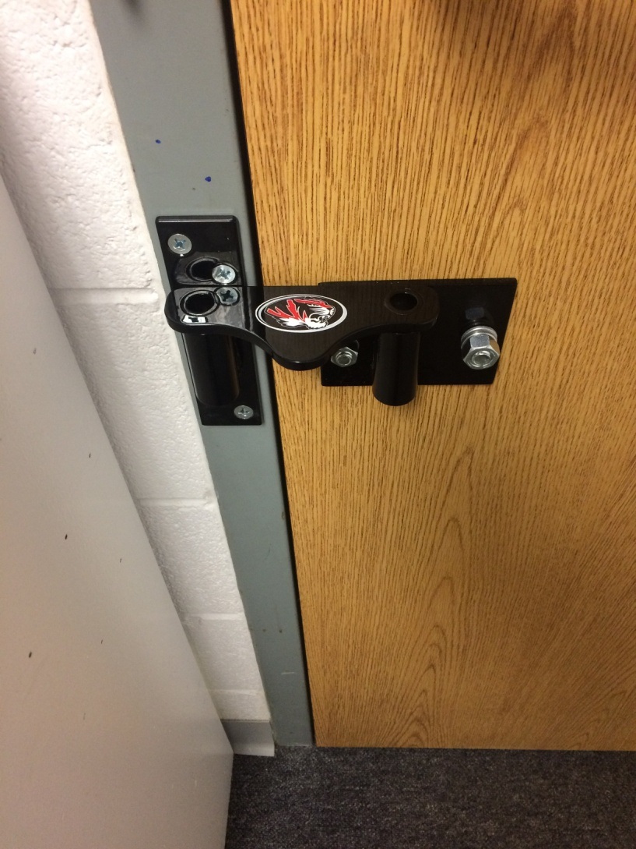
DK Safety Solutions Lock for doors that swing inward

Slide 8
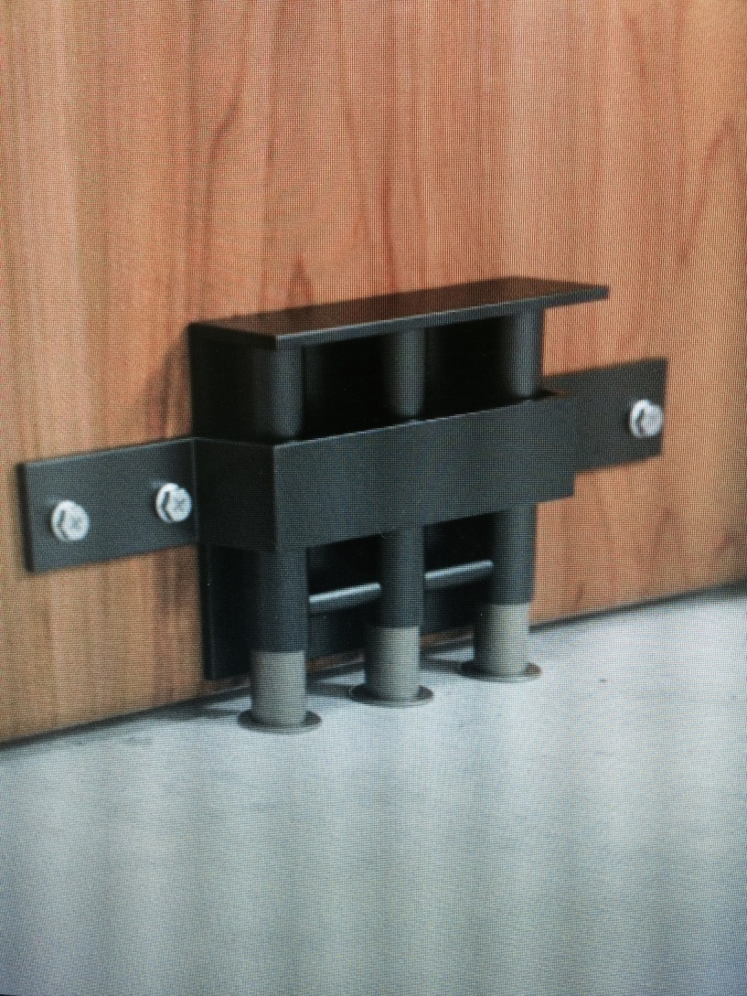
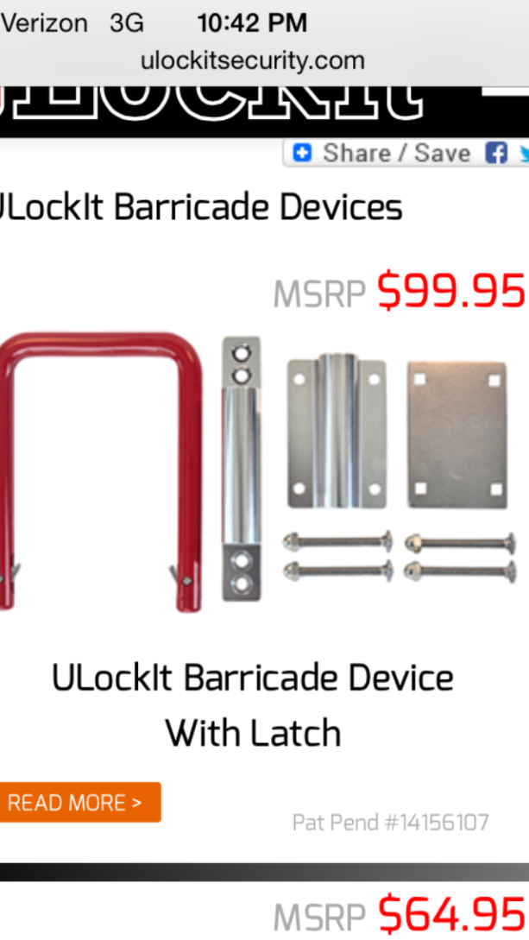
Other company’s devices

Slide 9
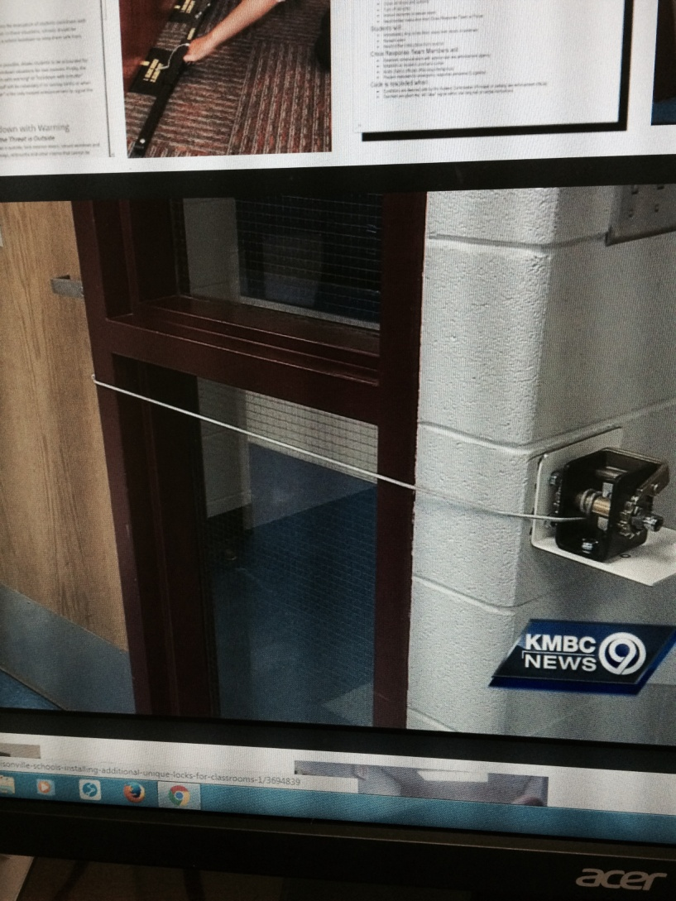
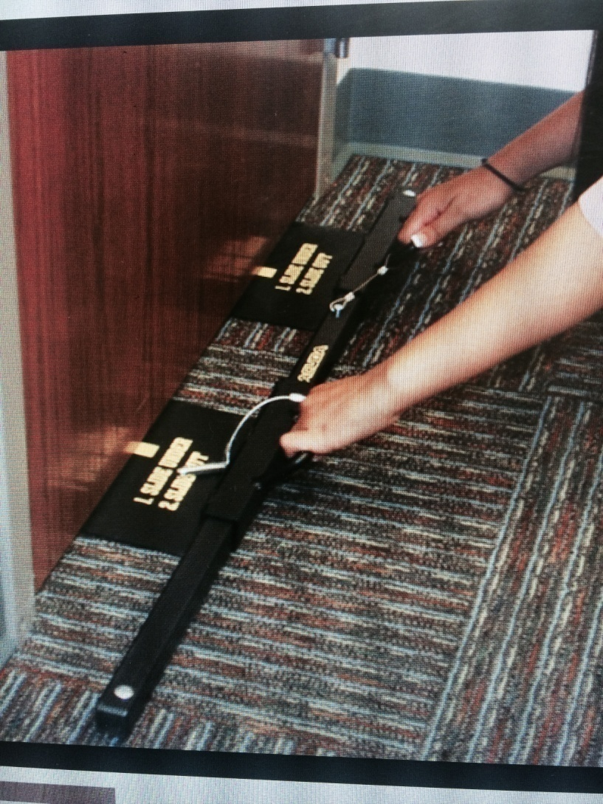
Other company’s devices over $120 per unit

Slide 10
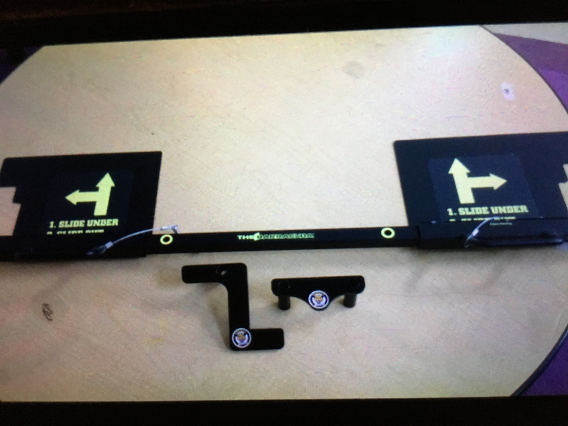
Z-Lock Size

Slide 11
Affordable
Other units are $100 plus per door
Z-Lock is only $40 with your school logo
In Swing and double door devices only $40
Any maintenance person can install or I can install for $10 a door.
One-time purchase
New Title IV money the federal government wants you to spend on school safety

Slide 12
Schools who have chose the “Z Lock” to protect their students
HICKORY COUNTY R-I, Urbana MO
HALFWAY, Halfway MO
PLEASANT HOPE, MO
FAIR PLAY, Fair Play MO
DADEVILLE, Dadeville MO
LAKELAND, Lakeland MO
FAIR GROVE, Fairgrove MO
BOLIVAR EPCO CENTER, Bolivar MO
DALLAS COUNTY R-I, Buffalo MO
NEVADA , Nevada MO
TURTLE LAKE SCHOOL DISTRICT, WISCONSIN
AWESOME ADVENTURE PRESCHOOL Joplin MO
KNOXVILLE CATHOLIC , KNOXVILLE TN
BLOOMFIELD R-XIV, Bloomfield Mo
GOOD NEWS BIBLE CHURCH, IOWA CITY, Iowa
BENNETT COMMUNITY SCHOOL DISTRICT, Bennett Iowa
HARTVILLE R-II, Hartville Mo
NEOSHO SCHOOL DISTRICT, Neosho Mo
HOLLISTER R-V, Hollister Mo
AVA SCHOOL DISTRICT, Ava MO
MACKS CREEK SCHOOL DISTRICT, Macks Creek Mo
ASH GROVE SCHOOL DISTRICT, Ashgrove Mo
SYMINGTON ELEMENTARY, Kansas City Mo
WHEATLAND R-II , Wheatland Mo
WEAUBLEAU R-III, Weaubleau, Mo
MOUNTANT VIEW BIRCH TREE R-III, Mountain View, Mo
CHARLOTTE PREP , Port Charlotte, Florida
FRIENDS SCHOOL MULLICA HILL, Moorestown, NJ
RICH HILL K-12, Rich Hill Mo
CRAWFORD COUNTY R-I, Bourbon Mo
HUGO SCHOOL DISTRICT, Hugo OK

Slide 13
School Administrator Feedback
“While we're aware no campus is ever 100% proof against violence ~ these locks have given our teachers, students, staff and community more peace of mind. These locks are now our teachers (or students) first responsibility to engage when it comes to securing our classrooms in the event we're in lockdown mode”. (Ore Pumariega, Knoxville Catholic HighSchool)

Slide 14
Feedback Continued
“Hello Jason! We unfortunately had to go into lock down at our preschool last week and we wanted to let you know that your locks are amazing. We have practiced our lock down drills with them, but having to use them in a real situation allowed my staff to feel safe and secure in their classrooms during a very frightening situation. THANK YOU!” (Ashlee Pahlow, Awesome Adventures Preschool, Joplin Mo)

Slide 15
“They are easy to install, simple to use and extremely secure. I think it's a great product. I have recommended them to several schools” (Chris Thompson , Ash Grove Principal)

