Slide 1
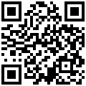
Student Problems? Us too!
Dr. Jennifer Davis
St. Clair High School
https://goo.gl/MDzkcP

Slide 2
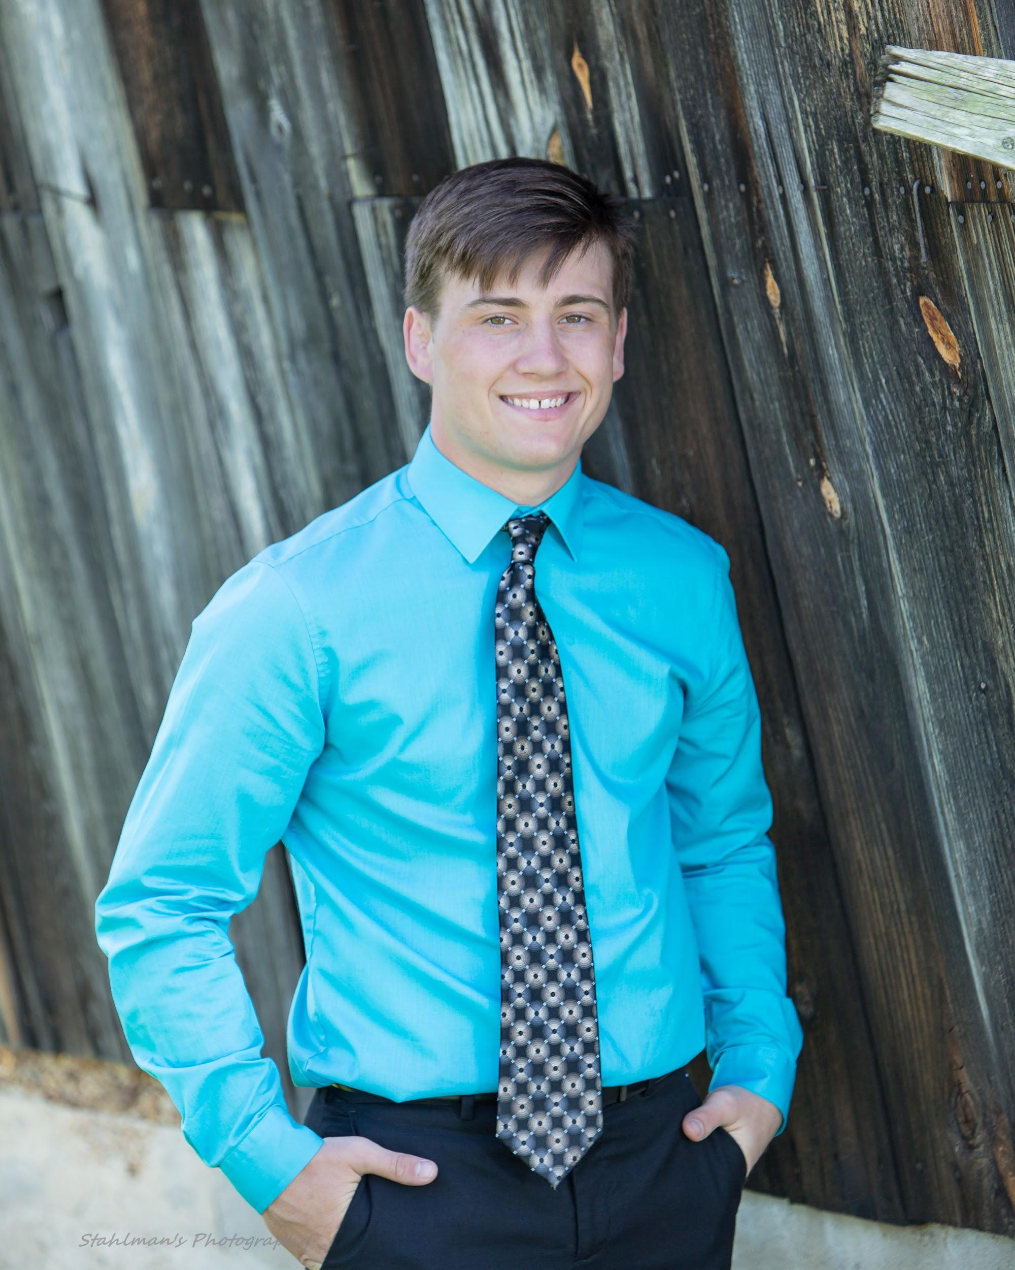
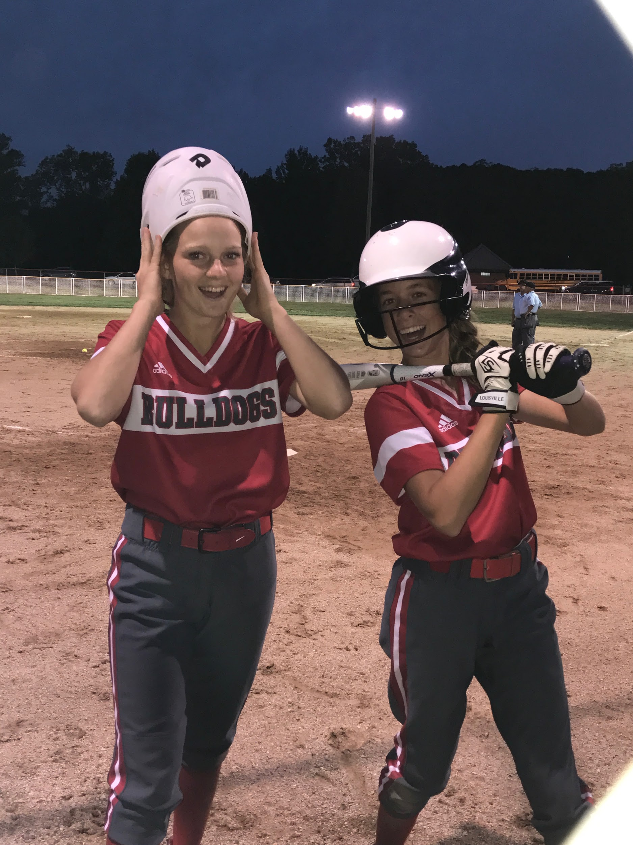

Slide 3
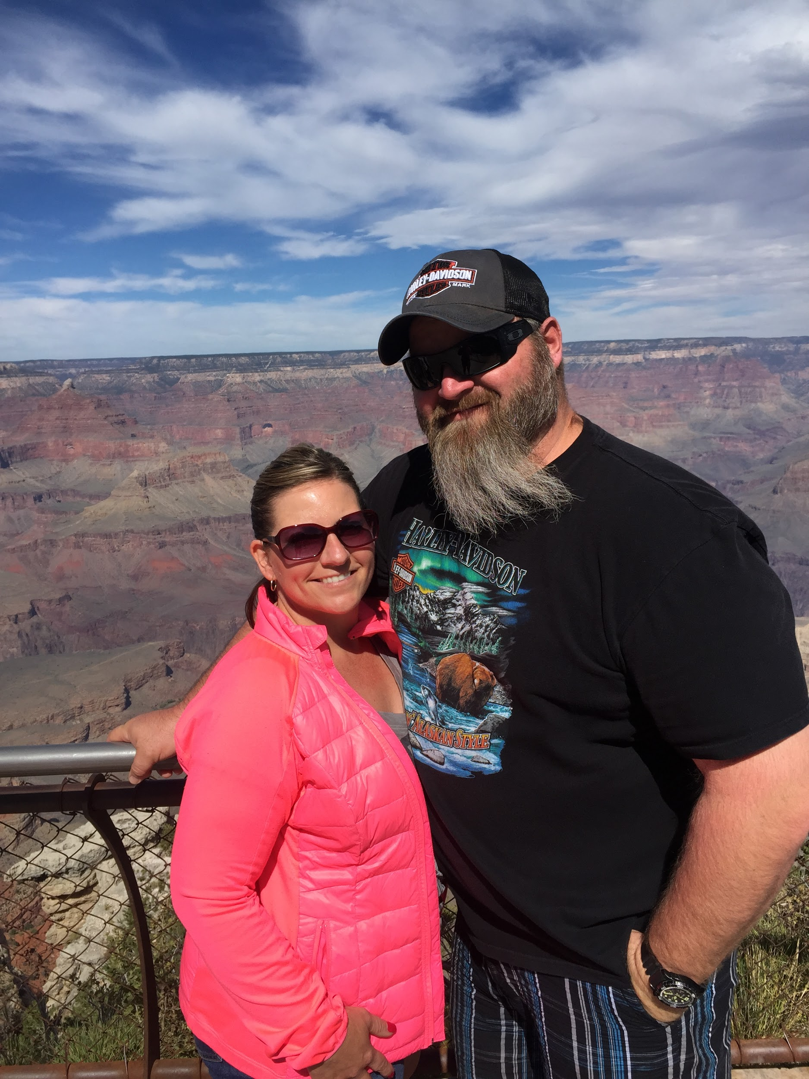
All About Me
SCHS Alum 91
Married 23 years
7th Grade ELA Teacher
Softball & BBall Coach
Elementary Assistant Principal
& Principal
Curriculum Director
High School Principal

Slide 4
Ghosts of Programs Past: Prior to FA 16
INL--Intentional Non-Learner list
Academic Lab
After School Tutoring
Intervention--blue passes=chaos
All had limited success but failed due to lack of follow through and the wrong people
ICU ties all these pieces together with our successful programs: Capturing Kids Hearts, Alternative Education and Teach Like a Champion--Inspect what you expect

Slide 5
Table Talk
What challenges do our teachers and principals face regarding classwork, homework, or practice?
Purpose?

Slide 6
Field Trip & Book Study
Review of Student Data Oct. 16
10/2016 54 students who are juniors with between 7-12 credits.
20% of these are Special Education Students
23 9th grd with 1 F
28 9th grd with MULTIPLE Fs.
7 of 9th are Special Ed=14% of 9th Fs
Established need for change
Definition of INSANITY?
Jackson Jr. High
ICU Book Study

Slide 7
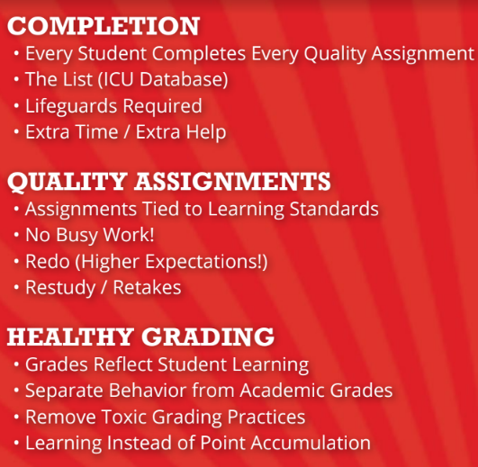

Slide 8
ICU Pilot
SP 17-Study Skills Classes
We changed HOW SCHS reacted to failing students.
We TRIED something new to SCHS while beginning to implement the ICU mentality.
NEW PLAN:
McDaniel & Codespoti teach at-risk class and Fs are recovered.
Three groups of 8 students, 7 10th, 1 11th, 16 9th.
At-risk class works on organization, planning, homework completion and credit recovery.
74% of Students saw success w/this intervention

Slide 10
ICU Approach
Combat Student Apathy & Quality Assignments
Create a System of Support
Lifeguard
ICU Database
BEST $$ I spend in BUDGET
Texts & emails parents
Tracks missing assignments
Sortable
All Staff Access
Advisories
Coaches
Sponsors
Secretaries
https://www.icudatabase.net/stclairhs/

Slide 11
WHY CHANGE?
Hard Data
Numbers Don’t Lie:

Slide 12
Summer School 2017
Identify the 36 students in 8th grade that pose the biggest risk of failing
Put 9 students a week in Summer School Program--Mr. Codespoti
Diagnostic tests in reading and math
Use USATestPrep to test Social Studies and Science
Meet their 9th grade teachers
Link leaders to introduce them to the students and the culture of the high school
Most important thing is make them feel welcome and comfortable in the high school and instill the high expectations of no missing assignments

Slide 13
2017/2018 ICU Roll Out in High School
9th grade students & teachers only
ICU list sorted by Advisory teachers and used to complete ICU work-if not complete, move to the ICU room
Example: we give students 1 day in Advisory (24 hours) to complete assignments
Access to ICU list is monitored by ALL staff and administrators
The more eyes on the list the better
Teachers, coaches, & club sponsors keep track of students and have consequences for being on the list chronically

Slide 14
ICU Room
Mr Codespoti runs the ICU room and ICU database
Paraprofessional in ICU room full time
Students on ICU List who do not get assignments done in Advisory are called to the ICU room for support until the assignment is done
When students complete assignments they return to class
Students who refuse to work, behave out, will move to ISS and will remain until willing to return to ICU and work
ICU eliminates the need for Study Skills classes and frees up staff to offer advanced programs in their field

Slide 15
ICU Missing Work Questions….
Remove the Emotion
What do you owe?
Who do you owe?
What do you need?
How can I help you?
Notes:
If Every Student Completed Every Assignment Every Day, how could that impact one classroom?
How might it impact an entire school?
District?

Slide 16
ISS: Party no More
ISS is consequence
Dedicated ISS teacher
ICU students only end up in ISS if they behave out of ICU (refuse to work)
Students do not return to class until they process through the ICU room
Mr Codespoti close contact w/ISS staff to ensure students complete assignments and understand behavior cause/effect
Administrators intervene for students who refuse to work
Behavior Chart
ISS Tiers

Slide 17
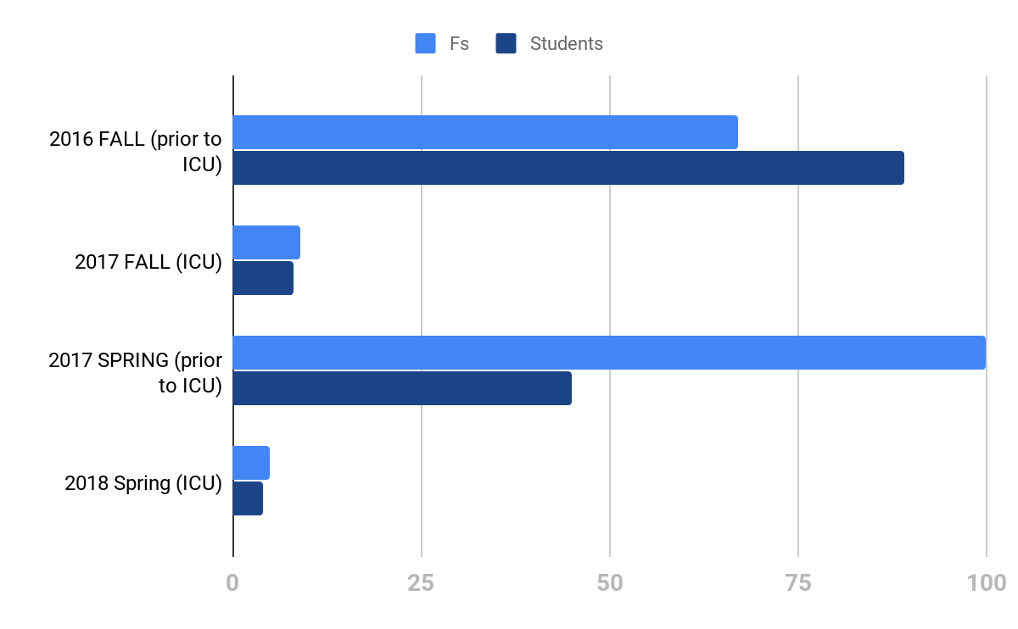

Slide 18
2018-2019 ICU PLAN
Train Entire Staff Aug. 13th
Add 10th Grade
Add Working Lunch
Place 9th Grade Time Bandits in ICU hour which is a proactive approach
Place 10th Grade Time Bandits in ICU hour
Lifeguard on duty from 7:15-4:00 daily
Fully utilize before & after school time

Slide 19
REAL TALK
Phase 1 ASSIGNMENT COMPLETION
Phase 2 QUALITY ASSIGNMENTS
BONUS: EXPOSES WEAKNESSES in the INSTRUCTIONAL PROGRAM

Slide 20
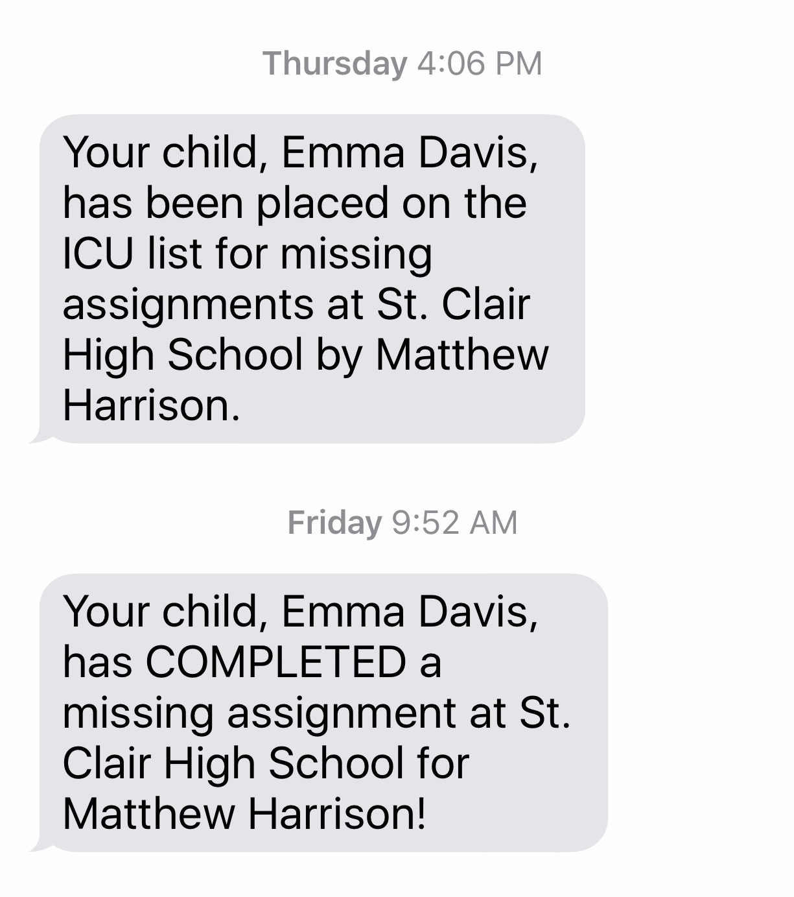
Text Example

Slide 21
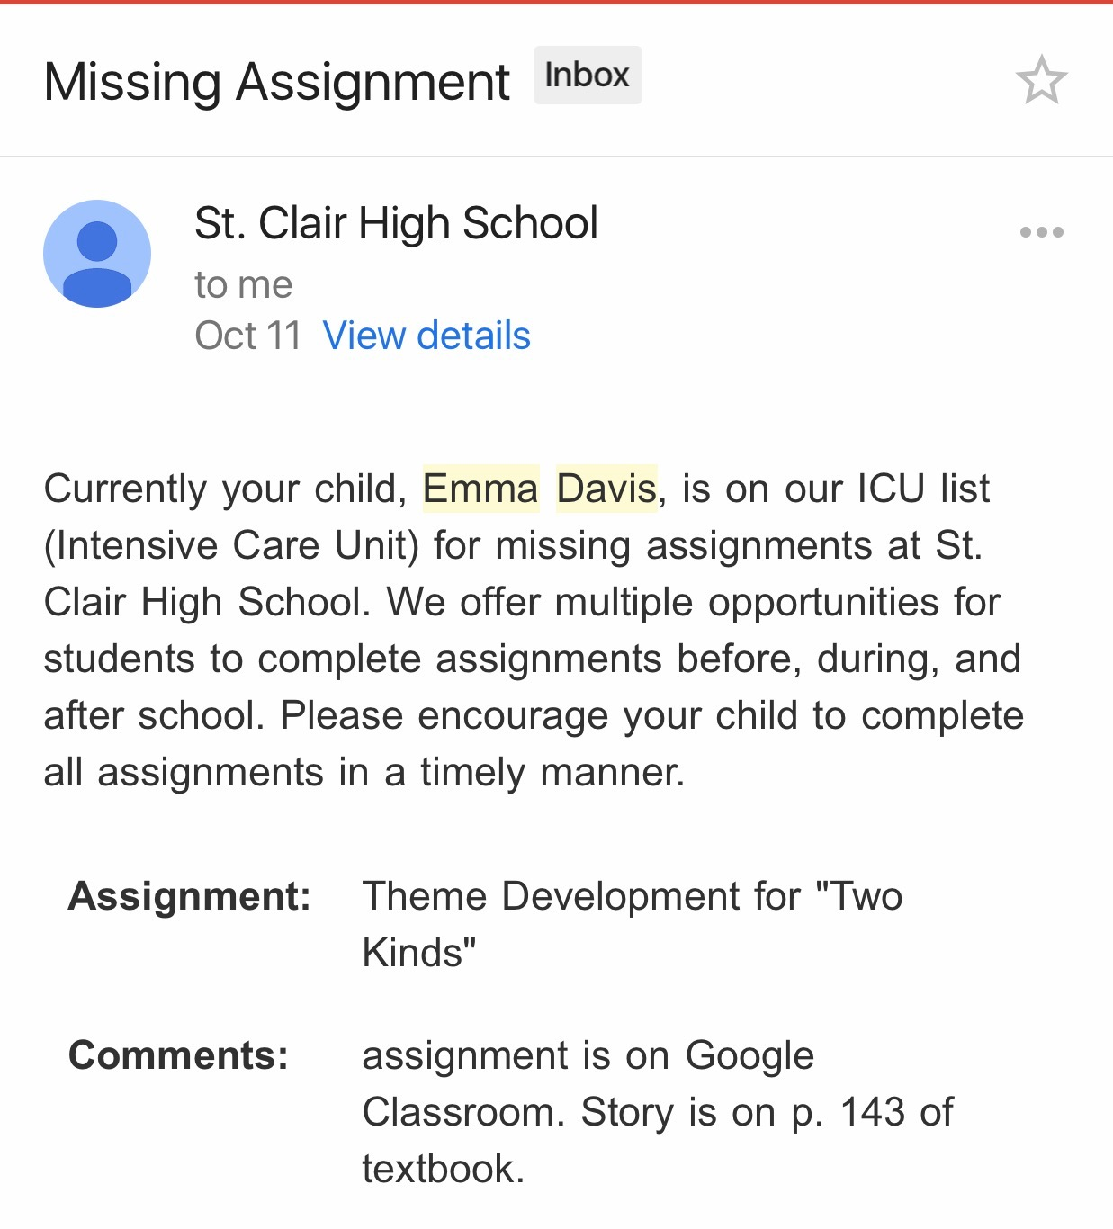
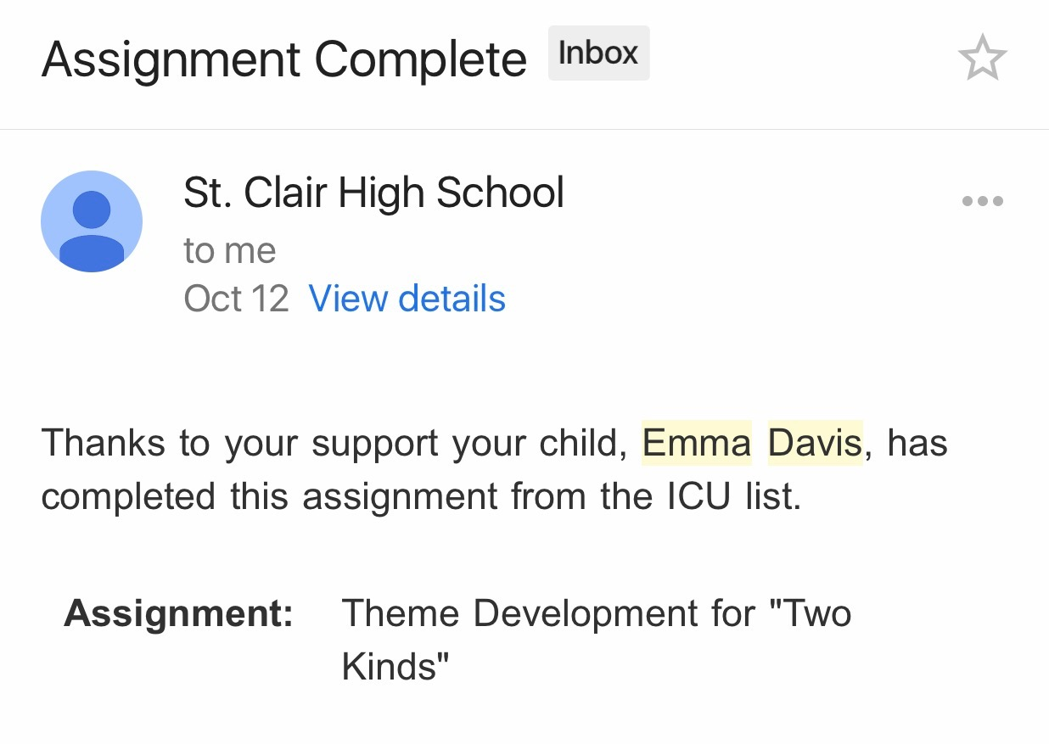

Slide 22
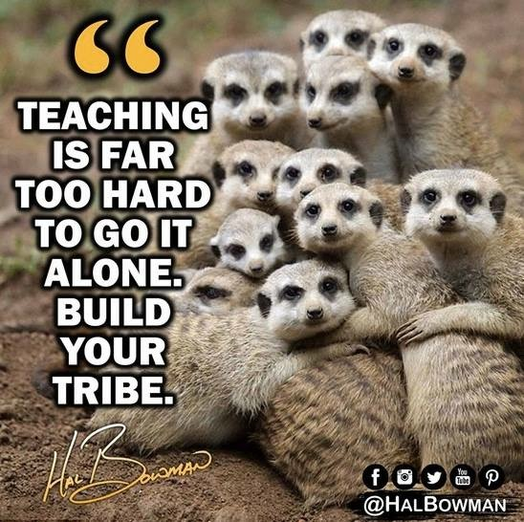
QUESTIONS?
Contact info:
Jenny Davis
jdavis@stcmo.org @StCR13Principal @POWERofICU

