Slide 1

Digital Leadership! Tips for Modern Schools
Invigorating Schools While Leading
https://tinyurl.com/emintsMARE

Slide 2

5 Major Practices...
Today we are going to discuss...5 major practices that we see principals, tech directors, trainers and/or teacher leaders doing to support change in education.
Notes:
Each year we provide training and online webinars to school administrators that are supporting technology integration in their schools. These are some of the major practices and trends we notice as we work alongside those that are invigorating their school through digital leadership!

Slide 3
What we believe
First, let’s have some “live” discussions about leading others…
Working with a small group, take a look at the prompt provided
Answer the discussion questions together
Rotate clockwise to the next prompt when instructed to do so

Slide 4
What we believe
So let’s dive deeper into these discussions and the 5 major practices that digital leaders do…..

Slide 5

Staying Connected (PLN Power)
Harnessing the Power of Professional Learning Networks
Notes:
Digital Leaders are Connected to other Professionals and actively share and receive information through those connections on social media.

Slide 6


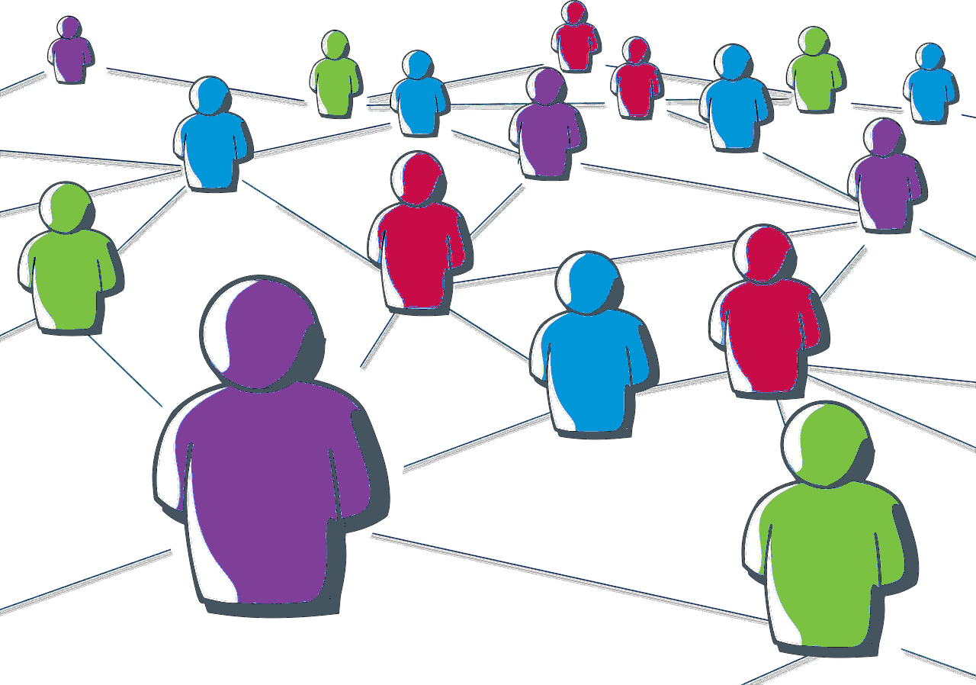


Harnessing the Power of Professional Learning Networks
Leading with Twitter
What is a PLN?
Edu Leaders to Follow
Edu Hashtags & Twitter Chats
Become a Twitter Rock Star
Why Every Leader Needs a PLN
Leading with Google +
Notes:
Connected Professionals create and maintain a PLN for sharing successes and locating best practices and other ideas from their peers.
Sylvia Duckworth infographic “The Connected Educator PLN = Professional Learning Network”

Slide 7
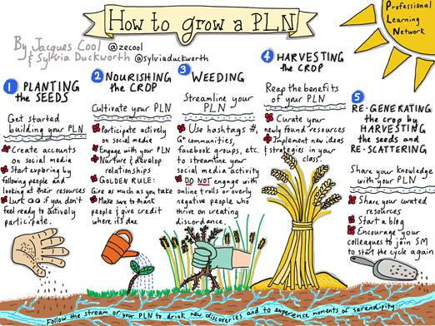

Slide 8
What advice do you have about PLNs?
I recommend that…
Look for these people to follow on social media….

Slide 9
2. Effective Communicators
Harnessing the Power of Digital Communication Tools
Notes:
Digital Leaders become Tech Savvy about something that they like or admire and use those tech tools to enhance relationships with patrons, teachers, and students.

Slide 10




2. Harnessing the Power of Digital Communication Tools
Do you Slide?
What’s up Doc?
Templates: Lesson Plans,
Essays, Reports, and more
Google Docs for Admin - 5 Ideas to Get Started / 5 More Ideas by Kyle B. Pace
Share - Connect - Create - Inspire
Top 10 Ways Blogs and Wordpress are Used in Schools
Top 100 High School Blogs, Websites and Newsletters to Follow in 2018
Keep it Real!
Notes:
Tech Savvy Admins use powerful learning tools like Slides, Docs, Keep, and Chrome Apps/Extensions in staff meetings and communications modeling to teachers and students those same tools and practices.
(See more here:) http://www.shakeuplearning.com/blog/20-google-chrome-apps-and-extensions-for-school-leaders/

Slide 11



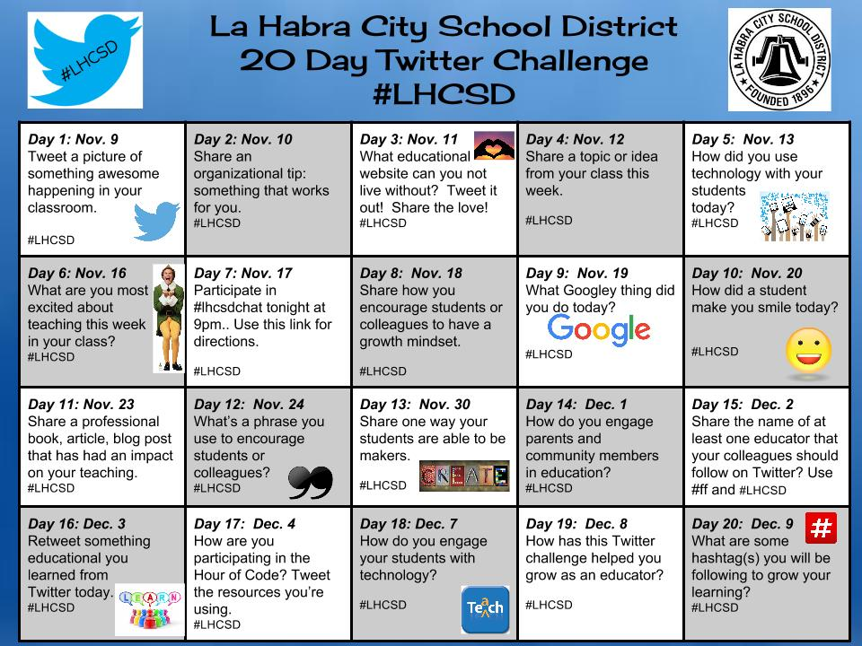

2. Harnessing the Power of Digital Communication Tools
Facebook Feeds
Twitter Challenges
Telling & Sharing Your Story
Parent Engagement in the Digital Age
8 Ways Teachers and Schools can Communicate with Parents in 2018
Notes:
Communication Gurus follow other national and regional examples, use school twitter feeds, school twitter challenges, and communicate information using digital tools like facebook, websites, blogs, or whatever gets the job done!
Example of a Tweet Challenge: eMINTS Tweet Week 2018!

Slide 12


Slide 13
What are some ways we can improve school communications?

Slide 14
3. Inspiring Innovations
Harnessing the Power of Innovative Leadership
Notes:
Digital Leaders help Lead Others by choosing activities, technology tools, and PD practices that allow for innovation .

Slide 15

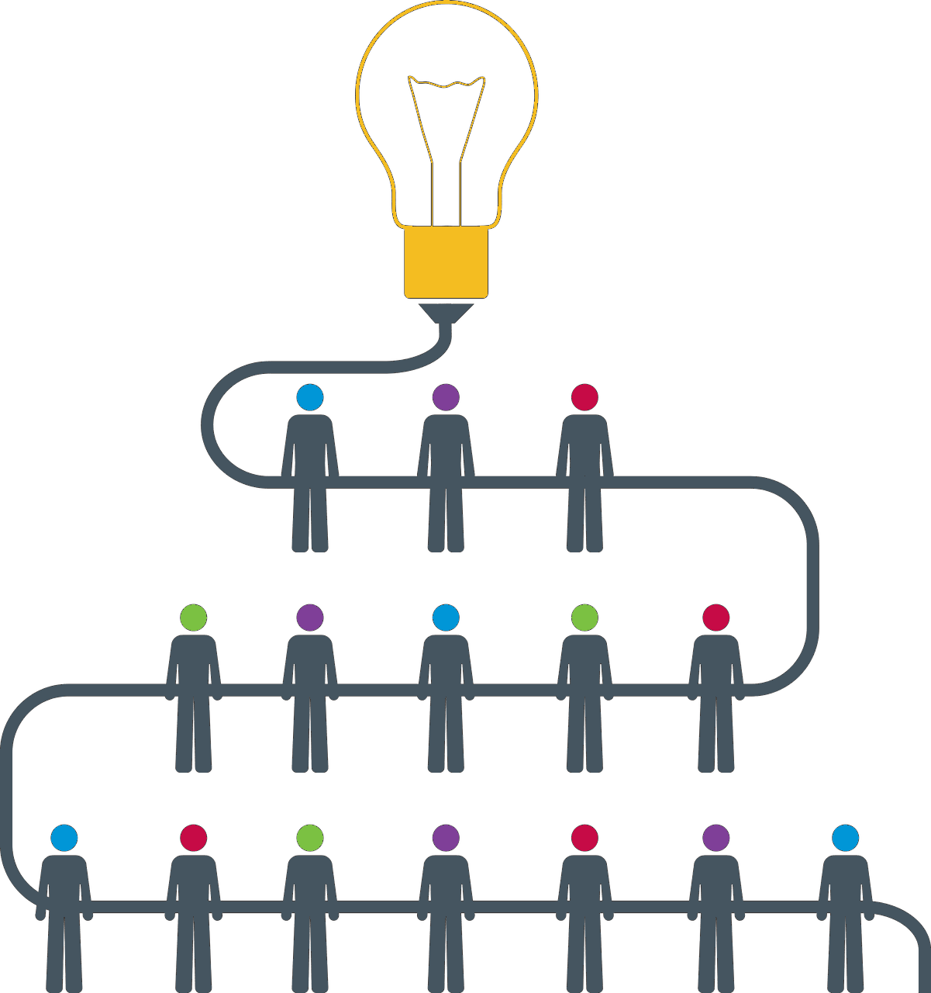



3. Harnessing the Power of Innovative Leadership
“Innovation distinguishes between a leader and a follower.”
Steve Jobs
Embracing an Innovative Mindset
eMINTS Tools
Innovative Leadership
What makes an Innovative School Leader?
18 Things Leaders of Innovative Schools Do Differently

Slide 16
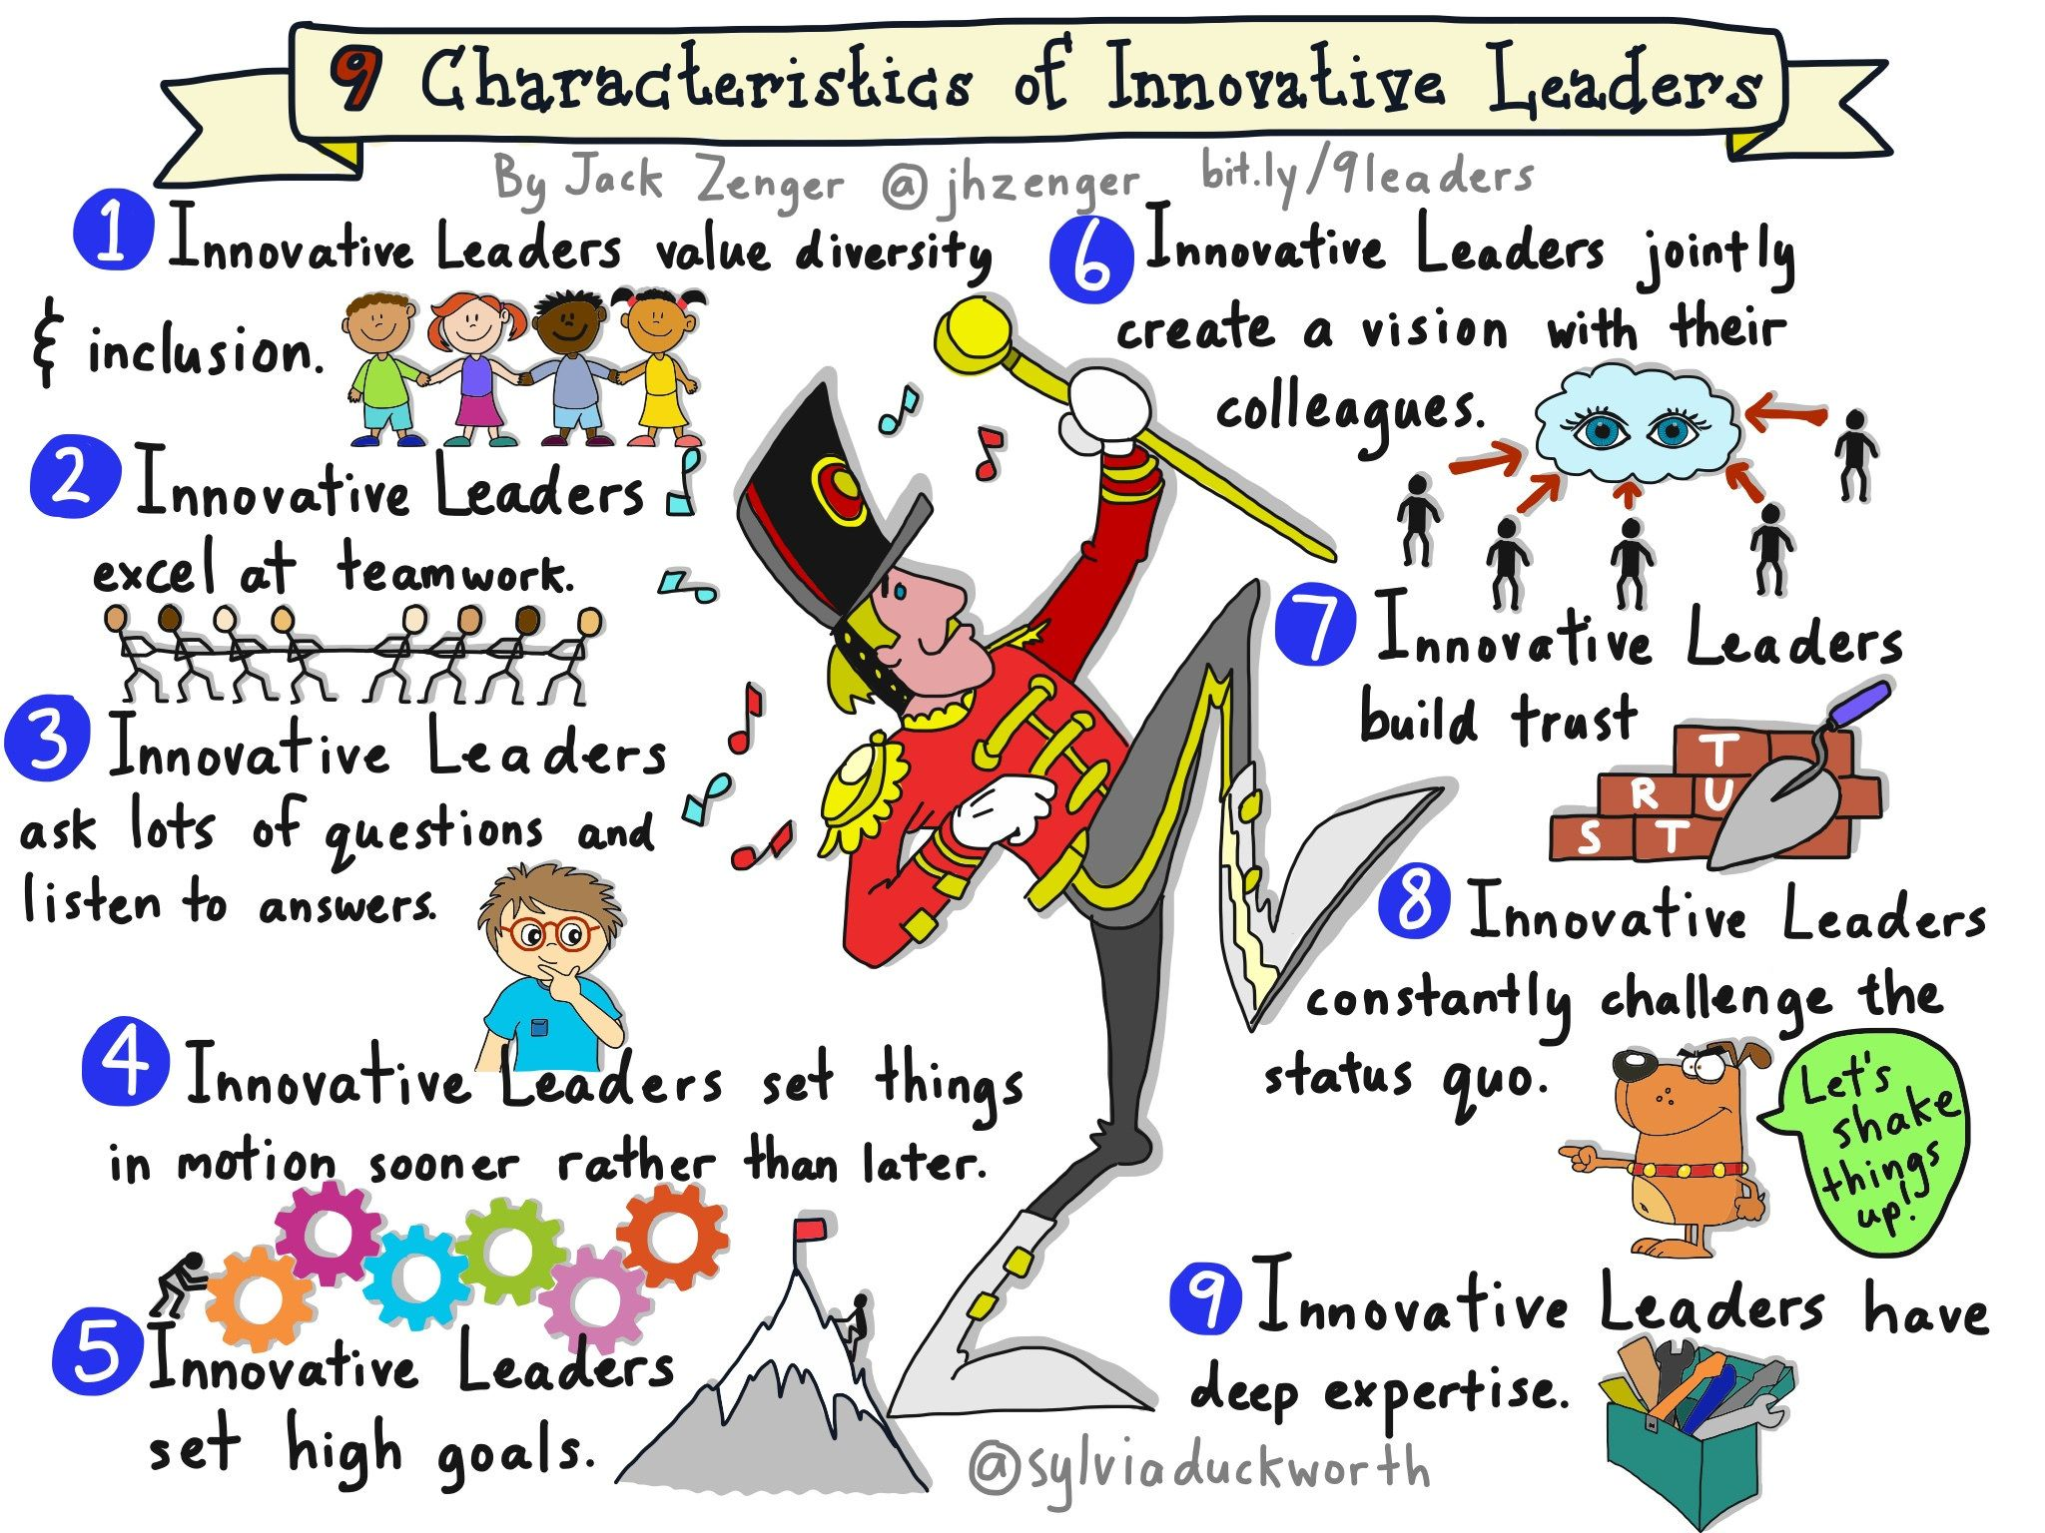

Slide 17
How can school leaders encourage innovation?

Slide 18
4. Supporting Needs
Harnessing the Power of Culture, Support, and Collaboration to meet the needs of teachers
Notes:
Digital Leaders help define Vision. They do this by first, understanding the needs of their teachers.

Slide 19


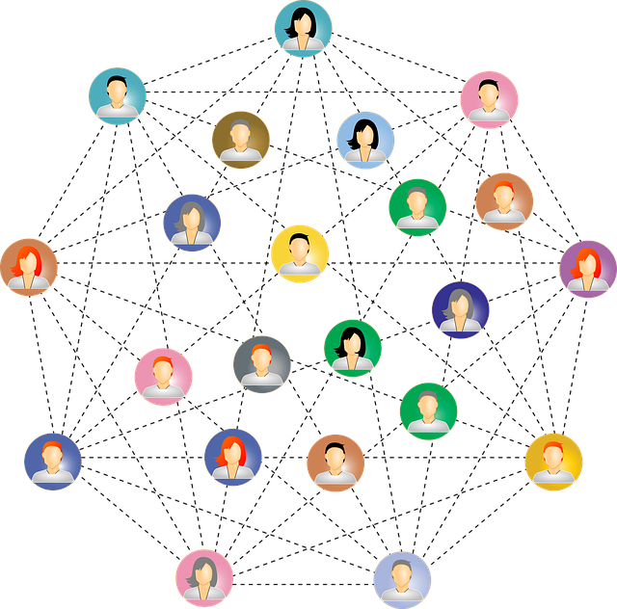

4. Harnessing the Power of Culture, Support & Collaboration
Creating Positive School Culture
Embrace Teacher Leaders
5 Ways Education Leaders Can Support Teachers
Building a School Culture that Supports Teacher Leadership
Collaboration
How we know collaboration works
Assessing Your
Learning Needs

Slide 20
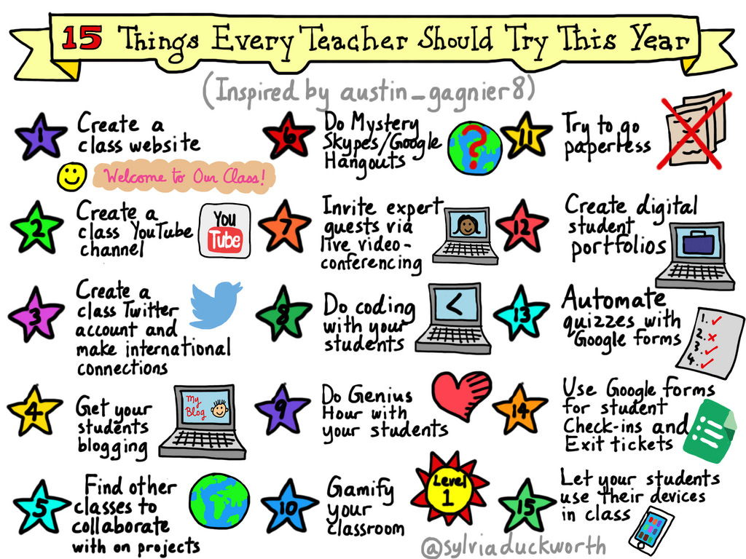

Slide 21
What new things are your teachers learning? trying?

Slide 22
5. Define and Focus Vision
Harnessing the Power of Missions, Vision, and Values for Tech in Your School
Notes:
Digital Leaders help define Vision. They then help communicate and model that vision in their school activities.

Slide 23
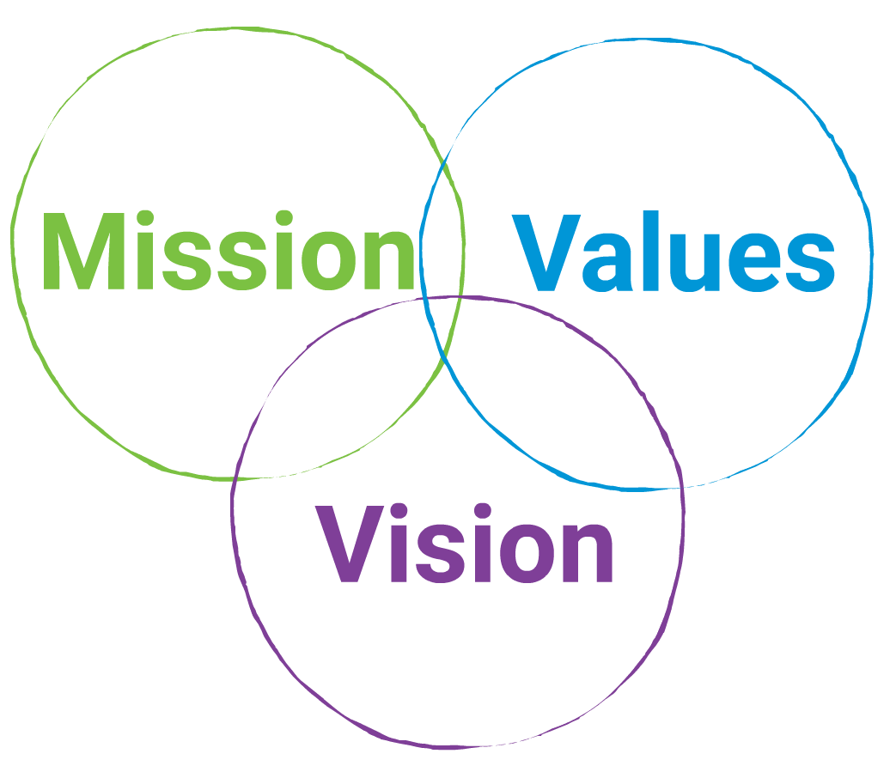

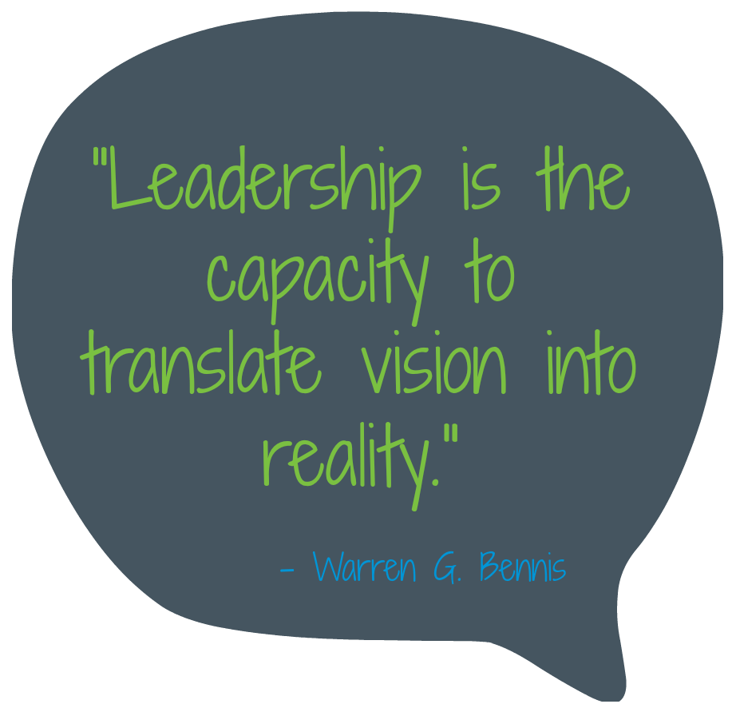

5. Missions, Vision, and Values for Tech in Your School
Visions
Standards
“One of the most important responsibilities of any leader is establishing a vision and inviting others to share in its development.” - John G. Gabriel and Paul C. Farmer
The ISTE Standards for Educational Leaders provide a framework for guiding digital aged learning and target the knowledge and behaviors required for leaders to empower teachers and make student learning possible.
Identifying Needs
More Resources
8 Ways to Establish a Shared Vision
Developing Mission and Vision Statements
From Vision to Action: Developing your school’s core purpose
Communicating the Mission
Notes:
Visionary Digital Leaders understand the tools that support school visions, standards, needs and missions.

Slide 24
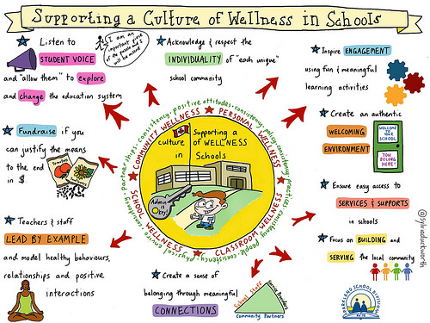

Slide 25
What is your best advice for maintaining a vision?

Slide 26
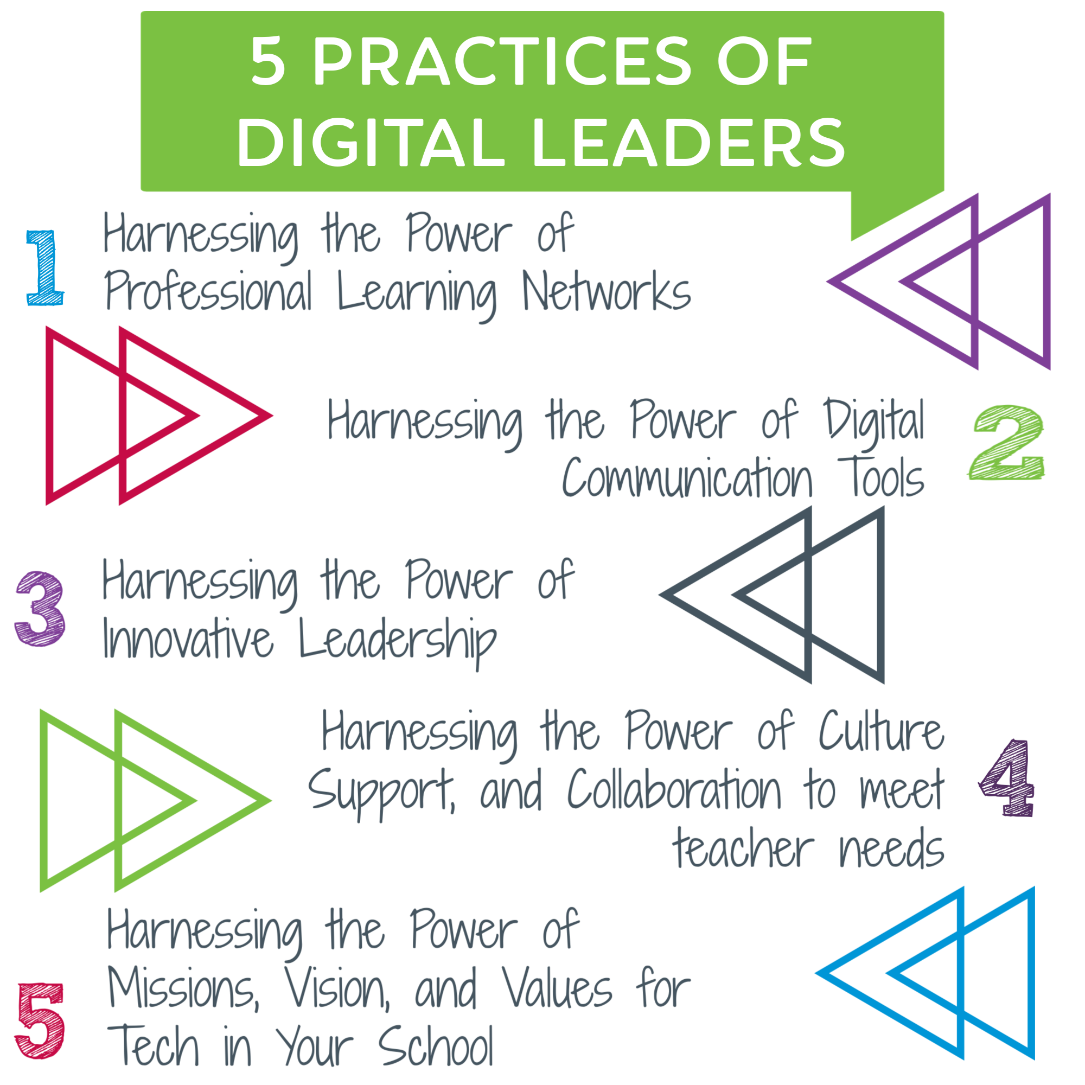

Slide 27

What is your best advice for digital leaders?
Tweet it out!!
Use a hashtag:
  #MAREconference
  #emints
  #emints4admin
  #leadup
  #moedchat
Notes:
By Tweeting out with these hashtags, we will be able to find and follow you:)!!

Slide 28
Who are We?
Doug Caldwell
caldwell@emints.org
Skype: dougemints
Phone: (417) 650-0054
Twitter: @dougemints
Cara Wylie
wyliec@emints.org
Skype: carawylie
Phone: (633) 357-5358
Twitter: @wyliec

