Slide 1
Compliance concerns for health and welfare plans
Fall 2018
Presented by | Gail Floyd www.usi.com

Slide 2
Today’s Agenda
ACA Update
Common Compliance Concerns for Group Health Plans

Slide 3
ACA Update

Slide 4
Latest on ACA
Individual mandate $0 as of 1/1/19
Health Insurer Fee $0 for 2019 (then back in 2020)
One or two more years of PCOR fee, depending on plan year
Employers receiving Letters 226J with Employer Penalty assessments
Cadillac Plan Tax delayed to 1/1/2022
Tax credit available for paying for family/medical leave when not otherwise paid such as due to PTO, 2018-2019
ADA/GINA rules expire 12/31/18
Trend of states, etc. passing paid leave laws
Leave administrator recommended
Association plan rules a bit looser, but still state MEWA issues

Slide 5
Future Bills to Watch
Provide retroactive relief from the Employer Penalty for 2015-2018
Further delay of Cadillac Plan Tax from 2022 to 2023
Offer more flexibility for HSAs
Allow patients to carry over any remaining balance in their FSAs to the next year
Allow individuals to receive tax relief for taking steps to better their general health, such as by signing up for gym membership or exercise class

Slide 6
Major Compliance Concerns for Group Health Plans

Slide 7
Eligibility Requirements
Eligibility should be spelled out in SPD
Generally only employers under common control (at least 80% common ownership interest) can participate under a single health and welfare plan
Beware of covering independent contractors or board members who are not current/former employees
Identify any measurement method used to determine ACA FTEs in coordination with health plan eligibility
Helpful Hints:
Spouse means same and opposite sex
Children must be covered up to age 26
If offering coverage to non-tax dependents (e.g., domestic partner) there are imputed income considerations
Don’t take into account Medicare or Medicaid eligibility – benefits generally must be provided on the same basis

Slide 8
Summary Plan Description
Primary source of plan information for participants and beneficiaries
Written for average participant in a manner to sufficiently inform individuals of their benefits, rights, and obligations under the plan
Includes some required notices (e.g., Newborn’s notice, QMCSO procedures)
Carrier contracts and booklets are not usually “enough” to create a sufficient SPD
Failure to furnish a copy upon request from participant may subject plan administrator to penalty of up to $110/day
A foreign language notice on the first page of the SPD must be included when there are at least 100 participants and the lesser of 500 or 10% are literate in the same non-English language

Slide 9
Section 125 Plan Document
Employers must have a written cafeteria plan document in place in order to allow employees to make pre-tax elections to pay for their share of benefits
Describes available benefits, election procedures, participation rules
Only employees may participate in a cafeteria plan (not “self-employed,” e.g., partners, 2% shareholders in S-Corp, members of LLC)
A health FSA and/or dependent care FSA may be included as qualified benefits under the cafeteria plan
Failure to maintain Section 125 plan document can result in gross income for employees
Should include permitted election changes – opportunities to change irrevocable pre-tax elections during the plan year

Slide 10
Employee Handbook and Leaves of Absence
Usually outlines policies and procedures of the employer
May include specific benefit related information
Include language on leave policies (including FMLA, state and/or city requirements)
General Notice of FMLA rights must be included in handbook
FMLA applies to private employers with at least 50 or more employees
Important to address how both FMLA and non-FMLA leave will impact group health plan benefits
Make sure insurer/stop-loss carrier is on board
Having no policy is really bad policy!

Slide 11
Wellness Program Disclosures
HIPAA Health Contingent Notice
Notice that describes the availability of alternatives to achieve any reward
Must be included with information describing the wellness program
Failure to comply could trigger penalties of $100/day/individual affected
ADA Notice
Required if employer incentivizes medical exams and/or disability-related inquiries (e.g., physicals, risk assessments, biometric screening)
Provide before employees provide health information and give enough time to decide whether to participate in the program
Failure to comply could trigger EEOC enforcement action

Slide 12
Form 5500
Form 5500
For plans with at least 100 participants on the first day of the plan year
Due no later than 7 months from the close of the plan year (7/31 for calendar year plan)
Electronically filed (EFAST)
Extension available (up to 10/15 for calendar year plan, if extension filed by 7/31)
Failure to file timely 5500 can trigger penalties of up to $2,140 per day from the due date of the filing
Delinquent filing program available to minimize penalties for un-filed returns

Slide 13
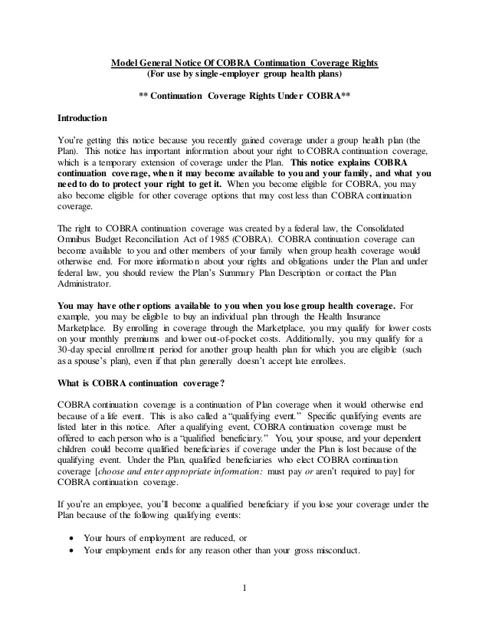
Initial COBRA Notice
Provide within 90 days of enrollment
Must be provided to employees and spouses
If a spouse is later enrolled, the initial COBRA notice must be sent at that time
Failure to provide may subject plan administrator to a penalty of up to $110 per day
Model notice available

Slide 14
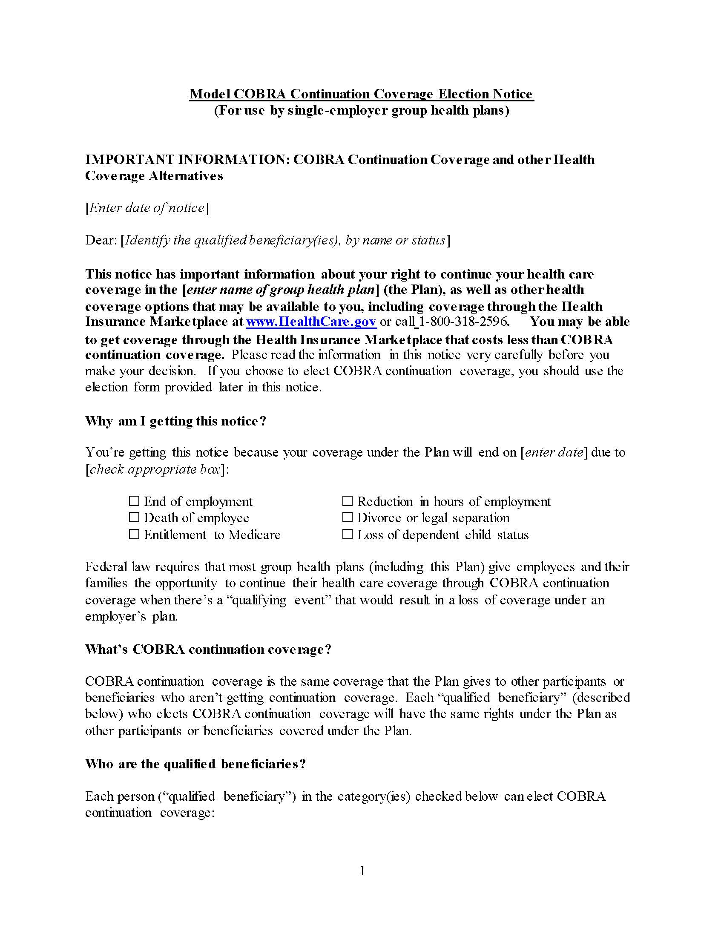
COBRA Election Notice
Provide within 44 days of loss of health coverage or qualifying event
Notice must be provided to all qualified beneficiaries

Slide 15
Other COBRA Notices
Do you know the benefits subject to COBRA?
Do you have a vendor? That will help!
Early termination notice
Unavailability of continuation notice
Conversion notice (if applicable)

Slide 16
Mental Health Parity Notices
Participants are entitled to receive criteria for medical necessity determinations
Must be provided upon request

Slide 17
HIPAA Privacy, Security & Breach
Self-insured health plan must establish HIPAA privacy and security policies and procedures:
Assign a privacy officer and a security officer
Conduct a risk analysis
Implement procedures regarding the use and disclosure of PHI
Self-insured plans should provide a HIPAA notice of privacy practices
Training of workforce who handle PHI
Keep records, including employee requests for disclosed PHI, for at least 6 years
Implement business associate agreements with third parties who have access to PHI
Have appropriate safeguards in place to protect against breach
Self-insured group health plans should have TPAs capable of complying with EDI requirements (including EFT remittance to providers)
Ongoing HIPAA training of internal policies and procedures and specific requirements

Slide 18
Secondary Payer Rules
Generally, the group health plan of the employer is primary to any covered employee’s (or the covered family member’s) Medicare coverage
Employer and group health plan cannot take into account Medicare status of employees
Don’t exclude Medicare eligible
Don’t pay for supplemental policies on behalf of Medicare eligible
Don’t “bonus” Medicare individuals who do not enroll in the group health plan
Penalties for noncompliance may include:
Excise tax equal to 25% of GHP expenses
GHP reimburse Medicare for up to twice the amount of improper payment
Potential ERISA §510 suit

Slide 19
Gail Floyd
Regional Employee Benefits Counsel | USI Midwest
Gail.Floyd@usi.com
This presentation contains confidential & proprietary information of USI Insurance Services and may not be copied, reproduced, and/or transmitted without the express written consent of USI. The information contained herein is for general information purposes only and should not be considered legal, tax, or accounting advice. Any estimates are illustrative given data limitation, may not be cumulative, and are subject to change based on carrier underwriting.
The information in this presentation was current as of September 1, 2018.
© 2018 USI Insurance Services. All rights reserved.

