Slide 1
Missouri Association of
Rural Education
General Session
Duane Martin & Emily Omohundro

Slide 2
Salary and Benefits Committees Under 1413

Slide 3
Bargaining before August 28th
All employees have a right to bargain collectively under Art. I, Section 29 of Missouri Constitution
Non-teacher employees have limited rights under the Public Sector Labor Law
Teachers have a constitutional right to bargain, but no statutory framework for certification or negotiations

Slide 4
HB 1413: Key Concepts
Definition of a “Labor Organization”
Requirements for “Labor Organizations”
Dues to “Labor Organizations”
Rules for Exclusive Bargaining Representatives
Certification, Recertification and Decertification
Rules for Negotiations
Mandatory Provisions for a CBA
Ratification
Impasse

Slide 5
“Labor Organization”
”any organization, agency, or public employee representation committee or plan, in which public employees participate and that exists for the purpose, in whole or in part, of dealing with a public body or public bodies concerning collective bargaining, grievances, labor disputes, wages, rates of pay, hours of employment, or conditions of work;”

Slide 6
“Labor Organization”
HB 1413
National Labor Relations Act
”Any organization, agency, or public employee representation committee or plan, in which public employees participate and that exists for the purpose, in whole or in part, of dealing with a public body or public bodies concerning collective bargaining, grievances, labor disputes, wages, rates of pay, hours of employment, or conditions of work.”
“Any organization of any kind, or any agency or employee representation committee or plan, in which employees participate and which exists for the purpose, in whole or in part, of dealing with employers concerning grievances, labor disputes, wages, rates of pay, hours of employment, or conditions of work.”

Slide 7
Factors Demonstrating Employee Committee is Not a “Labor Organization”
Employee representatives are selected by administration, not by employees.
Employee representatives are selected on a rotational basis allowing for greater participation of individual employees.
Representatives are not selected based upon affiliation with a particular association (MSTA, MNEA, etc.)
No stated purpose, in whole or in part, of “dealing” with employer—merely an opportunity for communication of ideas.
“Dealing” is broader than traditional collective bargaining.
Employees from committee do not make proposals to administration or board regarding salary or working conditions.
No formal organization (constitution, bylaws, etc.) associated with the committee.
No “anti-union animus” by the administration or board—no attempt to thwart union organization.
The committee does not have any decision making authority.
If all these factors are present, the committee will not likely be considered a “labor organization” under the law.

Slide 8
Requirements of Labor Organizations
Constitution and bylaws
Filings required with Missouri DOLIR
Annual Financial Report
Each officer and non-clerical/custodial employee of the labor organization must file a financial disclosure report with DOLIR
Considered an open record

Slide 9
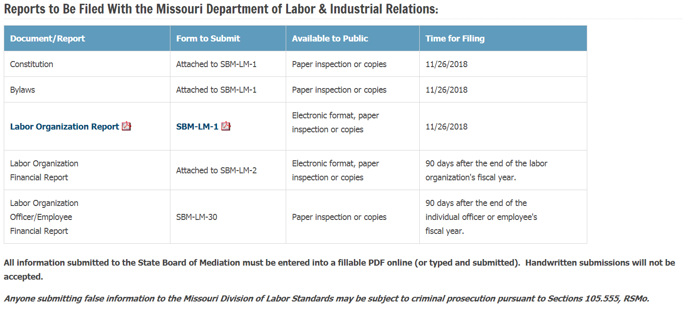

Slide 10
DOLIR Website

Slide 11
Penalties for Failure to Comply with Filing Requirements for “Labor Organizations”
Any person who fails to file a report required by sections 105.533 to 105.55, or files a report late, shall be subject to a fine of one hundred dollars for every day the report is late. RSMo Section 105.555(4).

Slide 12
Navigating Virtual Education

Slide 13
Notice about Virtual Course Options
Include in parent handbook
Print on registration documents
Feature in online enrollment screen
Feature on “home page” of district website

Slide 14
Student Eligibility
Student must be enrolled “full-time”
K – 12
Under age 21
Must have attended a MO public school the previous semester
Documented medical/pysch condition exception
Pre-approval by district is required

Slide 15
Enrollment and Denial
Policy must outline enrollment process
Enrollment process must be “substantially similar” to regular enrollment
Denial must be for “good cause”
Appeal process to the Board and then to DESE

Slide 16
Enrollment and Denial
What is “good cause”?
“not in the best educational interest of the student”
Could be student-related
Could be course-related
What the law doesn’t tell us
What if we already offer the course?
What if we have a preferred provider?
What if there is an EOC for the course?
What if this leads to class size reduction?
What if we cannot afford to have live classes plus virtual classes?

Slide 17
We Currently Have a Provider. Now What?
Courses currently offered by district that meet RSMO 162.1250 requirements automatically approved as providers (12 factors)
“Subject to renewal” … ?

Slide 18
Lehmann v. Fox C-6 Update

Slide 19
Case History
Teacher termination as a result of violations of board policies by the teacher
Teacher challenged validity of board policies
RSMO 171.011 requires board policies to be signed by order of the Board
Judge Green: Policies were not valid due to noncompliance with the language of the statute

Slide 20
Court of Appeals Reverse’s Judge Green’s Decision
District had not technically complied with the statutory requirement
District had “substantially complied” with the requirement
Substantial compliance is legally sufficient
Judge Green erroneously shifted the burden of proof from the teacher to the District
Burden to prove that adoption of the rule was not in substantial compliance lies with party making that claim, according to precedent

Slide 21
Reporting and Addressing
Student to Student Sexual Misconduct

Slide 22
Reporting
Determine whether there is reasonable cause to suspect abuse
Hotline
Determine whether a crime has possibly occurred
Contact law enforcement
Consider encouraging student/parents to report to law enforcement

Slide 23
Reporting (continued)
Determine whether sexual harassment has possibly occurred
Report the matter to the compliance officer
Determine whether the conduct may be considered “bullying”
Report to the anti-bullying coordinator
Continue to review the matter from a student discipline perspective
Communication plan with parents of students

Slide 24
Next Steps
Conduct disciplinary investigation:
On District property or transportation?
District event/function?
Sufficient nexus to the school environment?

Slide 25
Next Steps (continued)
Conduct Title IX/sexual harassment investigation
If no connection to the school environment, consider whether this is required
Implement interim measures if appropriate
Safety plans for students involved
Make findings and complete report and notifications
Implement remedial action
Complete bullying report, if applicable
Coordinate appropriately with law enforcement/Children’s Division efforts
Communicate with students and parents

Slide 26
Changes to the School Environment: What is Appropriate?
Disciplinary action
Safety plans and their components
Passing periods
Lunch periods
Before and after school
Transportation
District events/activities
Supervision plans
Dealing with orders of protection
Scheduling check-ins with students and parents

Slide 27
Taking Proactive Measures: Staff Training
Supervision
Harassment/discrimination training
Compliance with safety plans

Slide 28
Taking Proactive Measures: Student Education
Appropriate interactions
Being a good digital citizen
Reporting inappropriate conduct
Available resources and support

Slide 29
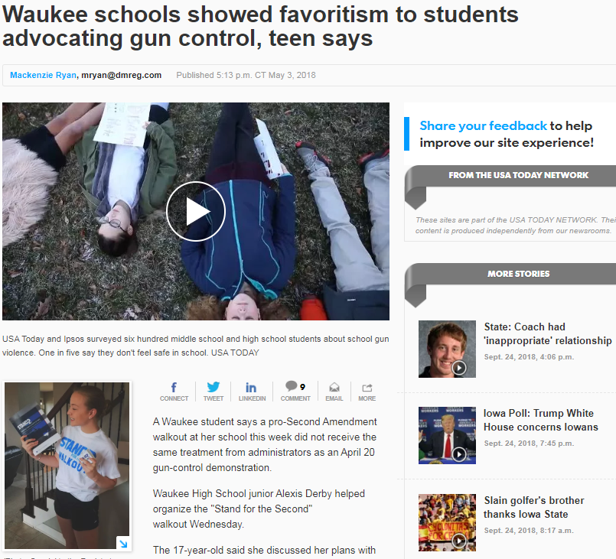
Student First Amendment Free Speech: Student Walkouts
Notes:
Talk about safety plan here; speaking to people involved to prevent retaliation

Slide 30
Student First Amendment Free Speech: Student Walkouts
ACLU sued Shawnee Mission School District regarding issues arising out of April 20th student protests.
The ACLU alleges that the speech was not school-sponsored, and therefore, the school could not in any way restrict the use of language about “guns” or “gun violence” during the walkout
Student organizers and the administration had agreed prior to the event that no such language would be permitted.
The 17-minute, student-led and district-permitted walkout marked the death of 17 students and teachers in February at Marjory Stoneman Douglas High School in Parkland, Florida.
Notes:
Talk about safety plan here; speaking to people involved to prevent retaliation

Slide 31
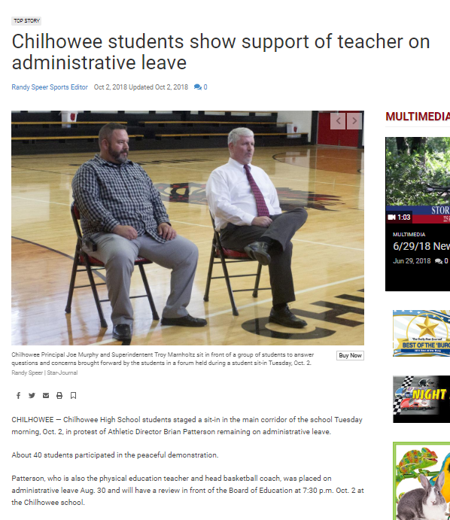
Chilhowee Sit-In
CHILHOWEE — Chilhowee High School students staged a sit-in in the main corridor of the school Tuesday morning, Oct. 2, in protest of Athletic Director Brian Patterson remaining on administrative leave.
About 40 students participated in the peaceful demonstration.
Patterson, who is also the physical education teacher and head basketball coach, was placed on administrative leave Aug. 30 and will have a review in front of the Board of Education at 7:30 p.m. Oct. 2 at the Chilhowee school.
Senior Payton Harness led the formation of the protest. Harness played basketball for Patterson and helped with his physical education classes.
The sit-in began about 8:45 a.m.

Slide 32
Chilhowee Sit-In
Marnholtz told the students participating in the sit-in that they would be excused for the first class missed but any classes missed after that, the students would be responsible for making up that work.
Marnholtz said about 15 students continued to participate in the sit-in as of 10:20 a.m.
Harness wore a shirt to school showing support of Patterson.
"Myself and some of the other members of the school, we fully support coach Patterson," Harness said. "We want him to come back, we like the way he runs things, we like him as a person."
During the sit-in took, Marnholtz and Principal Joe Murphy held a brief forum in the gymnasium for students to air their questions and concerns.
Just a handful of students joined the administration in the gym.
Students voiced concerns about what would happen with the head basketball coaching position as the process moves forward.
The administration told the students as much about the situation as it could but told the students the specifics of the case would be discussed at the hearing session that night.
"I think we were able to address some of the concerns with some of the kids," Marnholtz said. "There were some that did not want to listen, but those that came in were open to listening and asked appropriate questions."
Marnholtz said the school is using the situation as a learning opportunity.
"Our goal ultimately is to sit down with the kids who are doing the sit-in, bring them together so that they can sit down with the administration and talk to them, get their concerns, specifically address those concerns with what we can and hopefully turn it into an environment where kids feel comfortable with Mr. Murphy and myself and asking questions," Marnholtz said.

Slide 33
Could the speech be viewed as “school-sponsored”?
If the speech is “school sponsored”, then the school can regulate it.
The idea is that if the speech may bear the imprimatur of the school, and the public may view the speech as being sponsored by the school, then the school can control what that speech is with certain limitations.
Regulation must be based upon “legitimate pedagogical concerns.”
Limitations on speech must be viewpoint neutral and consistently enforced.

Slide 34
Is the speech “reasonably related to pedagogical concern”?
“educators do not offend the First Amendment by exercising editorial control over the style and content of student speech in school-sponsored expressive activities so long as their actions are reasonably related to legitimate pedagogical concerns.”
Kuhlmeier, 484 U.S., at 273, 108 S.Ct. 562.

Slide 35
What is a “pedagogical concern”?
A public school is not required to tolerate student speech that is inconsistent with its basic educational mission even though the government could not censor similar speech outside the school.
“[t]he universe of legitimate pedagogical concerns is by no means confined to the academic for it includes discipline, courtesy, and respect for authority.” Fleming v. Jefferson Cty. Sch. Dist. R-1, 298 F.3d 918, 925 (10th Cir. 2002)

Slide 36
Are the limitations/discipline consistent and viewpoint neutral?
A school's restrictions on speech reasonably related to legitimate pedagogical concerns must still be viewpoint-neutral.
Once the school determines that certain speech is appropriate for its students, it may not discriminate between speakers who will speak on the topic merely because it disagrees with their views.

Slide 37
Student First Amendment Free Speech: Takeaways regarding Student Walkouts
Carefully consider whether you will permit walkouts during the instructional day.
Be careful not to regulate political content based on viewpoint.
Be inclusive in terms of opposing political views.
Be aware that you may be establishing a precedent for future educational events.
Be clear with students about what is acceptable in the school setting.
Be clear with instructional staff about district policy on student expressive activity like walk-outs, as well as their role in a student walk-out or other protest.
Be clear with all staff about expectations for their conduct during a walk-out or protest.
Notes:
Talk about safety plan here; speaking to people involved to prevent retaliation

Slide 38
If not “school sponsored”, is it reasonably forecasted to cause a “material or substantial disruption”?
Not a mere desire to avoid the discomfort and unpleasantness that always accompany an unpopular viewpoint.
A specific and significant fear of disruption,
not just some remote apprehension of disturbance
The impact must be significant. This does not include school official anger or annoyance, a situation that requires the administrator to investigate.

Slide 39
If it is “off campus” speech, then, “is there a nexus to the District or are there disruptions in the educational environment”?
Each case is decided on its individual facts
Reasonable forecast of a material and substantial disruption at school should be carefully documented and clearly demonstrated, if possible.
There must be a nexus between the off-campus speech and the school community and an impact that has or is predicted to occur at school.
“School” in this context includes school-sponsored field trips, extracurricular activities, sporting events, and transit to and from school or such activities.

Slide 40
Missouri Association of
Rural Education
General Session
Duane Martin & Emily Omohundro

