Slide 1
Student Speech in the Age of Walk Outs & Social Media MARE 2018 Annual Conference
Michelle Basi
October 18, 2018

Slide 2
In the News…

Slide 3
Bedrock Legal Concepts
Notes:
Tinker v. Des Moines (1968) – students wore black armbands to school to protest the Vietnam War-- Court described as classic symbolic speech –told to go home and suspended until stopped wearing them
Court said no disruption, no basis for discipline

Slide 4
Analysis
Is speech protected under the First Amendment?
Intended to convey a message?
Under the circumstances, is the likelihood great that the message would be understood by those who view it?

Slide 5
Analysis
A school district can prohibit speech that materially disrupts classwork or involves substantial disorder.
Factors to consider:
Content of the speech
Time, place, and manner of the speech
Student’s intent in making the speech
The current environment in the community
Also, consider – does the speech infringe on the rights of others?

Slide 6
Bedrock Legal Concepts
Notes:
Bethel School District v. Fraser (1986)
Student gave student council election speech that was filled with sexual innuendos – court called it a lewd, vulgar, profane speech
“The pervasive sexual innuendo in Fraser’s speech was plainly offensive to both teachers and students – indeed to any mature person. By glorifying male sexuality, and its verbal content, the speech was acutely insulting to teenage girl students.”

Slide 7
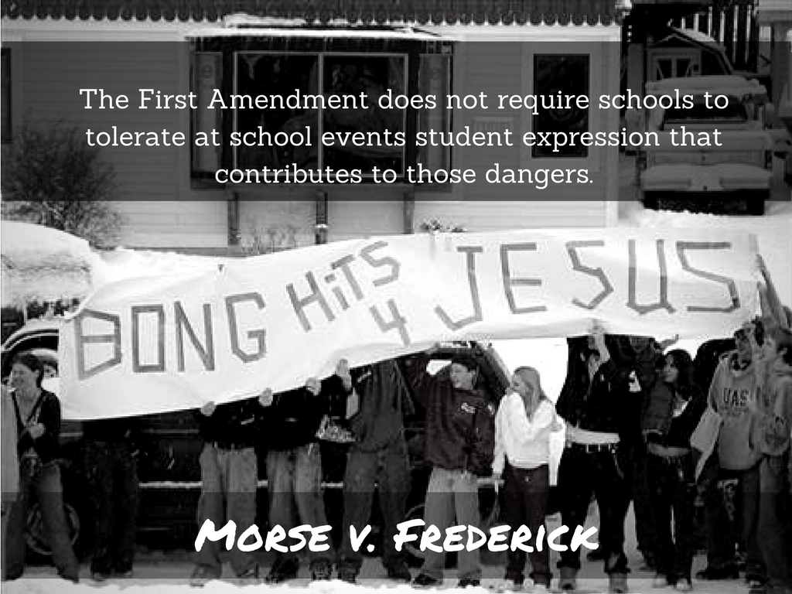
Bedrock Legal Concepts
Notes:
Morse v. Frederick (2007) – better known as Bong Hits 4 Jesus case
Olympic torch was passing through Juneau, Alaska – high school had students go outside to watch the torch
Frederick unfurled this banner across the street– principal told him to take it down, he refused. Suspended for 10 days.
Principal said she interpreted the message as promoting illegal drug use. Court upheld suspension.
NOTABLE: Frederick was actually across the street from where the other students were gathering, and had not been at school that day, but Court ignored those facts. However, that could have made a difference.
Generally, this case is cited for proposition that schools may prohibit speech that promotes illegal conduct.

Slide 8
Bedrock Legal Concepts
Notes:
Hazelwood v. Kuhlmeier – case regarding a student newspaper – principal removed articles regarding student pregnancy and impact of divorce on students from the student paper. Court held that the school can control style and content of speech in school-sponsored expressive activities so long as their actions are reasonably related to legitimate pedagogical concern
Courts have extended to other areas as well
Hayden Griffith v. Caney Valley Public Schools (Oklahoma 2016) –graduation attire – District denied student’s request to wear an eagle feather in her graduation cap

Slide 9
Analysis
Even if speech is protected…
Is it lewd, vulgar, or profane?
Does it promote illegal conduct?
Is the speech school sponsored?

Slide 10
Analysis
A note on school-sponsored speech:
Be wary of viewpoint discrimination.
Consider:
The amount of control exercised over the publication or activity by the district.
Any relevant school district policies.
Past practice related to publication/activity at issue.

Slide 11
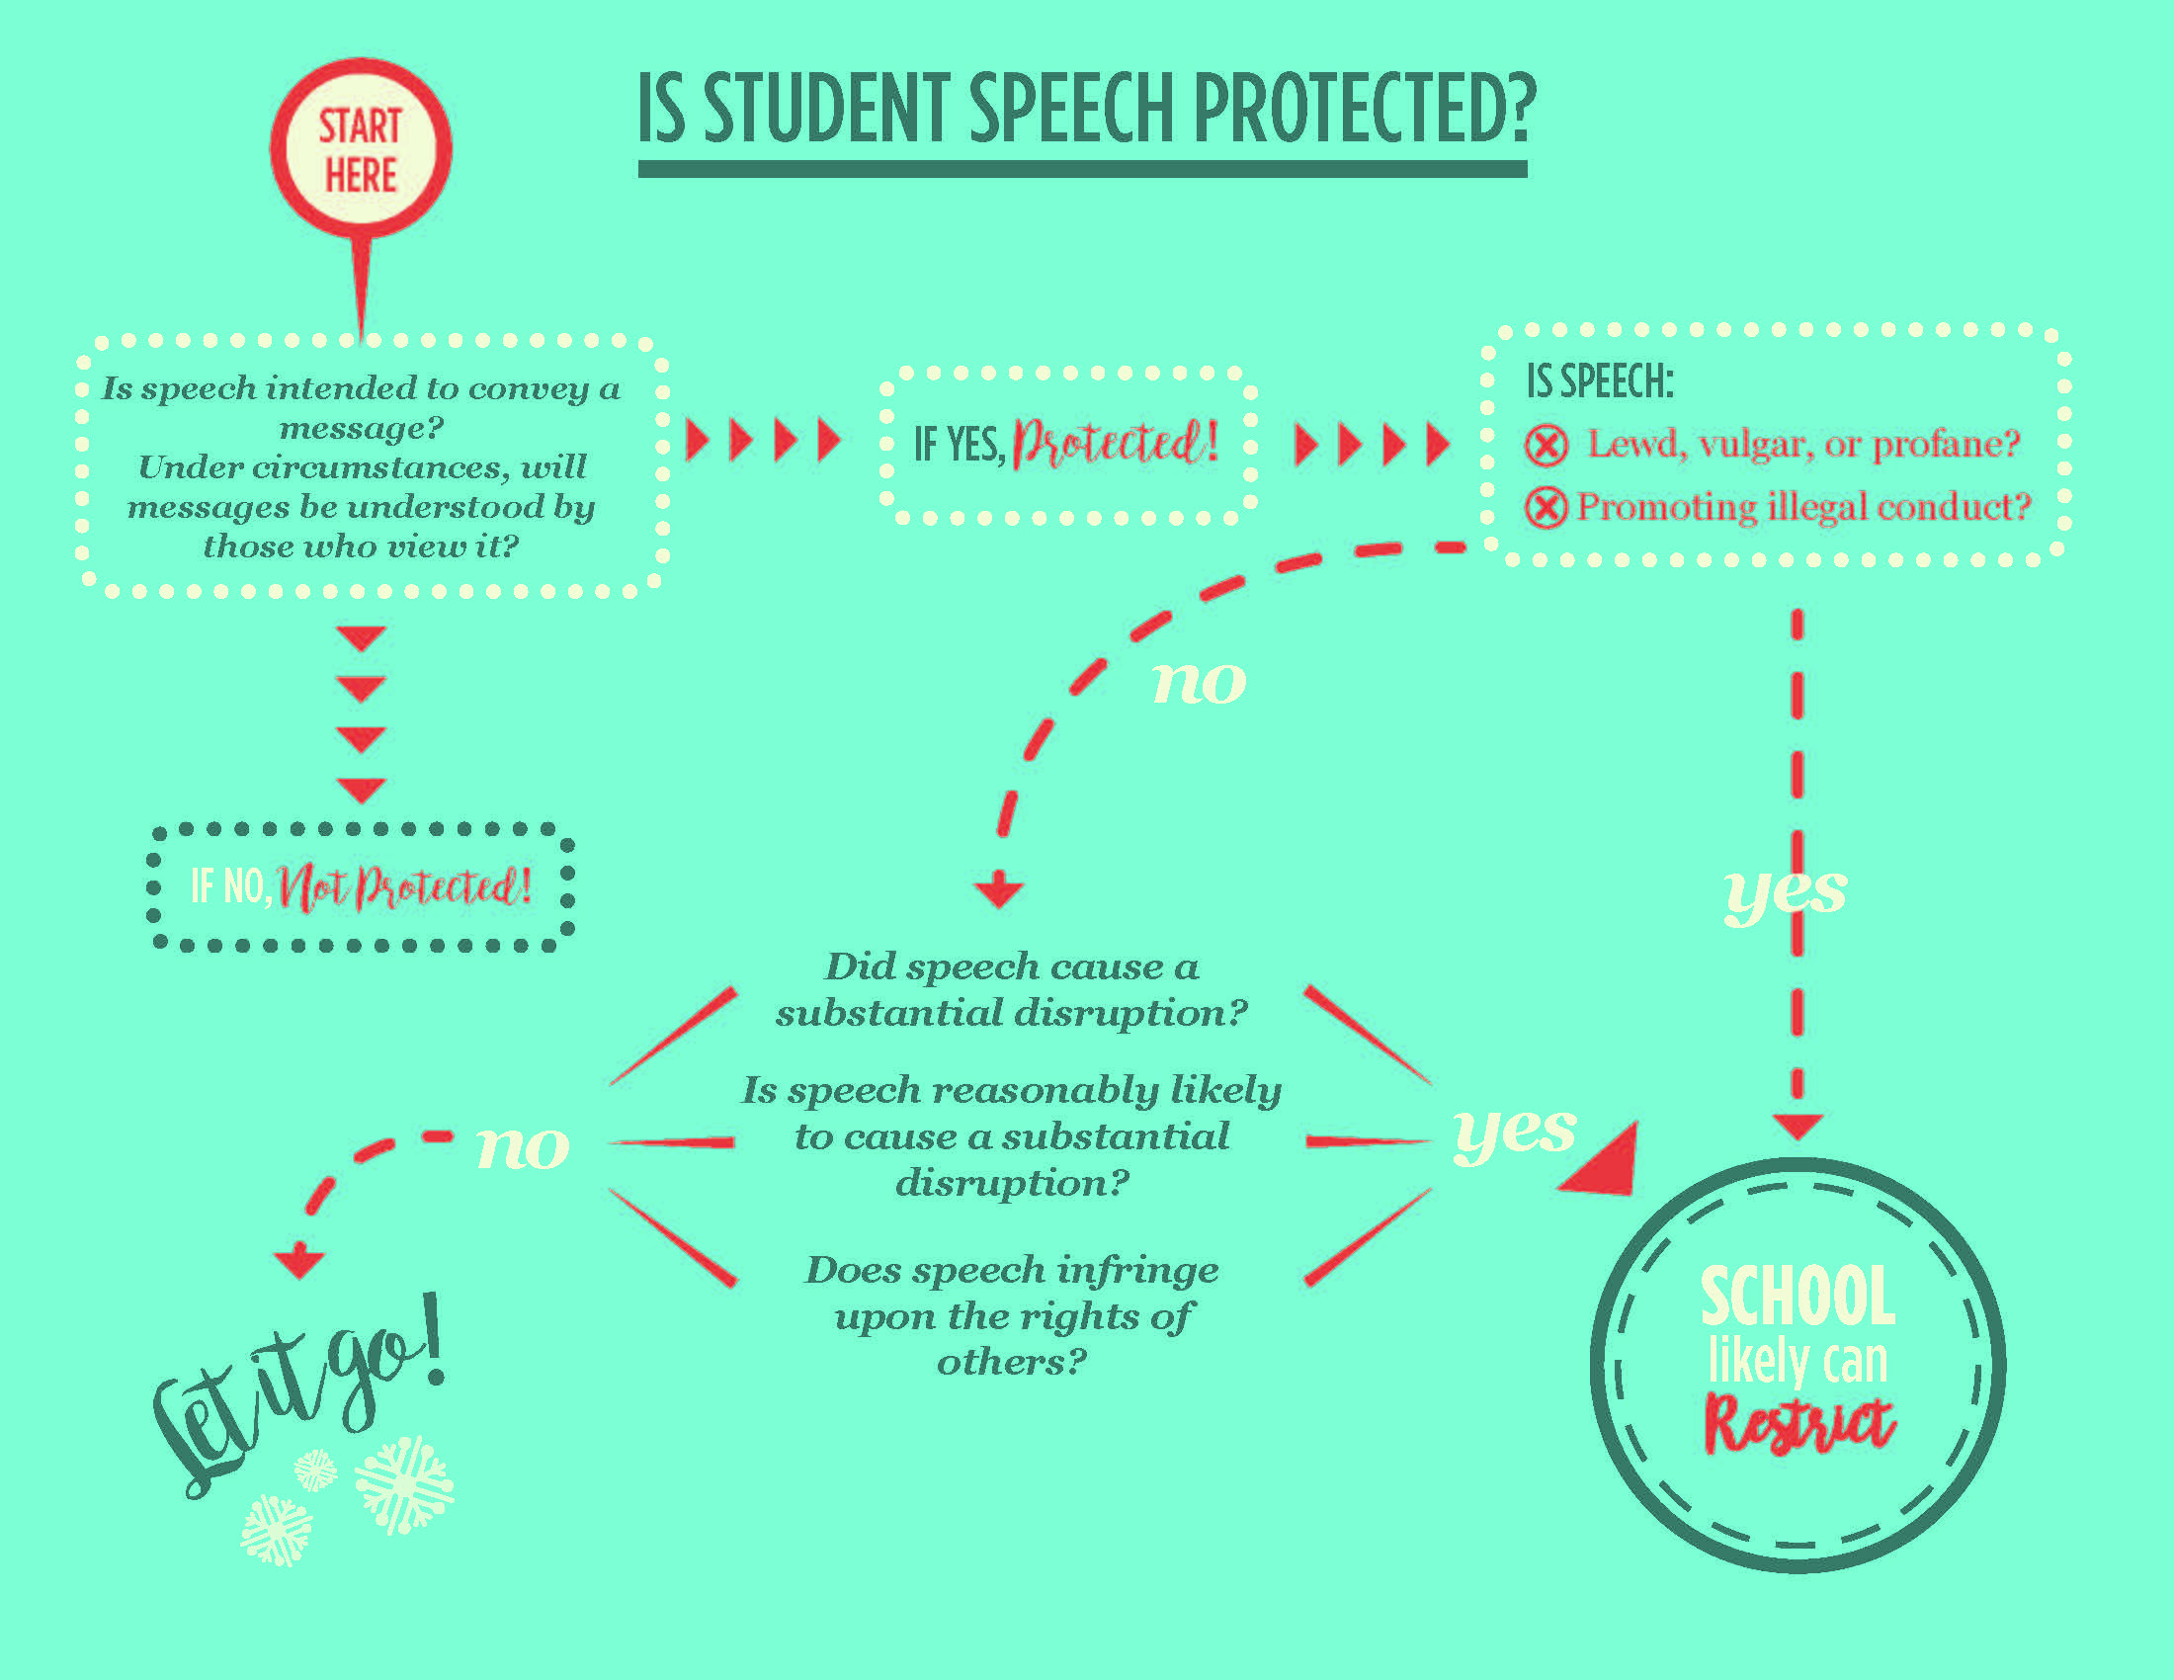

Slide 12
Hypothetical #1
Appleville School District is gearing up for World Hijab Day on February 1. Approximately 6% of the District’s students are Muslim, and several students regularly wear the hijab.
The District has a dress code that prohibits head coverings; however, there is an exception for religious head coverings.
Several non-Muslim students plan to wear hijab to show support for Muslim students and have placed flyers around the school encouraging participation. Another group of students, expressing concern about national security, plan to wear their “Make America Great Again” caps and have scheduled a walk out during the lunch periods.
Administrators have issued reminders to students regarding the dress code and truancy policies.
Notes:
Student Organized Student Walk Out
Have to allow?
Put restrictions on when, where, etc?
Discipline students who do participate?
Teacher organized Walk Out
Shirt wearing student
What is message?
Restrict this message?
Discipline?
4. Teacher Diet Coke protest – really outside the scope of this presentation – suffice to say that teachers do have some First Amendment rights, but the District can generally can control teacher speech when they are in their role as employees – must generally remain viewpoint neutral

Slide 13
Hypothetical #1
On February 1, several students are referred to the office for dress code violations.
Several students are also given detentions for leaving class without permission

Slide 14
Legal Issues
What is the student speech? Is it protected?
Can the students be prohibited from wearing hijab?
Can the students be prohibited from wearing the red ball caps?
Can the students be disciplined for dress code violations?
Can the student be disciplined for leaving class?

Slide 15
Legal Analysis
Is a “walk-out” a protected activity?
Does the District have policies that govern this conduct?
Before school/after school – facilities use policies
During the school day – attendance policies
Time/place/manner of speech

Slide 16
Legal Analysis
Specifics of the speech?
Lewd, vulgar, profane?
Promoting illegal conduct?
Infringe upon the rights of others?
Disruption?

Slide 17
Legal Analysis
Is wearing a hat or head covering protected speech?
Does the District have policies that govern this conduct?
Dress Code policy
Time/place/manner of speech

Slide 18
Legal Analysis
Specifics of the speech?
Lewd, vulgar, profane?
Promoting illegal conduct?
Infringe upon the rights of others?
Disruption?

Slide 19
Hypothetical #2
A student at Orangeville School District posts several pictures on Snapchat that contain messages that students perceive as racist. The messages are posted during non-school hours.
Over the weekend, the student posts pictures of a Black Lives Matter protest, making fun of the participants.
On Monday, students of color report to the principal that they are upset and scared to be in class with this student.

Slide 20
Legal Analysis
Are the social media posts protected speech?
Does the District have policies that govern this conduct?
Non-discrimination/harassment
Time/place/manner of speech

Slide 21
Legal Analysis
Specifics of the speech?
Lewd, vulgar, profane?
Promoting illegal conduct?
Infringe upon the rights of others?
Disruption?

Slide 22
Legal Analysis
Off-Campus Conduct – what is the nexus to the educational environment?

Slide 23
Practical Considerations
Do not to make assumptions about a student’s intent.
Ask the student what he or she meant by the conduct in question.
Ask other students what they understood by the conduct in question.

Slide 24
Practical Considerations
Consider underlying basis for policy at issue.
What is the governmental interest served by the policy?
Is the policy specifically tailored to that interest?

Slide 25
Practical Considerations
An actual disruption does not need to occur!
When school officials reasonably foresee that speech will cause substantial disruption or materially interfere with learning environment, the school can prohibit the speech.

Slide 26
Practical Considerations
Consider anti-harassment, anti-bullying laws
A note about off-campus conduct – must be reasonably foreseeable that the speech will reach the school community

Slide 27
Practical Considerations
Be reasonable in disciplinary response

Slide 28
Best Practices
Focus on the facts.
Document current environment to justify determination that substantial disruption is reasonable likelihood.
Consider whether to address the behavior through disciplinary consequences, or an alternative approach.
Consider whether it is better to prevent or facilitate a protest – but consider precedent.

Slide 29
Best Practices
Provide proactive training.
Use community resources.
Be prepared for media.
Be reasonable.
Remember:
Approach conduct in a viewpoint neutral manner, and
Treat similar conduct in a similar manner.

Slide 30
Michelle Basi mbasi@tuethkeeney.com Telephone: 314-880-3615

