Slide 1
Missouri
Rap Back Program
Presented by:
The Missouri State Highway Patrol, CJIS Division
Linda S. Lueckenhoff
Pamela Aberle

Slide 2


What is Rap Back?
Missouri statute authorizes DESE and school districts access to electronic updates to criminal background checks.
The Rap Back Program has the capability to provide automatic criminal history updates for individuals that have been previously fingerprinted for a Missouri background check.
If at any point an applicant that is subscribed in the program is arrested, DESE and/or school district maintaining the Rap Back subscription will be notified via e-mail.
School district users log-in to their account -- Missouri Automated Criminal History Site (MACHS) -- to request an updated criminal history response.

Slide 3
What are the Responsibilities?
Each school district is responsible for ensuring that their Rap Back subscriptions are up-to-date and that they are only maintaining subscriptions on individuals that are actively employed or otherwise still under the agency’s purview.
To ensure that this is done, each school district is responsible for conducting triennial validations of their subscriptions in order to keep the subscription active.
In addition, if a Rap Back update is available, the school district must confirm that the individual is still of interest prior to requesting a new criminal history response.
Lastly, school districts can also actively keep their subscriptions up-to-date by unsubscribing their applicants once an individual’s employment or certification is terminated.

Slide 4

Rap Back provides:
Once enrolled, Rap Back will notify your school district MACHS users if one of your subscribed applicants is arrested in Missouri.
Rap Back will notify your district of an applicant’s offenses when fingerprinted on a criminal fingerprint card pursuant to sections 43.503 and 43.506 RSMo.

Slide 5
Rap Back will NOT provide:
Notifications for arrests that occur outside the State of Missouri.
Notifications for arrests concerning non-serious offenses such as traffic citations.
Notifications for arrests in which the arresting agency fails to abide by 43.503 RSMo. and does not forward a set of criminal fingerprints to the repository.
Notifications concerning subsequent Prosecutor or Court actions
  Once notified of the arrest, it will be up to your district to request follow-up documentation from the applicant or court regarding the disposition of the case.

Slide 6
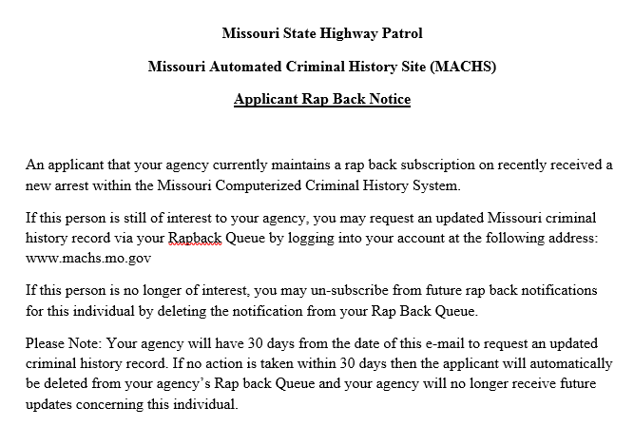
The Rap Back E-mail Notification
If one of your applicants is arrested, you will receive a generic Rap Back e-mail alert.
This e-mail alert will not contain any PII concerning the applicant.
Users must log-in to their MACHS Account to receive more information concerning the alert.

Slide 7
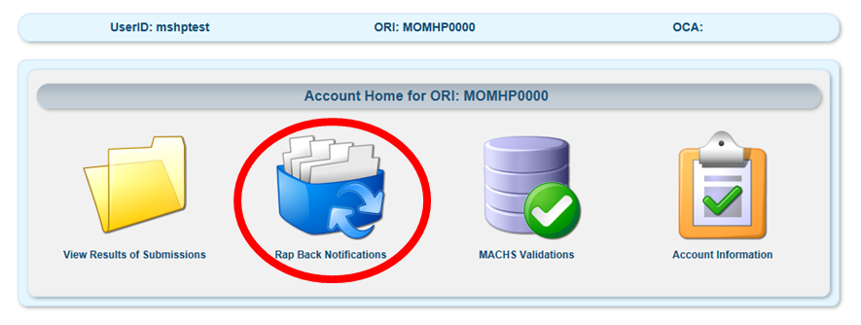
Accessing your Rap Back Queue
From your MACHS home screen, click on the icon titled “Rap Back Notifications”.

Slide 8
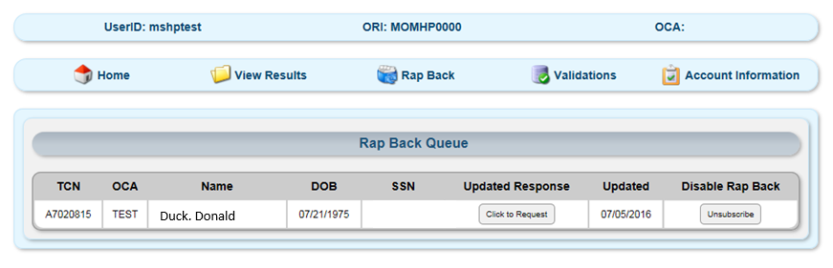
Requesting Rap Back information
All names/identifying information associated with applicants that have Rap Back notifications can be found in this queue.

Slide 9
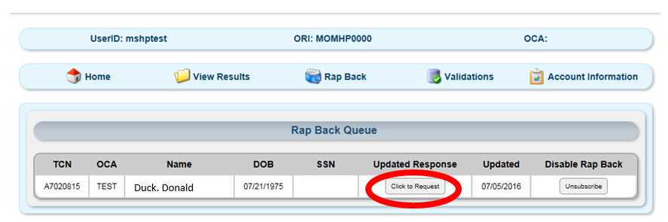
Requesting Rap Back information
If you wish to retrieve the criminal history information associated with the Rap Back event, you may select “Click to Request”.
You should only select this option once you have verified that the individual is still employed or otherwise still under the purview of your school district.
Requesting updated criminal history information on an individual that is no longer employed or under the purview of your school district is not allowed and may open up your district to criminal and/or civil liability.

Slide 10
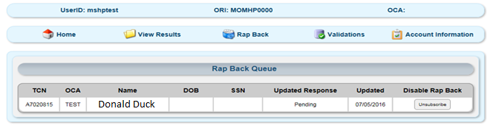
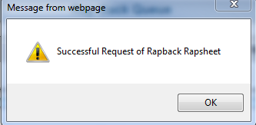
Viewing Rap Back Information
Once requested, you will receive a confirmation.
The request will be sent the Missouri State Highway Patrol for final review.
While the rap sheet is under review, the request will have the status set to “Pending”.

Slide 11
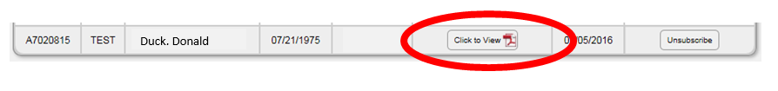
Viewing Rap Back Information
When the Rap Back is ready for viewing, it will have an icon labeled “Click to View”.
Clicking this icon will display the updated criminal history rap-sheet for the applicant.

Slide 12
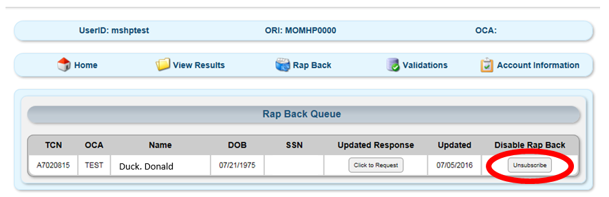
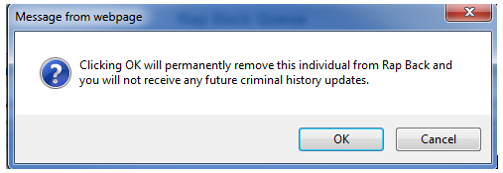
Discontinuing a Rap Back Subscription
If you receive a Rap Back notification on an individual that is no longer employed or otherwise under the purview of your school district, you must discontinue the applicant’s subscription.
This can be done directly via the Rap Back Queue by clicking “Unsubscribe”. Only ORI Administrators can initiate and complete this process.
Note: The removal of an applicant’s Rap Back subscription is permanent!
  To re-enroll an applicant, they must be re-fingerprinted for a new criminal record check.

Slide 13

Managing your Rap Back subscriptions and validations
It is the responsibility of each school district to keep their Rap Back subscriptions up-to-date and remove any subscriptions that are no longer required.
This can be done in real-time, as applicant’s leave your school district; and
This must also be done triennially, as part of the Rap Back validation process.

Slide 14
Triennial Validation**
The subscription for an applicant that is fingerprinted and enrolled in the rap back program will stay active for three years.
After three years have passed, the applicant will need to be validated in order for the Rap Back subscription to be extended.
When you have records that require validation, a notification e-mail will be sent to all individuals that have been granted access to your account.
The Administrator(s) of the account must then log-in and complete the validation process within 30 days.**
  Failure to validate Rap Back subscriptions in a timely manner will trigger the permanent removal of these individuals from the Rap Back program.**

Slide 15
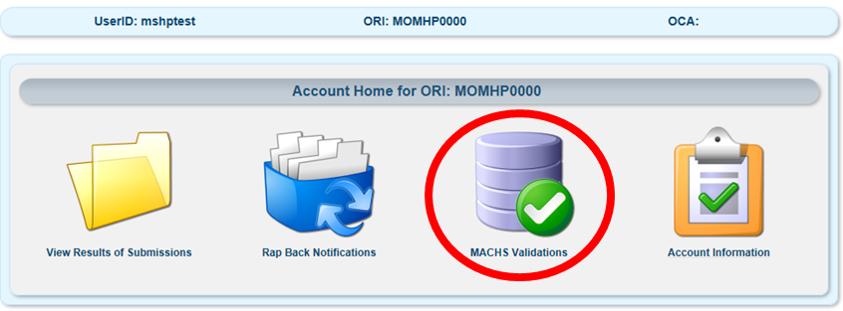
Validation of Records
To begin record validation, click on the icon labelled “MACHS Validations”.

Slide 16
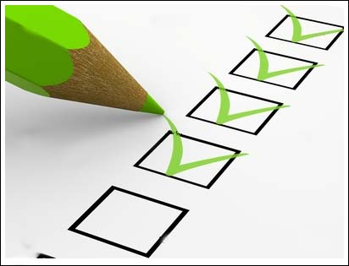
Validation of Records
The MACHS Validation Queue will list all records that require validation for the current month.
Administrator(s) must review these records to ensure that all applicants are still employed or otherwise still under the purview of the school district.
The Rap Back subscriptions for any applicants that no longer meet these criteria must be removed.
There are two methods to validate records: 1) Manual; or 2) Batch

Slide 17
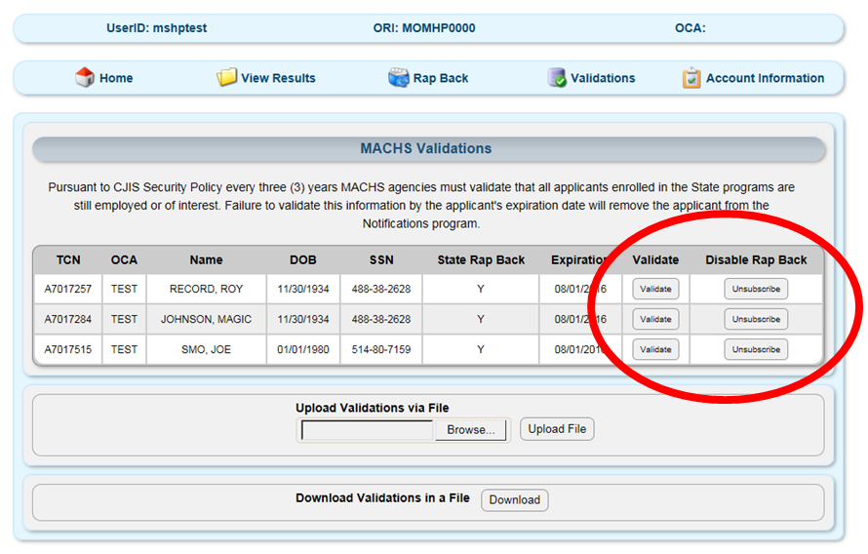
Manual Validation
Manual Validation can be completed by selecting “Validate” or “Unsubscribe”.
Clicking “Validate” will renew the selected applicant’s Rap Back subscription for an additional three year period.
Clicking “Unsubscribe” will permanently remove the applicant’s Rap Back subscription.

Slide 18
Manual Validation
Validation is considered complete once a decision has been made for each applicant.
Applicants not validated within 30 days will have their subscriptions automatically removed.

Slide 19
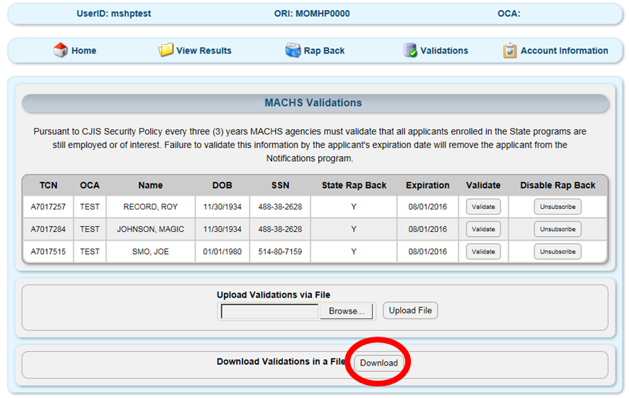
Batch Validation
The 2nd method to available to validate applicants is via Batch Validation.
This method is designed for school districts with a large number of applicant records to validate.
To begin, click the “Download” icon on the Validation queue.

Slide 20
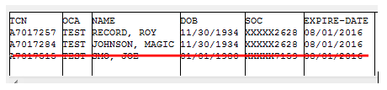
Batch Validation
This will allow you to download a list of all records requiring validation into a tab-delimited text file.
Your school’s IT may then use this file to compare to any in-house database that your district uses.
Your IT personnel should remove the rows in the validation file for any records that are no longer active.

Slide 21
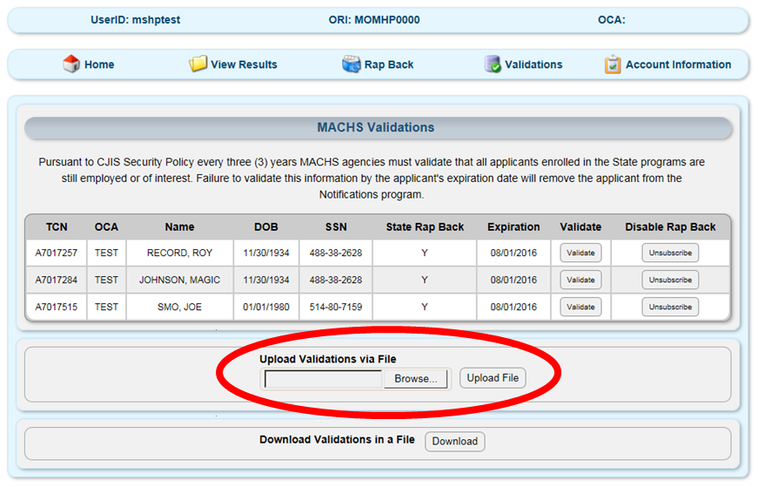
Batch Validation
Once all records that no longer require Rap Back are removed from the validation file, the file can be uploaded back to MACHS.
Utilize the “Browse” icon on the MACHS Validations page to find your validated file, and then click “Upload” to complete your validation process.
Once uploaded, you will notice that the records that were removed from the file will stay in your validation queue.
These records will automatically unsubscribe from Rap Back at the end of the validation period.

Slide 22
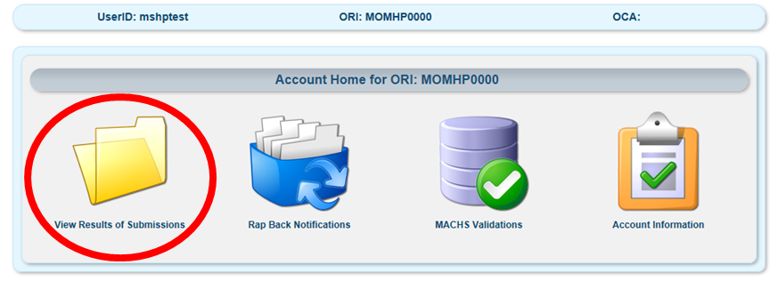
Keeping Rap-Back Subscriptions Up-to-Date
School districts that want to stay on top of their Rap Back Subscriptions can also manage Subscriptions in real-time.
This can be done via the “View Results of Submissions” Page.

Slide 23
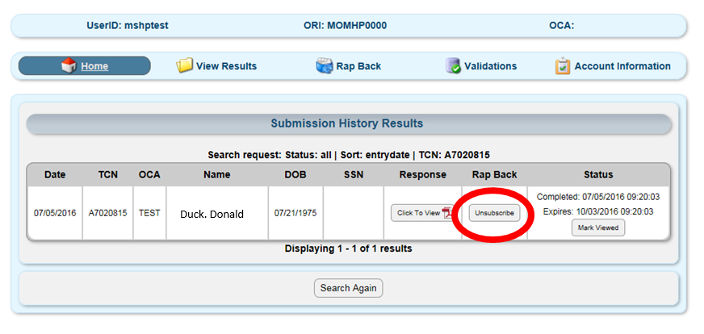
Keeping Rap-Back Subscriptions Up-to-Date
The search will return all applicants that meet your search criteria. If an applicant currently has an active subscription in the Rap Back program then you will have the option to “Unsubscribe” the applicant.
This also will ensure that the applicant does not show up on your triennial validations, thereby keeping your subscriptions up-to-date in real-time.

Slide 24
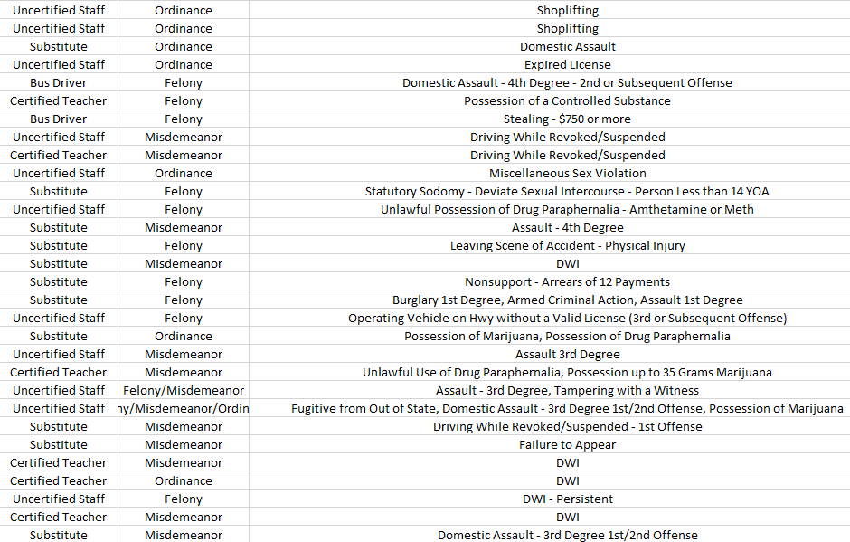
Rap Back Notifications

Slide 25
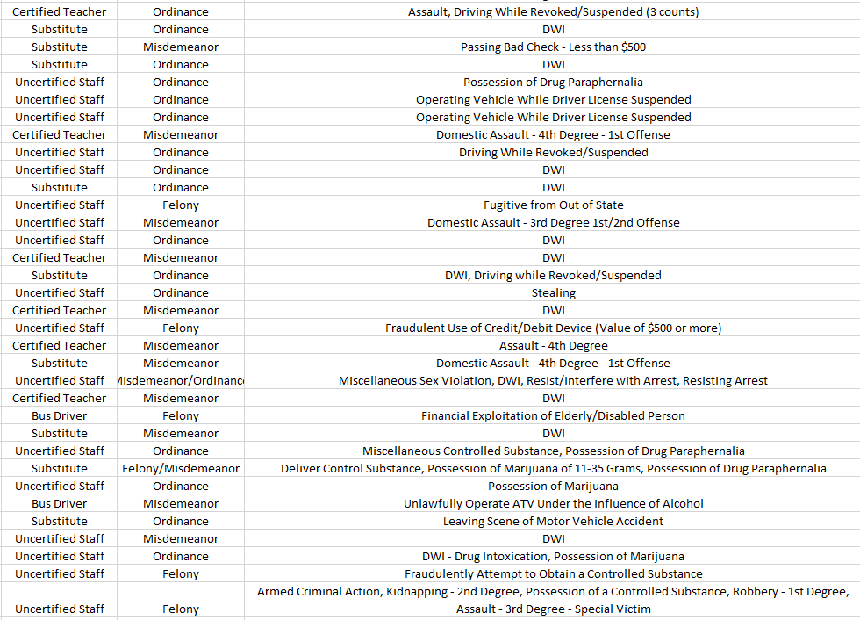

Slide 26
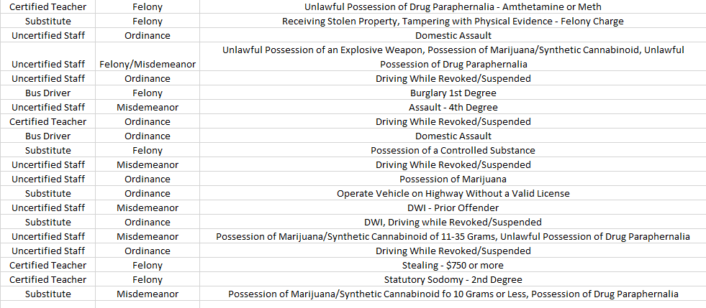

Slide 27
In Summary
When used correctly, the MACHS Rap Back Program can provide your school district timely criminal history information that can ensure the safety of your employees and/or applicants, as well as those individuals they care for.
Your agency has a responsibility to ensure that your Rap Back subscription lists are kept up-to-date.
Subscriptions must be validated every three years at minimum, however, real-time removal of subscriptions that are no longer needed, is encouraged.

Slide 28
CJIS Division
Noncriminal Justice (NCJ)
Access and Audit Unit
ATCHISON
NODAWAY
WORTH
HARRISON
MERCER
PUTNAM
SCHUYLER
SCOTLAND
CLARK
Scott Schlueter
Region 2
Scott.Schlueter@mshp.dps.mo.gov
Ext. 2653
GENTRY
SULLIVAN
ADAIR
KNOX
HOLT
GRUNDY
LEWIS
ANDREW
DEKALB
DAVIESS
LINN
MACON
Linda Lueckenhoff
Region 1
Linda.Lueckenhoff@mshp
.dps.mo.gov
Ext. 2630
SHELBY
MARION
BUCHANAN
CLINTON
CALDWELL
LIVINGSTON
PLATTE
RAY
CARROLL
CHARITON
RANDOLPH
MONROE
RALLS
Pamela Aberle
Region 3
Pamela.Aberle@mshp
.dps.mo.gov
Ext. 2625
CLAY
PIKE
SALINE
HOWARD
AUDRAIN
LINCOLN
JACKSON
LAFAYETTE
BOONE
CALLAWAY
MONTGOMERY
CASS
JOHNSON
PETTIS
COOPER
WARREN
ST. CHARLES
ST. LOUIS
HENRY
MONITEAU
COLE
OSAGE
FRANKLIN
ST. LOUIS
CITY
BATES
BENTON
MORGAN
GASCONADE
MILLER
MARIES
JEFFERSON
Clara Apel
Region 4
Clara.Apel@mshp.dps.mo.gov
Ext. 2655
ST. CLAIR
CAMDEN
CRAWFORD
WASHINGTON
VERNON
HICKORY
PULASKI
PHELPS
STE.
DALLAS
GENEVIEVE
CEDAR
POLK
LACLEDE
DENT
IRON
ST. FRANCOIS
PERRY
Tina Ramsey
Region 5
Tina.Ramsey@mshp
.dps.mo.gov
Ext. 2629
BARTON
IRON
MADISON
DADE
TEXAS
REYNOLDS
CAPE
WEBSTER
WRIGHT
SHANNON
BOLLINGER
GIRARDEAU
JASPER
LAWRENCE
GREENE
WAYNE
SCOTT
NEWTON
STONE
CHRISTIAN
DOUGLAS
HOWELL
CARTER
STODDARD
MISSISSIPPI
BARRY
TANEY
OZARK
OREGON
RIPLEY
BUTLER
MCDONALD
NEW MADRID
DUNKLIN
PEMISCOT
NCJ Access and Audit Unit (573) 526-6153
CJIS Program Manager– Kerry Creach (573) 522-3821

