Slide 1
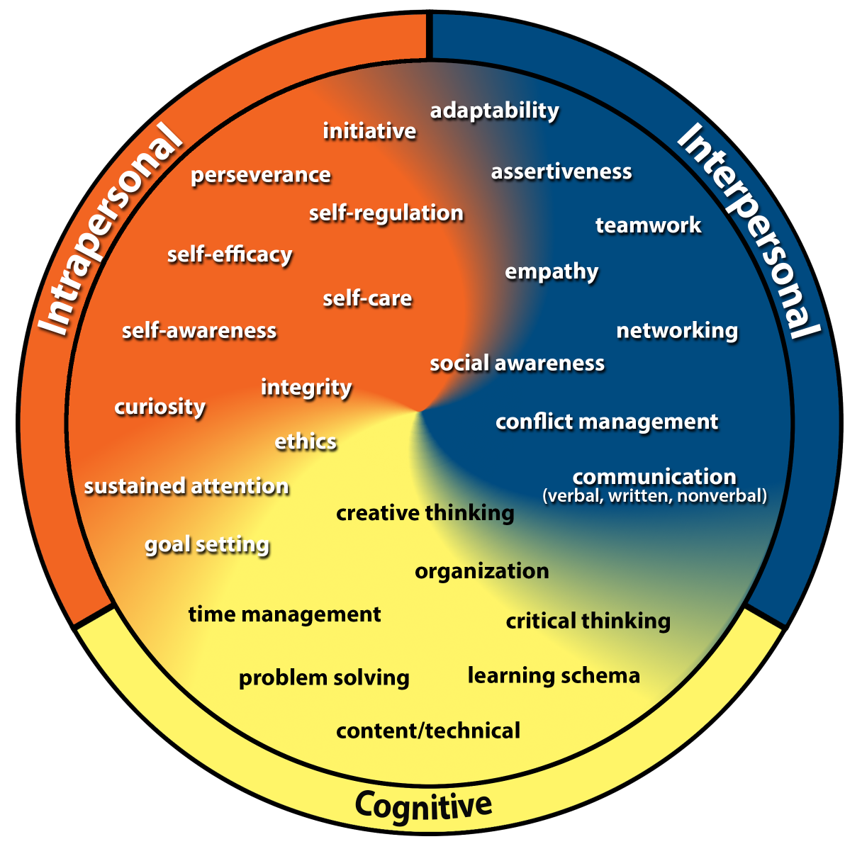
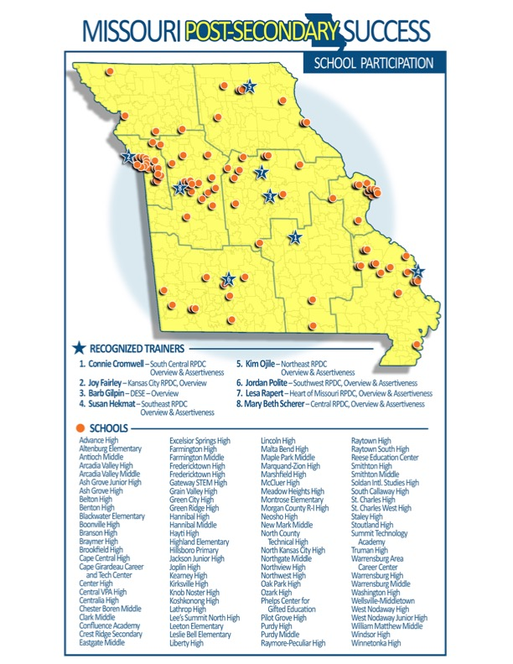
The College and Career Competency Framework and the Missouri Post-Secondary Success Project
Mary Beth Scherer
mbscherer@ucmo.edu
Elise Heger, Ed.D.
eheger@ku.edu
Notes:
Do not let the Post-Secondary in the title mislead you we are a FREE Quality program for students K-12 Our focus is developing the skills our students need to be successful once there public school experience is over.
We are not here to sell you an expensive program. The training is free. If you chose to buy the curriculum with activities it is $16.00 for the PDF file. So you would only need I file for your district. There are recognized trainers and participating schools all over the state.

Slide 2
Learning Objectives
I have a basic understanding of the College and Career Competency Framework.
I understand the goal of the Missouri Post-Secondary Success Project and how to become involved.
I understand why the social-emotional competencies should be taught and how they impact student outcomes.

Slide 3
What is one thing that you wants students to be able to do when they graduate from your district?
Notes:
On your table are sticky notes and pens. I am going to give you about 30 seconds to write down one thing that if you could guarantee every child in your district would learn what would it be. Go
Now post it on the wall on the correct piece of chart paper. Is is an academic skills or is it a social/emotional skill. Everytime I ask teachers to do this – it is overwhelmingly the social/emotional skills. If you asked employers where do you think it would be?
It is just a shame we don’t have a MAP or EOC on Social/Emotional Skills because we all understand how important they are, we just have a hard time justifying why

Slide 4
Ask the Kids: Highest Need Competencies Identified by Over 7500 Students
Overall Rank by Highest Need | Males | Females | 6th Grade | 9th Grade | 12th Grade
Sustained Attention | Sustained Attention | Sustained Attention | Sustained Attention | Sustained Attention | Sustained Attention
Self-Regulation | Self-Regulation | Self-Regulation | Self-Regulation | Self-Regulation | Self-Regulation
Initiative | Initiative | Assertiveness | Initiative | Initiative | Assertiveness
Assertiveness | Assertiveness | Initiative | Assertiveness | Assertiveness | Communication
Conflict Management | Conflict Management | Conflict Management | Conflict Management | Communication | Initiative
Goal Setting | Communication | Self-Efficacy | Goal Setting | Conflict Management | Conflict Management
Source: Competency Student Needs Assessment (available free at http://CCCFramework.org)
Notes:
As a free resource, we provide the Competency Framework Needs Assessment which lists the intrapersonal and interpersonal competencies with definitions and asks students to determine the degree to which they demonstrate the skill. Results across grades and genders consistently show that students feel the need to develop self-regulation and sustained attention. Administrators, if a goal is to garner buy-in from all of your teachers, the needs assessment is a great way to analyze student perspectives and prioritize competency instruction.

Slide 5
CASEL Video
https://www.youtube.com/watch?v=Do1R67Ek0NI
Notes:
This is a short video about the importance of social and emotional learning and the reason why we really need to teach these skills and he overall positive impact it can have on student learning.
Social Emotional Learning is truly a win/win for school districts not only do we see student behavior improve, we see student engagement in learning and increase in test scores. And you can’t be involved in education in Missouri and not understand the importance of test scores.

Slide 6
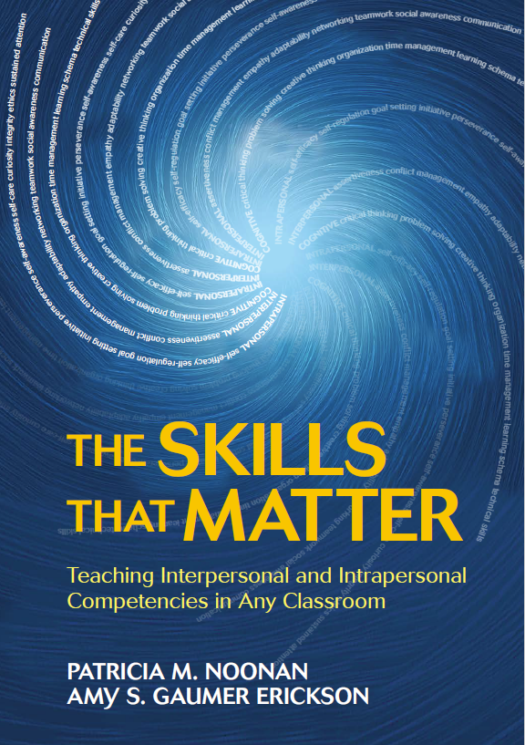
The Skills that Matter: Teaching Interpersonal and Intrapersonal Skills in Any Classroom
http://CCCFramework.org
Contact us with any questions you have about the College & Career Competency Framework. We are available to support teachers and school-wide implementation through virtual and on-site trainings.
Amy Gaumer Erickson, Ph.D.
agaumer@ku.edu
Pattie Noonan, Ph.D.
pnoonan@ku.edu
Notes:
The purpose of the Framework is to support educators in systematically embedding intrapersonal and interpersonal competencies into course content. The competencies are integral to in-school and post-secondary success, as determined by current and emerging research. Our website, http://CCCFramework.org, provides free resources and tools to help you apply the information that you learn today.
To further support educators, Drs. Noonan & Gaumer Erickson, the creators of the CCC Framework, recently published a book. The Skills that Matter: Teaching Interpersonal and Intrapersonal Competencies in Any Classroom is available from Corwin Press.

Slide 7
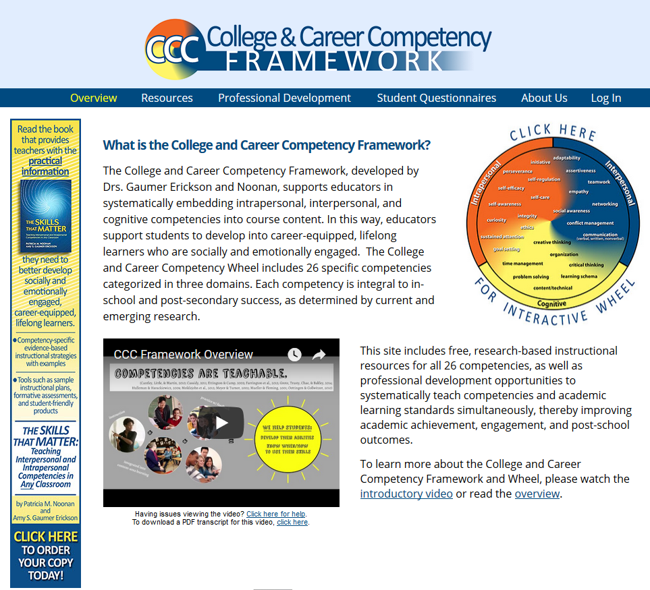
Who we are, our work, and our mission
http://CCCFramework.org
Notes:
The College and Career Competency Framework was developed by Dr. Amy Gaumer Erickson and Dr. Pattie Noonan. They are both associate research professors at the University of Kansas. Amy’s background is in secondary education. She taught language arts, math, special education, physical education, and coached track and football. She taught middle and high school in rural, suburban, urban, charter, and alternative schools. Across all of these schools, she found that it often wasn’t students’ academic ability that impeded their learning. In most cases, it was their intrapersonal and interpersonal skills. Pattie’s background is in adult services, in human resources and as a job developer. She also found that it often wasn’t adults’ content knowledge that impeded their employment. I bet you can guess which competencies these adults needed to work on! Those in the intrapersonal and interpersonal domains. Pattie and Amy met while getting their doctorate degrees in Secondary School Reform and Special Education Secondary Transition at KU. In talking to administrators, counselors, general and special education teachers, career technical instructors, higher education faculty, parents, employers, everyone wanted to help youth develop skills that would help them be more successful, but they were all using their own terms and working in isolation. Pattie and Amy started looking for a way to create a common vision and language for all roles to collaborate in supporting ALL students to develop these competencies. After frustratingly realizing the limitations of the existing resources, they developed the College and Career Competency Framework.

Slide 8
Missouri Post-Secondary Success (MO PSS) project is a partnership between the DESE and the University of Kansas that supports schools in comprehensively embedding the college and career competencies including self-regulation, assertiveness, and self-efficacy into core content.
MO PSS Staff Contact Information:
Elise Heger—eheger@ku.edu
Pattie Noonan—pnoonan@ku.edu
Michelle Loewenstein—mloewenstein@ku.edu
Amy Gaumer Erickson—agaumer@ku.edu
Notes:
Because DESE is working with University of Kansas they are developing trainers in each RPDC to provide the necessary training.
Last year the focus was on Assertiveness. Now when I heard that we were going to teach assertiveness. I had just raised twin daughters to the tender age of 21 and I was not sure they needed to be any more assertive than they already were. But I did not know the definition of assertiveness which is “Even when it is difficult, expressing your wants, needs and thoughts while respecting others.
Self-Regulation – “A proactive, self-directed process for attaining goals, learning skills, managing emotional reactions and accomplishing tasks.
Self –Efficacy – Believing in your abilities to accomplish challenging tasks and that your ability can grow with effort.

Slide 9
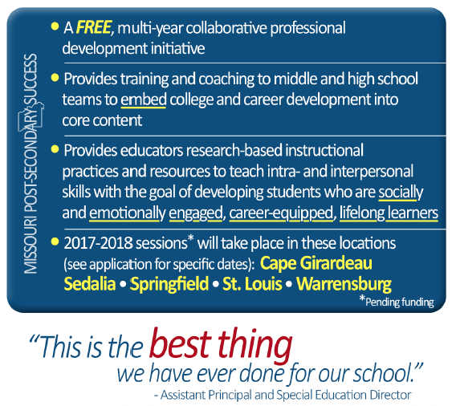
Notes:
Again this shows the schools that have been involved in the training. We are asking districts to make a multi-year commitment to go through the training. The first year, we work with a team from a building within a district. We have a cross-section of teachers and an administrator on the team. In the first training they learn about the competency and how to go about teaching it. They will develop an instructional plan on how they are going to implement it within their curriculum. We have them utilize it and try it out and then report back how it went and on the second day of training, we see what went well and talk about how we can roll this out to the rest of the building. We provide on-site technical assistance & coaching the second year helping get if off the ground in the district.

Slide 10
The Roadmap: A Navigation Guide for College & Career Competency Framework Implementation
Notes:
Any time a building our district implements a new program it is done in phases. It doesn’t happen all at once. The team explores the materials and then commits to utilize it in their classroom. The team comes up with a systematic way to roll in out and then meet and begin to look at involving more students and deciding how they want to do it successfully with that group of teachers and students and finally ensure that all students receive the competency instruction. Teachers generally sell it to other teachers in the building.

Slide 11
Foundational Competencies
Intrapersonal
Interpersonal
Self-Efficacy
Self-Regulation
Self-Awareness (integrated)
Assertiveness
Conflict Management
Empathy (integrated)
Assertiveness
Self-Regulation
Self-Efficacy
Empathy
Self-Awareness
Conflict Management
Research-based
Shown to improve in-school & post-school outcomes
Distinct
Teachable
Measurable
Generalizable
© 2013 Amy Gaumer Erickson and Patricia Noonan
Notes:
This is the College and Career Competency Wheel.
The terms on the wheel are called a variety of things, such as soft skills, social/emotional skills, employability skills, leadership skills, professional skills.
In 2012, the National Academy of Sciences defined skills needed for the success as falling into 3 domains: intrapersonal, interpersonal, and cognitive (the outer ring on the wheel). We found that these terms (intrapersonal, interpersonal, and cognitive) resonate with individuals across roles and show the balance that is necessary for in-school and post-school success.
The Intrapersonal domain focuses on students’ internal, reflective capacities
The Interpersonal domain focuses on capacities related to cooperation and interaction with others
And the Cognitive domain focuses on effectively processing and using information
There are 26 competencies on the wheel. All the competencies are research based to show improvement both in schools and post school and can be taught. Most teachers are not excited about teaching 26 new areas of study. So the researches came up with foundational competencies and they are: self-regulation, self-efficacy, self-awareness, assertiveness, empathy and conflict management. We teach ------- and weave in empathy and self-awareness into the other five. This year we are doing __ last year we did ___ so districts can receive training on any of those this school year

Slide 12
Systematic Instruction & Application
The competencies are not new.
Educators are already supporting students to learn many of the competencies.
School initiatives support development of many of the competencies.
The Challenge: Systematically providing instruction and application of the competencies for all students, focusing on the aspects that current research has identified as most important.
Notes:
To summarize:
The competencies are not new.
Educators are already supporting students to learn many of the competencies.
School initiatives support development of many of the competencies.
The Challenge: Systematically providing instruction and application of the competencies for all students, focusing on the aspects that current research has identified as most important
Students will not develop these skills in Assertiveness Thursdays – 20 minutes every other Thursday. The instruction needs to be systematic include instruction, practice and reflection.

Slide 13
Why focus on…
COGNITIVE competencies | INTERPERSONAL competencies | INTRAPERSONAL competencies
Effectively solve real-life problems. Understand more course content and retain more information. Generalize information to apply in multiple contexts. | Better physical and mental wellness and social functioning. Improved school attendance. Feel more engaged in school. Spend more time studying. Higher employment rates. Earn better grades and achievement scores. Better able to effectively overcome stressors. | Sustain attention in class better. Improved retention of subject matter. Earn higher salaries and advance further in careers. Better able to avoid drug use. Reduced bullying and victimization.
(Brewer, 2000; Chang, Wu, Weng, & Sung, 2012; English & Sriraman, 2010; Kuo, Hwang, & Lee, 2012). | (Davidson & Demaray, 2007; Malecki & Demaray, 2002; Opengart, 2007; Rosenfeld, Richman, & Bowen, 2000; Sabo, Miller, Melnick, Farrell, & Barnes, 2005; Schwab, 2013). | (Dignath, Buettner, & Langfeldt, 2008; Duckworth, Peterson, Matthews, & Kelly, 2007; Durlak, Weissberg, Dymnicki, Taylor, & Schellinger, 2011; Eskreis-Winkler, Shulman, Beal, & Duckworth, 2014; Nota, Soresi, & Zimmerman, 2004; Ursache, Blair, & Raver, 2012).
Notes:
In 2011, Durlak and colleagues found an 11 %ile gain on standardized math and reading tests through teaching social/emotional competencies. In 2015, the Teachers College at Columbia University found that every $1 invested in Social Skills instruction results in $11 in economic returns for the community.
Look through this abbreviated list of research conclusions. Pause for a minute to consider: Which outcomes did you expect and which ones are you surprised to see? All three domains are important. Schools already have a strong foundation in the cognitive domain so our professional development focuses primarily on interpersonal and intrapersonal competencies.

Slide 14
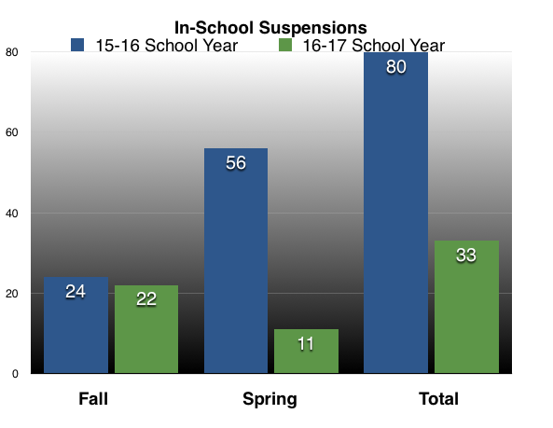
Short-Term School Outcomes
School-wide: 50% reduction in office disciplinary referrals and suspensions in one semester (Spring 2017)
Career & Academic Planning: 60% of students improved their grades within two weeks with all students becoming more aware of their grades and actions they could take to improve
Counseling: Student conversations became more focused around steps they could take to improve; students analyzed the impact of personal behaviors
Notes:
Schools who received training in MPSS reported these kinds of results within weeks of implementing the training. It did not take years to get this kind or results. This type of results were not based on teachers who had years of intense training.
They came to the training with an open mind, a willingness to try something they believed would help their students and very quickly they reported this kind of results.
Is there anything here that you would not want in your schools?

Slide 15
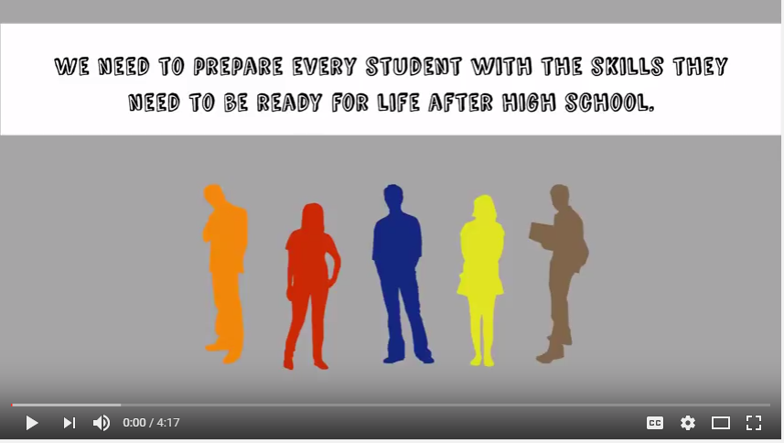
CCC Framework Video
http://CCCFramework.org
Notes:
The CCC frameworks web page has a great deal of free resources for teachers. This is a video that you could have staff or parents watch to help understand what you are doing and why.

Slide 16
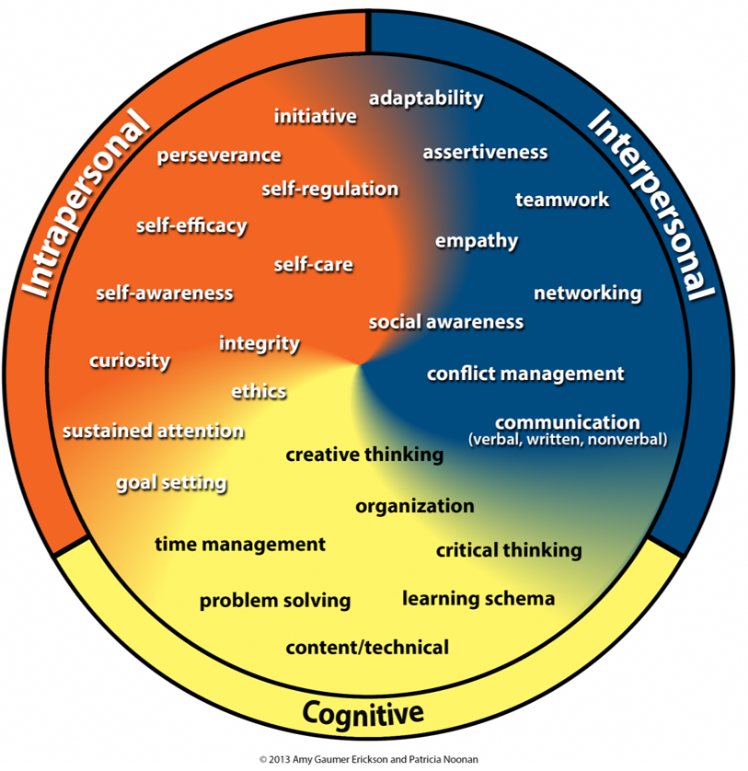
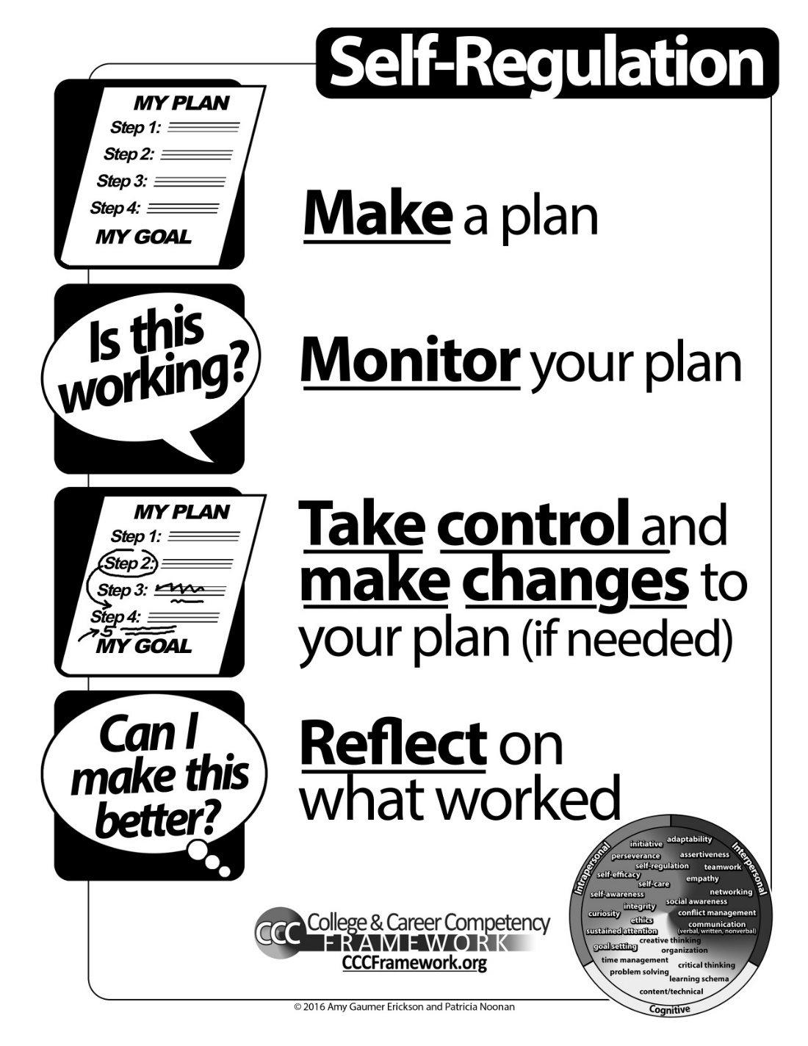
Self-Regulation
Self-Regulation: A proactive, self-directed process for attaining goals, learning skills, and accomplishing tasks
Notes:
This year we are training on the competency of self-regulation during the fall semester. The definition is ………………….. Each competency has essential components which we have depicted as posters that you can download on CCCframework.org. In order to self-regulate, students must do all four components. So students receive instruction, practice and reflect on those 4 components.
The plan may be for them to complete homework, pass a test, manage their behavior and classroom time is used to help them create, monitor, take control and reflect on the success of a plan. That is s o important because a goal without a plan is just a wish.

Slide 17
Self-Regulation Outcomes
Improved student responsibility
Improved ability to set realistic goals, monitor progress, and evaluate results
Improved academic achievement
Increased reflection on successes and areas for improvement
Science: 98% of 8th graders earned a B or higher on a project.
Language Arts: Students increased engagement, wrote higher quality sentences, turned in more work on time, willfully revised writing.
Math: Grades improved; students were able to accurately predict how long assignments would take to complete.
Notes:
This is what teachers reported that they saw after teaching self-regulation.
Seriously, is there any of these bulleted items that you would not want to see in your schools

Slide 18
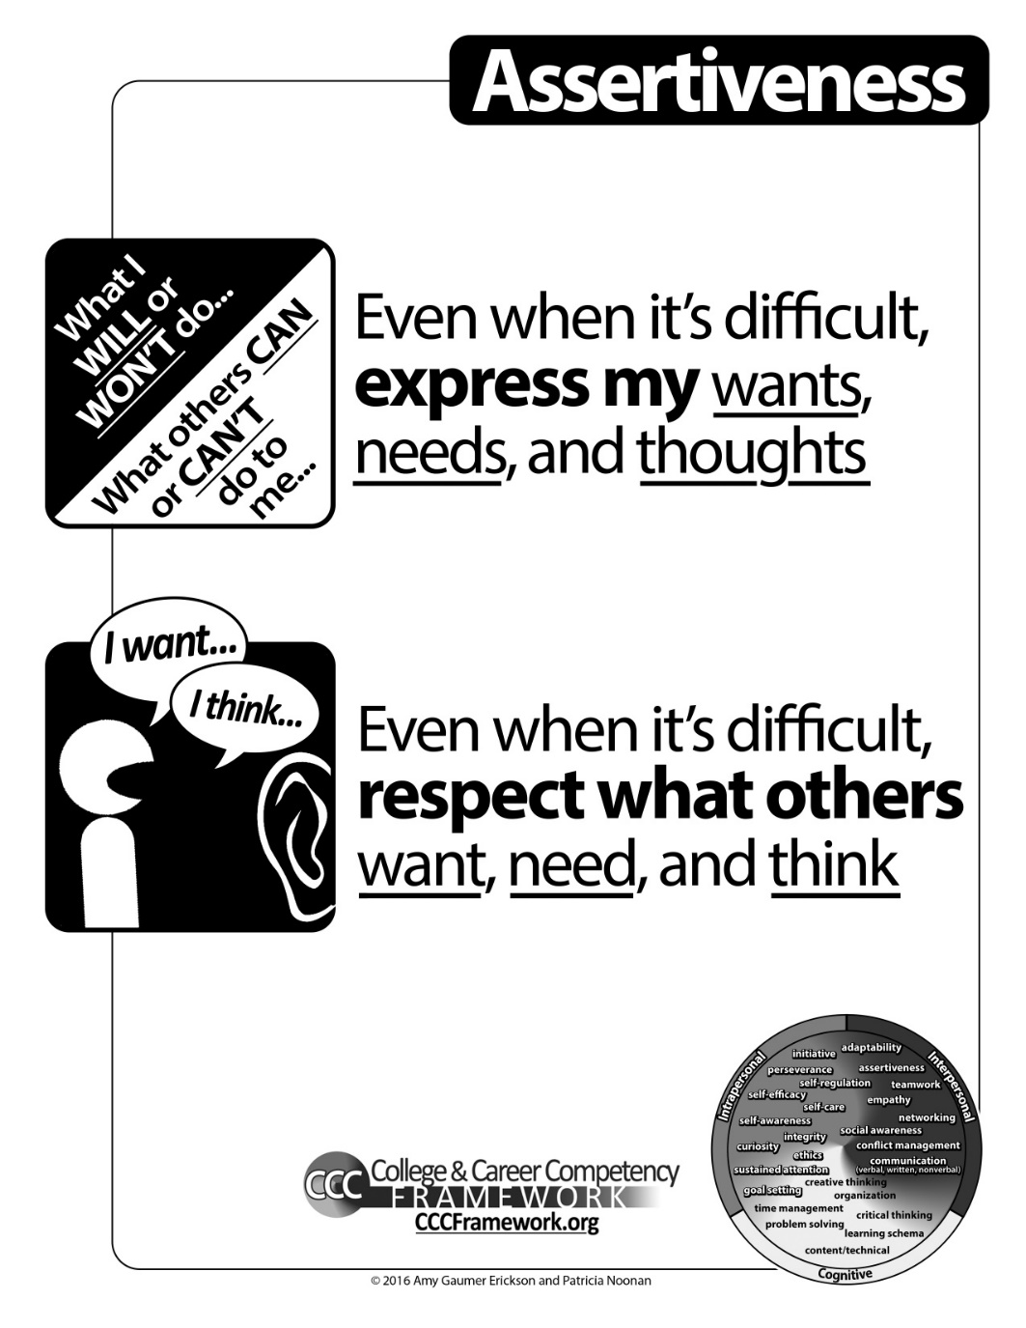
Assertiveness
Notes:
Remember the definition of assertiveness is Even when it is difficult, expressing your wants, needs and thoughts while respecting others.
There are two components that need to be taught in that competency and they are
If I can just express my wants, needs and thoughts and can’t be respectful that is called Aggressive
If I can just respect that wants, needs and thoughts of others but can’t express my own that is called – Passive
We teach students the difference between passive, assertive and aggressive and when to use them

Slide 19
Assertiveness Outcomes
Increased confidence in their own abilities
Increased ability to seek assistance and supports
Improved interactions among students
Improved ability to resist peer pressure
Reduced incidents of bullying
Science: Asking for help more often; less frustrated; sharing opinions and feelings about tough topics.
Language Arts: Improved attitudes, behavior, and conversations; better able to think through issues; improved discussions
Math: Asking more questions and seeking help in class
Notes:
And despite my initial concerns about teaching students to be appropriately assertive… these are the outcomes reported by teachers who utilized the activities and lessons in their classroom
Again, are there any of this you would not want in your schools?
To be passive is to let others decide for you. To be aggressive is to decide for others. To be assertive is to decide for yourself. And to trust that there is enough, that you are enough."

Slide 20
Assertiveness Activity
Part 1: An empathy statement, or indication that you understand another person’s perspective and feelings.
Part 2: The rationale behind your action/request. Provide some reasons and your feelings to support your opinion. Do not blame others (e.g., don’t say “you make me angry”), but do share feelings (e.g., do say “I feel frustrated”).
Part 3: A coherent, direct statement of what you want to happen. Be clear and detailed.
I understand that you have a lot of papers to grade.
I am really trying to improve my math grade.
Could you please grade my test early so that I know what I need to work on.
Notes:
One of the things that we do to teach assertiveness is to teach students 3 part assertive statements and how powerful they can be.
Read slide
Doesn’t that sound so much better that “grade it now?’ As a parent this is reinforcing so much of what you are trying to get your children to do as they take on more and more responsibility in their lives.

Slide 21
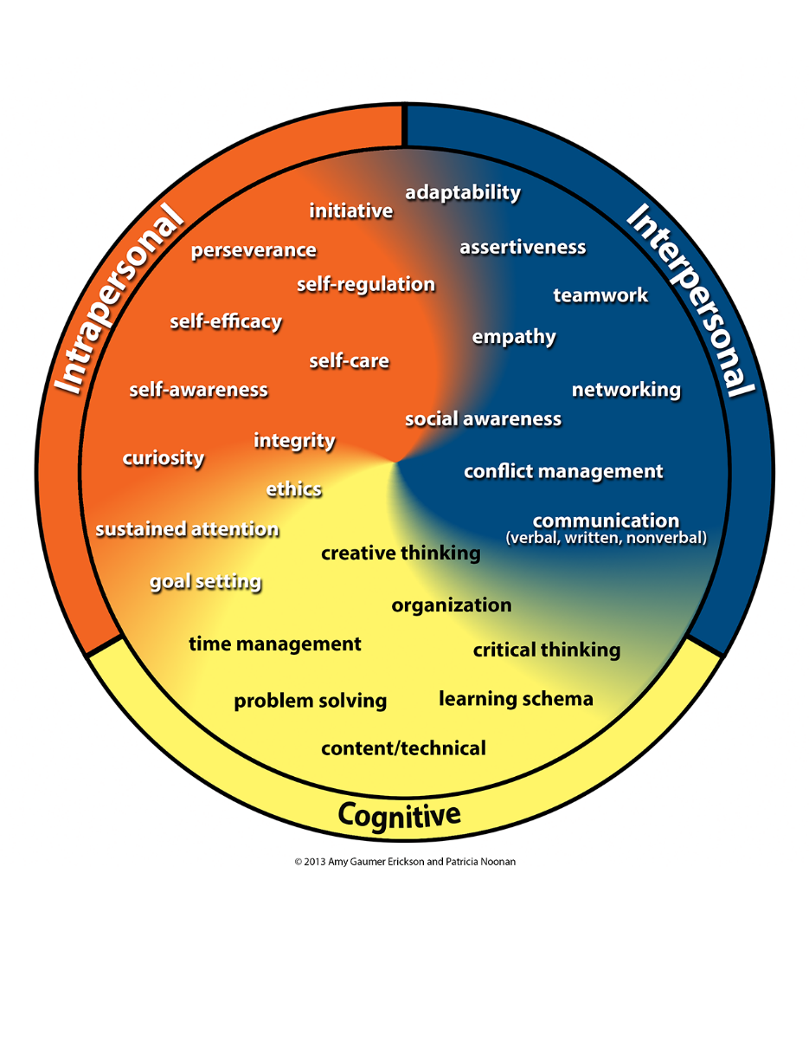
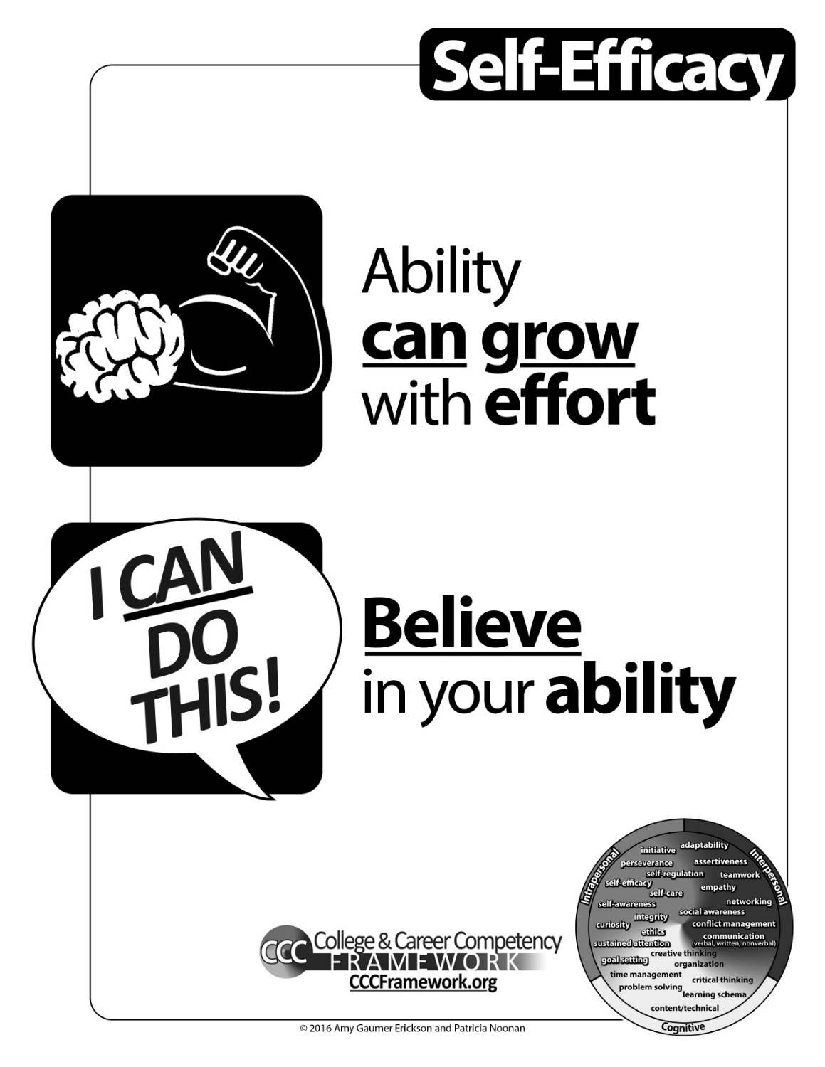
Self-Efficacy
Notes:
Remember the definition of self-efficacy is Believing in your abilities to accomplish challenging tasks and that your ability can grow with effort.
To teach efficacy we teach the two components, the first is the belief that ability can grow with effort. When students understand that intelligence and ability are malleable, they don’t feel their efforts are pointless and are more willing to take chances
The second component is believe in your ability to meet specific goals and or expectations. It is important to recognize their students for both their effort and achievement, increasing their belief that they can accomplish more.

Slide 22
Self-Efficacy Outcomes
Increased confidence in their own abilities
Improved ability to see the areas they needed to work on and why
Increased willingness to take on and persist in challenging tasks
Increased sense of control and awareness of their academics
Science: Students recognized tendency towards negative self-talk regarding academics, and were able to reframe that to positive self-talk
Language Arts: Students changed their habits to seek help when they didn’t understand something; improved engagement
Math: Students’ problem-solving abilities improved; students had better self-awareness of abilities
Notes:
these are the outcomes reported by teachers who utilized the activities and lessons in their classroom
Again, are there any of this you would not want in your schools?
If I have the belief that I can do it, I shall surely acquire the capacity to do it even if I may not have it at the beginning.
Ghandi

Slide 23
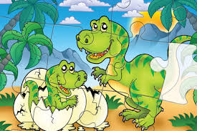
Promoting Self-Efficacy Through Praise
The majority of students who were told, “You are so smart…” chose the easier puzzle or problems.
The majority of students (90%) who were told, “You must have worked hard…” chose the harder puzzle or problems.
Mueller & Dweck, 1998
Notes:
When we praise students for effort we demonstrate that hard work can often win-out over innate talent. This growth-mindset helps students see that intelligence is not fixed and that when students believe that they can get smarter and understand that effort can make them stronger they will put in the extra time and effort that leads to high achievement.

Slide 24
Implementation Issues
Competency development isn’t absorbed; it’s learned.
Like learning anything else, it takes practice over time.
While relatively simple to define, competencies are complex to teach and learn.
Competencies are addressed in school, but not typically in a systematic way for all students.
Notes:
Research tells us that if we want students to develop skills we must work with them to learn those skills. Most students just don’t learn self-regulation by watching others. To make sure students are getting the skills they need to be deliberately taught and students need opportunity to practice these skills. They can be incorporated into the current curriculum and not be a separate activity.
And even though we all understand what it means to have self-regulation it is tricky to teach it so having a common definition and components are helpful and to have students get systemic instruction is very helpful for them.

Slide 25
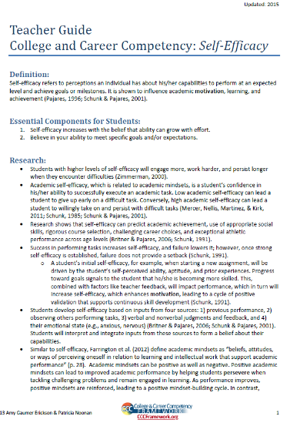
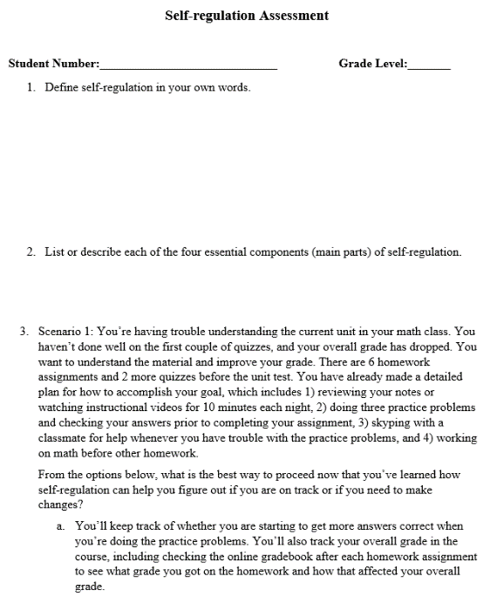
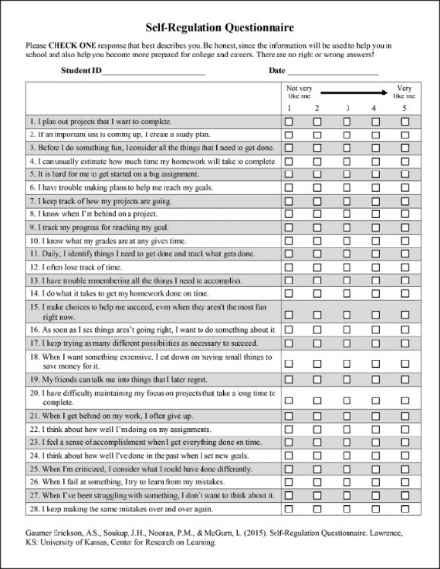
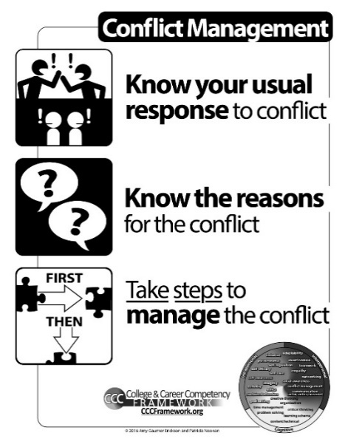
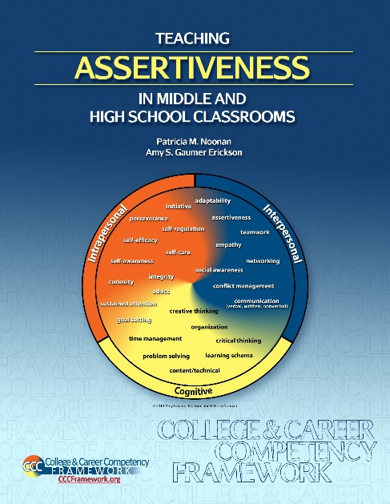
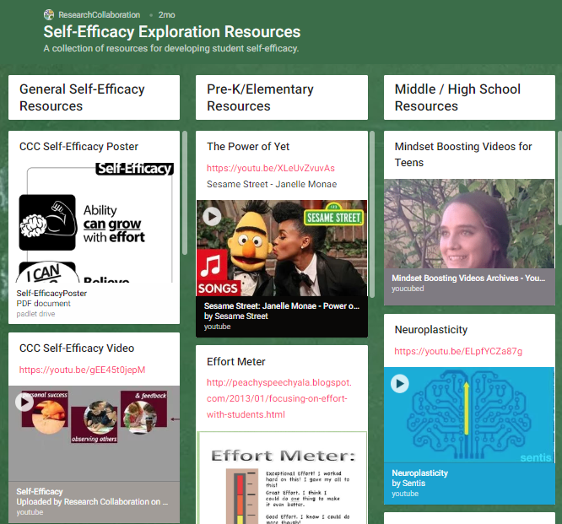
Competency-Specific Resources
Situational Assessments
Teacher Guides
Questionnaires
Lesson Plans
Videos
Posters
Padlets
http://CCCFramework.org
Notes:
The CCC frameworks website is a great resource with lots of helpful information for teachers. They have brought together great resources that teachers can use and assessments they can give students to see where they are in their skill development.

Slide 26
Become Involved in the Missouri Post-Secondary Success Project
Self-Efficacy Cohort
Self-Efficacy cohort begins January 21.
Complete and submit an application.
Two trainings in Columbia.
Followed by on-site coaching and support.
Schools receive $500 stipend.
On-Site Opportunities
Trainings available in Assertiveness, Self-Efficacy, and Self-Regulation
Contact:
Michelle Loewenstein
mloewenstein@ku.edu
Notes:
There is still time to get started this school year. Self-Efficacy is rolling out its training in January. The two training dates in Columbia. We have applications if you are interested,
Most of the RPDCs have scheduled Self-Regulation training. In my area it is December 3. at thye UCM campus. We are happy to come to schools to provide training during the school year. We are required to give the training twice to become certified trainers so we are always looking to get into schools.

Slide 27
4 R’s Reflection Activity
Restate: What did you learn?
React: How might this project meet your school/district need?
Relate: How does it fit with work you are already doing?
Respond: What else do you need to know?

