Slide 1
Overcoming the Disruption: How to Address the Distracting “Concerned Citizen”
Presented by:
Joseph M. Wientge, Jr.
MARE Conference
October, 2019

Slide 2
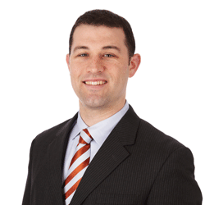
Presented by:
Joseph M. Wientge, Jr.
Littler Mendelson, P.C.
St. Louis
314.659.2017
jwientge@littler.com

Slide 3

Presentation Outline
Disruptions at Board Meetings
Disruptions at School or School Events
Disruptions Online

Slide 4

Who Are The District’s Patrons?
Students
Teachers / Staff
Administrators
Parents
General Public
Board Members
EVERYONE!

Slide 5
Disruptions at board meetings
Overcoming the Disruption: How to Address the Distracting “Concerned Citizen”

Slide 6
Disruptions at Board Meetings
Fight Breaks out at school meeting: 3/9/13
https://www.youtube.com/watch?v=A1shkZENeso

Slide 7

“No Love Lost” Scenario:
Background
Member of general public, father of several students, and former teacher, recently wrote op-ed column for local paper blasting administration’s handling of “Title VII” issues, calling for Superintendent’s termination, and resignation of the entire board

Slide 8

“No Love Lost” Scenario (cont.)
Rises to speak during general public comment section
Can you stop him? – Should you?
What options do you have to exercise control
over situation?

Slide 9

Board Policies
Provides guidance for decision-makers.
The best defense is a good offense – be prepared and know your District’s policies regarding complaints to the Board.
Districts’ policies vary significantly on these issues, so must know and FOLLOW yours.
BOARD
POLICIES

Slide 10
Public Grievance Procedure
Policy KL-AP(1)/1480 - The following steps are to be followed by parents/guardians or the public when questions or complaints arise regarding the operation of the school district.
  Issue should first be addressed to the teacher or employee involved
  Unsettled matters should be presented to the principal
  Then the appropriate Central Office Administrator
  Then the Superintendent
  Finally the Board of Education

Slide 11
Public Grievance Procedure (cont.)
After first level interaction – each step should include written complaint and written response
If issue reaches Board, then Superintendent and Board President shall determine if it will be brought to Board’s attention. Board may address issue without requirement of public comments.
Board Options:
  Do nothing and let Superintendent’s decision stand
  Issue written decision
  Solicit comments from patron during closed session
  Place issue on agenda for public discussion

Slide 12

Public Grievance Procedure (cont.)
Application to Scenario – use grievance procedures to eliminate many potentially contentious issues
  Early resolution
  Support for faculty and administrators
  The Board is not the District’s Complaint Department
  Allows Board and Administration
  to be prepared to address issues
  in public session.

Slide 13
Public Grievance Procedure (cont.)
General Rule – If issue does not have application to broader issues, no need for public comment
  OK to deny request until satisfied policy has been followed
Typically – the patrons will get it exactly wrong and go to the Board first
Follow Policy – students, employees, parents, general public

Slide 14

Maintaining Control During Meeting
Legal Backdrop for Controlling Public Comments
  When discussing potential restraint or limitation of comments – must be concerned about Freedom of Speech applications
  Public forum – different types
    Traditional Public
    Designated or Limited Public Forums
    Non-public

Slide 15
What Type of Forum is Public Comment Section?
Designated or Limited Public Forum
What does it mean:
  Content-based restraints are permitted so long as designed to conform to the limited purpose of the forum
  Viewpoint neutral
  Reasonable in light of forum’s purpose
Result - Policy provides basis for maintaining control over unruly patrons

Slide 16
Legal Basis for Actions During Meeting:
Green Case
Facts of Case
  Community activist arrested when he refused to leave a public board meeting. Plaintiff was charged with disturbing the peace and resisting arrest
Ruling:
  As School Board could reasonably restrict public access to this forum, its authority necessarily included the ability to remove an unruly or disruptive member of the audience:
    “to prevent his badgering, constant interruptions, and disregard for the rules of decorum.” Green v. Nocciero, 676 F.3d 748, 753 (8th Cir. 2012)

Slide 17
Maintaining Control Through Policy:
Policy 0412/BDDH – Typical Language
Time for public comment shall not exceed 30 or 15 minutes (depending on specific policy).
Must register to speak and identify the matter before the meeting is called to order.
Can only speak once.
3 minute limit per speaker.
Board members cannot respond to any comment that is not on the agenda.
Alternatively, public can only speak on agenda item.

Slide 18
Impact of Policy on Scenario
Read District’s public comment policy at start of each comment period
Determine if topic is permissible under your policy
Consistently follow policy
Enforce the policy
  Problems arise when policy is not enforced – looks like District is not viewpoint neutral, and restrictions become unreasonable.

Slide 19

Exercise: What Types of Conduct/Speech Can Board Restrict?
Comments critical of Board, Admin, Teachers,
employees, students?
Personal attacks?
Obscenity/profanity?
Generally disruptive conduct:
  Interruptions
  Refusing to follow established limits
  Threats

Slide 20
War and Hell Broke loose at West New York Board of Education (5/16/2011)
Julio Reynoso
https://www.youtube.com/watch?v=mLHJgCi2Iwk

Slide 21

Practical Tips for Addressing Unruly Patron(s)
Plan ahead
  If contentious issues will be addressed, Board President and Superintendent should discuss
  safety issues ahead of time
Board may meet to discuss ways
to facilitate conversations
  Beware of Sunshine Act Issues

Slide 22

Practical Tips for Addressing Unruly Patron(s) (cont.)
Board President must be prepared to enforce policy:
  Three strikes and you’re out policy
  Upon first violation – stop patron, identify policy, warn
Escalating discipline:
  Prevented from making
  further statement
  Asked to leave
  Escorted out
  Arrested – absolute last resort

Slide 23
Teacher Forcibly Removed, Arrested at School Board Meeting (January 9, 2018)
https://www.youtube.com/watch?v=Ix9lIwa9h1E

Slide 24
Unintended/Unknown Disruptions
Discussion of student discipline issues –
not proper forum
  Potential FERPA violation – District’s responsibility
  to prevent
Identification of special education kids
  IDEA violation – potentially big problem
Personnel files
Other confidential issues: litigation, employee discipline
  Discussion of employee performance, not the
  same as discipline

Slide 25

Board Member Causing Disruption
Confront – Closed Session
Confront – Open Session
Warnings from Board President
Board Resolution

Slide 26
Disruptions at
School / Events
Overcoming the Disruption: How to Address the Distracting “Concerned Citizen”

Slide 27
Disruptions at School / Events
Scenario – Parents attend a meeting with the principal following their child being punished for disruptive behavior at school. While the mother was meeting with the principal to address the behavior of her child, the father decides to trespass into an area in the school that was off limits to visitors.

Slide 28
Limiting Access to School Property
School has the authority to ban individual from property
  Supreme Court – No unfettered access to school property or events
  KK-AP(1)/PR 1431: Individuals can be banned from property
What can result in ban:
  Possession or under the influence of alcohol or drugs
  Possessing a weapon in violation of Board policy
  Fighting, threats, or profanity
  Engaging in any illegal or disruptive activity
  Violating Board policy or failing to obey the instructions of
  a security official or school district employee

Slide 29

Limiting Access to School Property (cont.)
Typical responses from Patrons:
  Freedom of Speech/Association
  Right of the Parents to participate in their Child’s education
  Due Process
All true – still can ban people, might need to be creative
Scenario example – even if ban is appropriate, work with Dad to provide him opportunity to
participate in daughter’s education
  Parent-teacher meeting – separately
  Ability to communicate with teachers,
  electronically, or through principal, etc.

Slide 30
Limiting Access Checklist
Who bans – Superintendent, in consultation with attorney, Board, if time allows.
Ban letter contents:
  Identify Ban and length
  Reason
  Policy/regulation citation – provide copy
  Board’s discretion to reduce or extend
  If Parent – still permitted to participate in education
  Authorities will be notified of violations/prosecuted
Meeting if possible, if not mail and Certified mail

Slide 31

Limiting Access Checklist (cont.)
Disseminate ban to individuals
who need to know:
  Law enforcement
  Building principals
  Teachers
  Secretaries – whomever is
  responsible for access to buildings
Follow up on any violations –
notify individual and law enforcement
Press trespass charge or seek injunction

Slide 32

Other Disruptions:
“Cares-Too-Much” Mom
Shows up for reading EVERY DAY for her son
Policy 1430 – a parent does not have a right to observe his/her child in the educational setting.
Policy KK: parents discouraged from using district property to visit students and may be refused the use of district property for that purpose. The District will not tolerate any person whose presence disturbs classes or district activities or hinders the instructional process

Slide 33
School Disruptions: Test Your Knowledge
Sally and several other students have been planning a District-wide walkout to protest gun violence. This walkout coincides with nationwide planned walkouts. The District clearly communicated to parents the event was not school sponsored; however they permitted students to participate in the walkout without facing disciplinary action. The District prohibited students from using any language specifically referencing guns or gun violence, out of a desire to remain neutral regarding Second Amendment issues. The District then shut down the event when students began discussing gun violence rather than school safety at gun violence awareness rally.
Does it matter that the event was not school sponsored?
Under the First Amendment, can the District prohibit speech relating specifically to guns or gun violence?
What action, if any, can the school take against students who state have specific views on guns or gun violence?

Slide 34
School Disruptions: Test Your Knowledge
Jeffrey is the quarterback for the school football team and follows the NFL closely. After agreeing with Colin Kaepernick’s decision to kneel during the National Anthem, Jeffrey begins kneeling during the National Anthem before football games. The coach is furious and wants to suspend Jeffrey from the team.
Was Jeffrey’s conduct protected by the First Amendment?
What risk is there to the school if it permits Jeffrey to kneel?
Does it matter that Jeffrey did not use words or say anything while he kneeled?
Does it matter that this occurred after school hours for a school-sponsored sport?
What action, if any, can the school take against Jeffrey?

Slide 35
School Disruptions: Test Your Knowledge
Frank and several other students have been planning to walk out on April 20, 2019 to protest Donald Trump. Frank is able to get 150 students to commit to walking out on that day and notified the principal so that the school would be aware of Frank’s plans.
Is Frank’s planned protest protected by the First Amendment?
Does it matter that the protest has not taken place yet?
What action, if any, can the school take against Frank?
What action, if any, can the school take against the students who walk out?
What if the discipline planned by the school interferes with the student’s ability to get into college or eligibility for a scholarship?

Slide 36

Free speech or Disruption?
Students do have a constitutional right to free speech at school but it can be regulated so that it does not interfere with the operations of the school or infringe upon the rights of others

Slide 37

Free speech or Disruption? (cont.)
Absolutely not
Schools are permitted to ban speech or conduct that materially and substantially disrupts the work and discipline of the school
However, protesting is a form of protected student speech

Slide 38
“King of the Castle” Board Member
Board member believes he is a generous benefactor to the district. Shows up frequently
at the school to “check up on things.” Shows
up to cafeteria, doesn’t like meal, so he tries
to bring in different, “better” food.
Denied access, but has a key, so lets himself in after school’s out. Removes district food and puts in his own. Pad-lock and chain placed around refrigerator, he uses bolt-cutter to remove them.

Slide 39

The “King of the Castle” Board Member (cont.)
Policy 0311 – individual Board members must follow the regular procedures for visitors.
If Board member wishes to visit school, must arrange it through the Superintendent.

Slide 40
Disruptions Online
Overcoming the Disruption: How to Address the Distracting “Concerned Citizen”

Slide 41
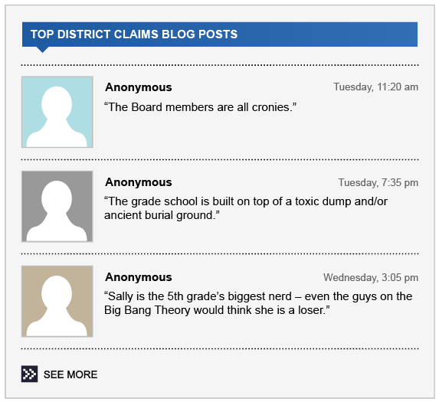
“Local Blog” Scenario

Slide 42




  @jbarr The Administrators are only in it for the paycheck
#overpaid #cakejob #countingthedaystoretirement
12:47 PM August 2nd via Seesmic
@labeen My son’s third grade teacher at District 13 is dumber than
a box of hammers
#itainthammertime #toolegittoquit
1:08 PM August 2nd via Seesmic twhirl in reply to rsanchez
My District’s MAP scores are atrocious. It’s like the inmates are running the asylum over there.
#getoutwhileyoucan #fridaynightisfrightnight
1:02 PM August 2nd via Seesmic twhirl

Slide 43
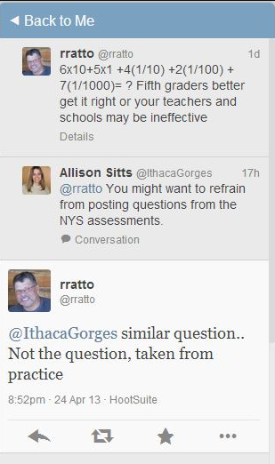
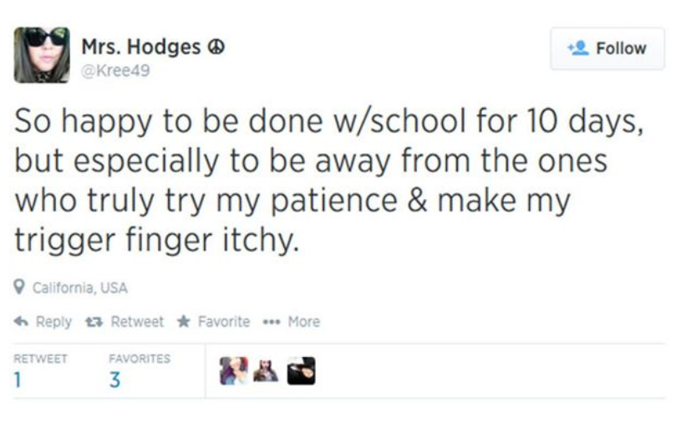
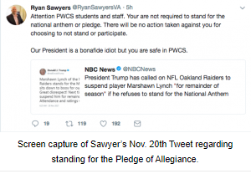

Slide 44
How Do You Investigate?
Determine who posted the statements
  If statements are from employees or students –
  more power to address it
How do you determine who made the statements?
  Traditional investigation
  Ask website for information:
    User name
    Actual name
    IP address
  Possible legal action with subpoena directing production
  of information

Slide 45

How Do You Respond?
Different options depending if poster is:
  Employee of the District;
  Student; or
  Member of the public

Slide 46

Employee: Response Test
  Garcetti – DA commented on office’s conduct in pending case
Test - Speech protected when teacher is speaking as private person on a matter of public concern

Slide 47

Employee: Response Test (cont.)
Garcetti – If not matter of public concern, then can potentially be subject to discipline, even if after school and using personal computing equipment.

Slide 48

Student: Response Test
NEXUS TEST (Tinker case):
  Practical Application: Connection between off-campus speech and material and substantial interference with efficient school operations.
  Students can be disciplined for speech that occurs off-campus when a relationship or nexus to the school can be established.

Slide 49
Student: Response Test (cont.)
Scenario: Parents are upset with principal’s leadership and hold many meetings in an effort to get her fired. Student overhears parent discussing his dislike for principal and decides to make a dozen stickers with principal’s face that state “fire principal.” Student hands a few stickers out during class which causes the teacher to send student to the principal. One sticker ends up on a gym water fountain.

Slide 50

Student: Response Test (cont.)
Response to online student disruption depends on type of speech.
Be vary wary of reacting to the following:
  Off campus communications which don’t threaten.
  Insufficient connection between speech and substantial disruption in school.
  The communication is directed toward someone other than students.

Slide 51

General Public: Response Options
Ignore
  Often times best advise
Removal of offensive post
  Seek assistance from service provider
Respond
  Almost never a good idea
  Response not approved
  Nothing resolved

Slide 52
Response Options (Cont.)
Fox cautionary tale
  Certain concerned citizens posted thread on Topix forum accusing administrators of nepotism
  Response: administrators allegedly responded and accused citizens of: 1) pedophilia; 2) bestiality; 3) serial killing; 4) homosexuality; 5) kidnapping; and 6) domestic terrorism.
  Result: One administrator fired and another resigned; significant issues for District; and lawsuit against administrators individually for defamation.

Slide 53
Lawsuit Options for Individuals
Defamation – essentially the same as libel/slander
Elements:
  Publication;
  Defamatory statement;
    Harms the reputation or deters people from associating with you
  Identifies plaintiff;
  False;
  Published with requisite degree of fault;
    Public Figures – Malice
      Defendant actually knew it was false; or
      Serious doubts about it (reckless disregard)
  Damages Plaintiff’s reputation

Slide 54

Lawsuit Options (cont.)
Defamation – lawsuit almost never a good idea
  Very hard to prove
  Distracting
  Who is suit brought by (individual or district)
  Costly
  Recovery worth it?

Slide 55
Final Thoughts:
Know and Follow Policies
Prepare in Advance for Potentially Disruptive Situations
Keep Open Lines of Communication
Be Consistent in Enforcement of Policies
Do Not Be Afraid to Take Decisive Action to Prevent or Control Disruptive Patron

Slide 56

Questions?

Slide 57


Unruly Patrons:
How to Handle Overzealous
“Concerned Citizens”
October, 2019

