Slide 1
October 24, 2019 Ryan Fry and Alex Hall
MARE/MO K-8 Fall Conference
Virtual Education –
Welcome to the Future!
www.gmschoollaw.com|1-833-GMEDLAW| @GuinMundorfKC

Slide 3
I Want It All & I Want It Now | Money, Money, Money | Talk to the Judge | I Know What’s Best for Me | Legal Potpourri
400 | 400 | 400 | 400 | 400
600 | 600 | 600 | 600 | 600
800 | 800 | 800 | 800 | 800
1000 | 1000 | 1000 | 1000 | 1000

Slide 4
I Want It All & I Want It Now for 400
As a provider of virtual education services in MO, you must be what.

Slide 5
I Want It All & I Want It Now for 400
Q. What is an approved provider?

Slide 6
I Want It All & I Want It Now for 600
This provider was the test case in Missouri for gaining approval from DESE.

Slide 7
I Want It All & I Want It Now for 600
Q. What is MOVA?

Slide 8
I Want It All & I Want It Now for 400
What did we learn from Estill v. DESE?

Slide 9
I Want It All & I Want It Now for 800
This is the number of credit hours that equates to a full-time virtual equivalent student.

Slide 10
I Want It All & I Want It Now for 800
Q. What is six?

Slide 11
I Want It All & I Want It Now for 800
Can a student mix and match?
What unwanted scenarios may that create?

Slide 12
I Want It All & I Want It Now for 1000
This is the grade range eligible for virtual course enrollment.

Slide 13
I Want It All & I Want It Now for 1000
Q. What is K-12?

Slide 14
Money, Money, Money for 400
This is the max price for an single semester equivalent course.

Slide 15
Money, Money, Money for 400
Q. What is 7% of SAT?
Current SAT of $6,308 ($441.56)

Slide 16
Money, Money, Money for 600
These are the two basic requirements obligating districts to pay for a student’s virtual courses.

Slide 17
Money, Money, Money for 600
Q. What are 1) full-time enrollment for one semester and 2) approval from the district through its process?

Slide 18
Money, Money, Money for 600
Caveats to one semester enrollment: 1) medical diagnosis, and 2) prior virtual enrollment

Slide 19
Money, Money, Money for 800
This is how frequently districts are obligated to pay for virtual education services.

Slide 20
Money, Money, Money for 800
Q. What is monthly?

Slide 21
Money, Money, Money for 1000
Upon the occurrence of this event, a district may stop making monthly payments to a virtual education provider.

Slide 22
Money, Money, Money for 1000
Q. What is upon a student’s un-enrollment from a course?

Slide 23
Money, Money, Money for 1000
DESE and our districts are supposed to track virtual achievement – how long will it take to start getting a good picture of virtual education results?

Slide 24
Talk to the Judge for 400
This body hears the initial appeal of a regular education student denied enrollment in a virtual course.

Slide 25
Talk to the Judge for 400
What is the local Board of Education?

Slide 26
Talk to the Judge for 600
This is the appropriate body for appealing the denial of virtual education services to a special education student.

Slide 27
Talk to the Judge for 600
Q. What is the administrative hearing commission?

Slide 28
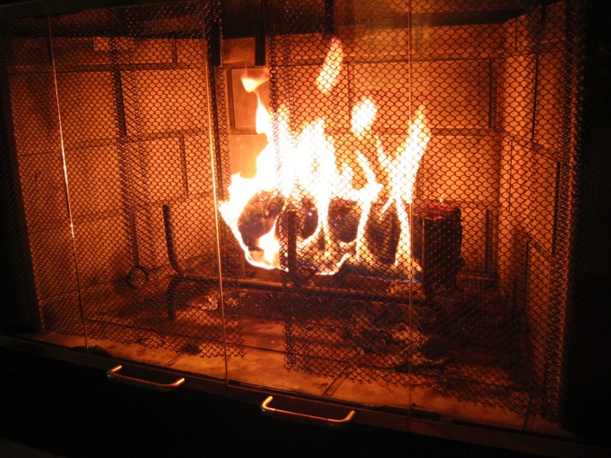
Talk to the Judge for 600
Why not throw another log onto the AHC fire?

Slide 29
Talk to the Judge for 800
This document must be submitted by a parent/guardian and the district in the event of an appeal to the BOE.

Slide 30
Talk to the Judge for 800
Q. What is the written rationale for seeking/denying virtual education services?

Slide 31
Talk to the Judge for 1000
This is the final authority for decisions related to virtual course eligibility.

Slide 32
Talk to the Judge for 1000
Q. What is DESE?

Slide 33
I Know What’s Best for Me for 400
To allow enrollment in a virtual course, the district must determine that it is in the ______ _______ ______ of the student.

Slide 34
I Know What’s Best for Me for 400
Q. What is Best Educational Interest?

Slide 35
I Know What’s Best for Me for 600
This course is not presently a virtual course offering in the State of MO.

Slide 36
I Know What’s Best for Me for 600
Q. What is
Physical education
3rd grade art
Speech class
Driver’s education
None of the above?

Slide 37
I Know What’s Best for Me for 800
True or False – a student may not take a virtual course offering that is also offered in the district?

Slide 38
I Know What’s Best for Me for 800
Q. What is false?

Slide 39
I Know What’s Best for Me for 1000
A student may elect to take a virtual course in this location.

Slide 40
I Know What’s Best for Me for 1000
Q. What is any location?

Slide 41
Legal Potpourri for 400
An A+ student who successfully completes a virtual course is attributed this percentage for attendance.

Slide 42
Legal Potpourri for 400
Q. What is 95%?

Slide 43
Legal Potpourri for 600
This is the number of virtual courses creating the requirement for a individual learning plan (ILP) or an individual career and academic plan (ICAP).

Slide 44
Legal Potpourri for 600
Q. What is 3?

Slide 45
Legal Potpourri for 800
The enrollment process for virtual courses should be _______ ______ to the typical process by which a student would enroll in on-campus district courses.

Slide 46
Legal Potpourri for 800
Q. What is substantially similar?

Slide 47
Legal Potpourri for 1000
This is the easiest way to run afoul of the MOCAP notice requirements.

Slide 48
Legal Potpourri for 1000
Q. What is failing to post notice on your district website.

Slide 49
October 24, 2019 Ryan Fry and Alex Hall
MARE/MO K-8 Fall Conference
Virtual Education –
Welcome to the Future!
www.gmschoollaw.com|1-833-GMEDLAW| @GuinMundorfKC

