Slide 1
The Nature of Regional Professional Development Centers: Helping Improve Student Achievement
Russ Brock
Coordinator of Programs
Agency for Teaching, Leading, and Learning
Jim Judd
Director
Northeast RPDC
Truman State University

Slide 2
The Value of Ongoing Professional Development
Educator preparation programs cannot prepare educators for everything they will encounter during their career
New techniques, strategies, methods, and systems are being developed and researched
The educational landscape changes over time and educators need to stay current
Teachers and administrators both need to grow in the profession

Slide 3
Dr. John Hattie’s Research
Completed a meta analysis of 1000 research reviews conducted on variables that impact student learning
To date, his analysis includes over 50,000 studies involving 250 million students.
He created an effectiveness scale and rated each variable according to the impact the variable had on student learning

Slide 4
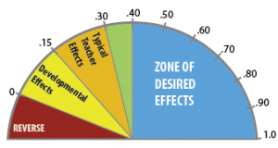
Scale of Effective Practices - Dr. John Hattie
.40 is equal to one years’ growth over one year of time

Slide 5
Research-Based Best Practice - Dr. John Hattie
Teachers shared belief that through collective action, they can positively influence student outcomes, including impacting those who are disengaged and/or disadvantaged.
1.57 effect size
Collective Teacher Efficacy
Notes:
Marzano

Slide 6
Research-Based Best Practice - Dr. John Hattie
Self-Reported Grades
Students knowing about their chance of success
Awareness of what they know about a subject
1.33 effect size
Notes:
Marzano

Slide 7
Research-Based Best Practice - Dr. John Hattie
Instructional Quality
Teachers ability to identify essential representations of subject
Guiding learning through classroom interactions
Monitoring learning and providing feedback
Influence student outcomes
1.00 effect size
Notes:
Marzano

Slide 8
Research-Based Best Practice - Dr. John Hattie
You had the child for a year, and you failed, now you’re going to give him the same kind of curriculum, the same kind of strategies…
What that kid needs is not more, he needs different.
- John Hattie
-0.17 effect size
Retention
Notes:
https://www.youtube.com/watch?v=sng4p3Vsu7Y

Slide 9
Research-Based Best Practice - Dr. John Hattie
The problem with tracking is the expectations it sets for kids.
It says to them very clearly, this is where you perform...
0.12 effect size
Quite often teachers only teach material that is relative to that tracking. -John Hattie
Ability Grouping
Notes:
https://www.youtube.com/watch?v=m6czhy6kPpc

Slide 10
Research-Based Best Practice - Dr. John Hattie
If you are going to reduce class size, the first thing we have to do is change how we teach. - John Hattie
.21 effect size
Class Size
Notes:
http://thelearningexchange.ca/videos/john-hattie-class-size/

Slide 11
Regional Professional Development Centers
Region 1 – Cape Girardeau – Southeast Missouri State University
Region 2 – Columbia – University of Missouri
Region 3 – Kansas City – University of Missouri, Kansas City
Region 4 – Kirksville – Truman State University
Region 5 – Maryville – Northwest Missouri State University
Region 6 – Rolla – University of Missouri, S & T
Region 7 – Springfield – Missouri State University
Region 8 – St. Louis – Ed Plus
Region 9 – Warrensburg – University of Central Missouri

Slide 12
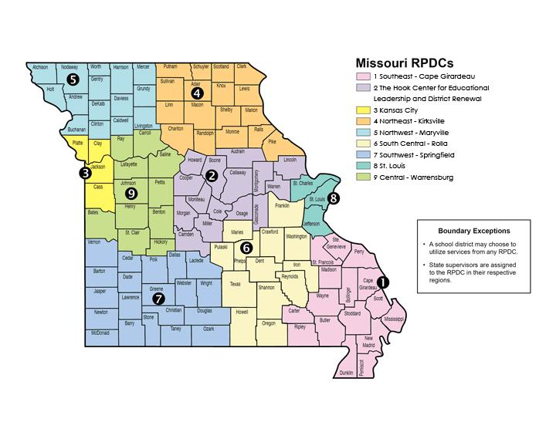

Slide 13
RPDC Programs and Services
The RPDC’s provide training, mentoring, observation, feedback, coaching, and support across a wide spectrum of programs and services.
Some of the work RPDC’s do with school districts is free or at a low cost.
The Statewide Mission of the RPDC’s is to build the capacity of educators through high quality professional learning to maximize student success.
Specific programs and services available are as follows:

Slide 14
Special Needs Students
Special Education Compliance – works with teachers and administrators to assist them in complying with all special education laws.
Special Education Improvement – works with teachers and administrators to assist them with improving the quality of their special education services.
Blindness Skills – works with teachers and administrators to assist them in providing services to visually impaired students.
ELL/Migrant – works with teachers and administrators to assist them in providing services to students who qualify for Migrant and English Language Learner services.

Slide 15
Addressing student behavior issues
Positive Behavior Interventions and Support – (PBIS)
Works with schools to implement the PBIS system to address student behavior issues. By reducing the number of office referrals and discipline issues, students are more focused on learning and the result is increased student achievement.

Slide 16
Career Focused Efforts
Career Advisor – works with school counselors and teachers to improve the quality of the Individual Career and Academic Plans for middle and high school students.
Career Pathways Regional Consultant – works with schools, career centers, and local employers to increase student opportunities for job shadowing, internships, externships, and workplace experiences to help prepare them for employment opportunities after high school.

Slide 17
Missouri Model Districts
Missouri Model Districts (MMD) is a pilot program that began last year and involves training and assisting school districts in identifying and implementing effective teaching practices, using common formative assessments to evaluate results on an ongoing basis and making decisions based on that data.
The main components of MMD work include Collaborative Teams, Data-Based Decision Making, Common Formative Assessments, Effective Teaching and Learning Practices, School-Based Implementation Coaching, and Leadership.
The goal is to implement this in every school in the district.

Slide 18
Missouri Leadership Development System
MLDS provides training for principals and assistant principals from their first year until retirement
Assigns mentors for principals in their first and second years

Slide 19
Teacher Development
Beginning Teacher Assistance Program (BTAP)
Mentor/Mentee training
Teacher Academy
Professional Development Committee training

Slide 20
Dyslexia Training
State Mandated Dyslexia and Related Disorders Training – 2 hours
Techniques and Strategies in serving students with dyslexia

Slide 21
Content Area Specific Training
Standards
Curriculum Development
Assessment Development
Horizontal and Vertical Alignment
STEM/STEAM

Slide 22
Other training and support
Technology Integration
Project Based Learning
Cognitive Coaching
Adaptive Schools
Instructional practices
Becoming a Trauma Informed School
Effects of Poverty on Learning

Slide 23
Observation/Feedback/Coaching
Effective implementation of any initiative begins with training but should also include observation, feedback, and coaching.
RPDC consultants are uniquely qualified and available to observe the implementation of teaching practices and provide valuable feedback and coaching
Many implementation efforts struggle or fail due to a lack of support during the implementation process

Slide 24
Regional Connections and Networking
RPDC’s, through training, workshops, and cohort groups, connect teachers and administrators from different schools and provide opportunities for valuable networking to occur.
Teachers and administrators benefit when connecting with their peers from other schools by learning from each other.

Slide 25
RPDC Consultants
Former Teachers, and Administrators
Many are retired from public education with several years of experience
Well trained in all areas where services are provided
Continue to receive training each year

Slide 26
Contact Information
Russ Brock
Agency for Teaching, Leading, and Learning
Missouri State University
rbrock@missouristate.edu
417-836-4092
Jim Judd
Northeast RPDC
Truman State University
judd@truman.edu
660-785-4310
Questions?

