Slide 1
Interpreting Data to Make Data-Driven Decisions
https://goo.gl/DxePei

Slide 2
Who am I?
Melissa Husereau
Director of Teaching and Learning
mhusereau@stcmo.org
636-629-3500 ext. 3008
@husereaumelissa

Slide 3
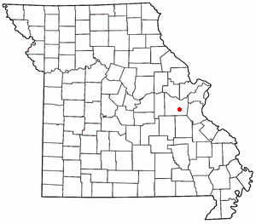
Where Am I From?
St. Clair R-XIII School District
4 buildings:
St. Clair Elementary (preK-2)
Murray Elementary (3-5)
St. Clair Junior High (6-8)
St. Clair High School (9-12)
Approximately 2200 students
210 certified staff including administration
230 classified staff members
Instructional Coaches at each building

Slide 4
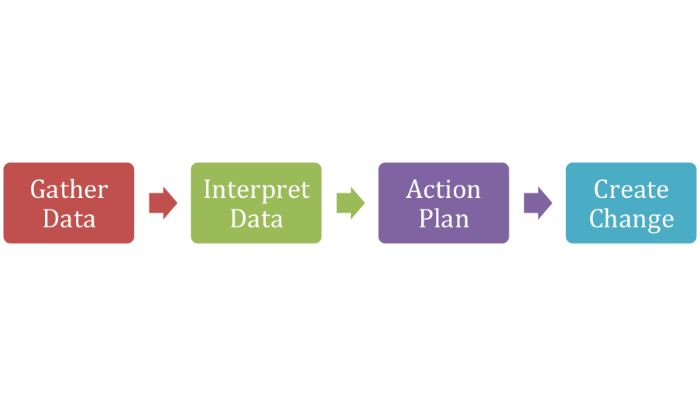
Why Are We Here?

Slide 5
Does Data Make You Feel Like…?

Slide 6
What is data?
Use a shoulder partner and in one minute brainstorm what data is to you.

Slide 7
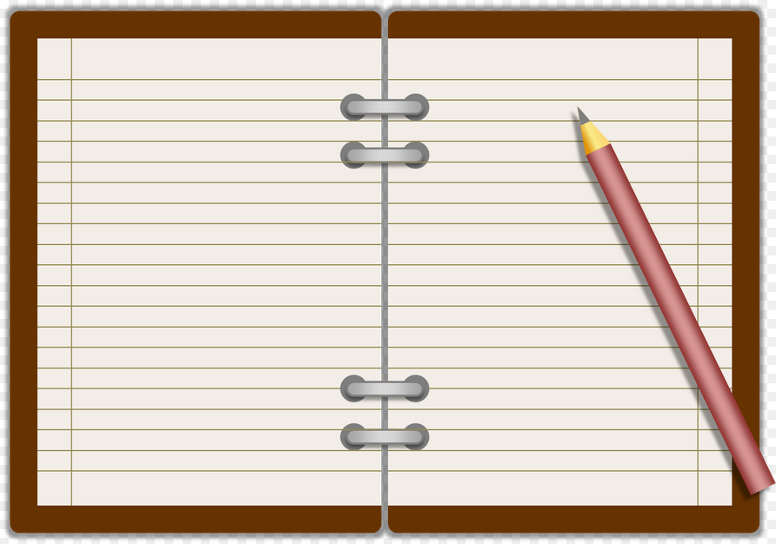
Big Data vs Little Data
Each can drive instruction and/or alter instruction
Everybody Writes
What is Big Data?
What is Little Data?

Slide 8
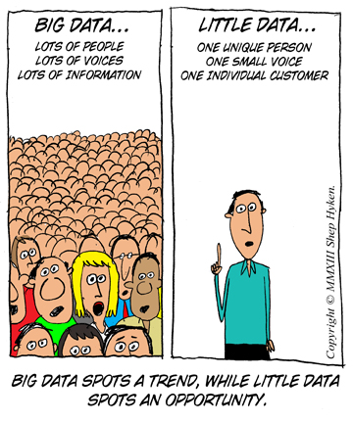

Slide 9
Big Data Examples
MAP
Pre and Post Assessments
Benchmark Assessments
SLOs
Surveys

Slide 10
When and Why Use Big Data?
Big Data is effective to use to establish a scheme and plan for unit instruction. This gives a big picture.
Big Data can also assist in chunked lesson plans. Chunked plans are basically a list of plans created based on Big Data that may last longer or shorter than the original time thought.
Big Data is best studied for larger group of students.
For example, the class scored particularly low in fractions, so unit lessons need to reflect more diligence in that area.
Benchmarking

Slide 11
Little Data Examples
Thumbs up/Thumbs Down 1-5 Hand Signs Clapping
3 pile strategy Call and Response Anticipation Guide
Exit Tickets Thermometer Hand Parking Lot Chart
Twitter Post Activity Kahoot, Quizlet, Plickers, Padlet, etc.
Opinion Charts (students write their opinion about what they learned)
Scaled ratings (1-10 scale, circle where you are from confident to not confident)
Predict success (students predict score on an assessment, then compare assessment score to prediction score)
Case scenarios (writing skill activity = explain or narrate what they might do to solve a problem
...The list is long and plentiful.

Slide 12
When and Why Use Little Data?
Little data is awesome for Checks for Understanding. They can and should be used multiple times per class.
Use little data to tweak the lesson in class. No plan is perfect as each class changes and taking in little data helps adjust for each class.
Use little data see what students need differentiation.
Use little data to create student groupings.
Use little data to see what sticks and what gets thrown out of a lesson.

Slide 13
How Do We Use Big Data?
MAP
Quarterly Benchmarks
Pre and Post Assessments

Slide 14
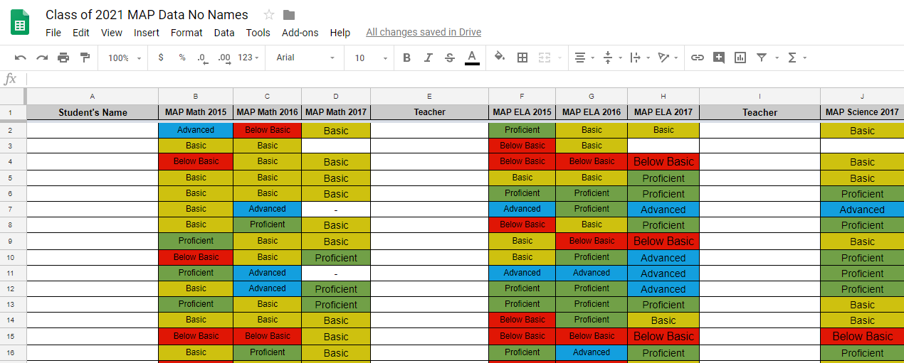
Overall MAP Data
Spreadsheets By Graduating Class

Slide 15
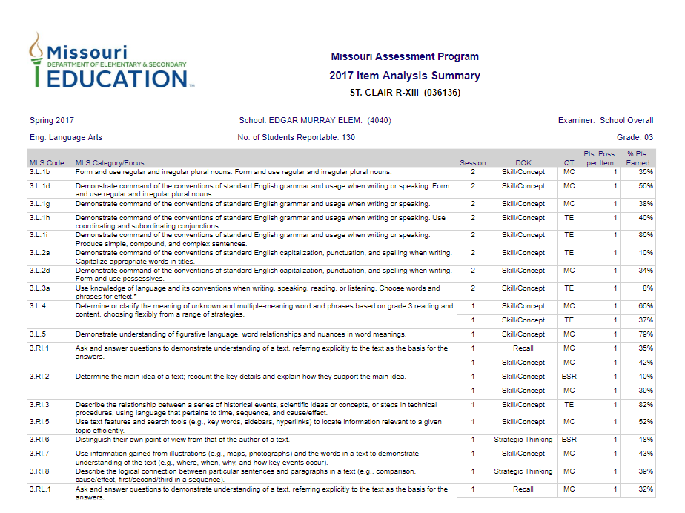
MAP Item Analysis Summary

Slide 16
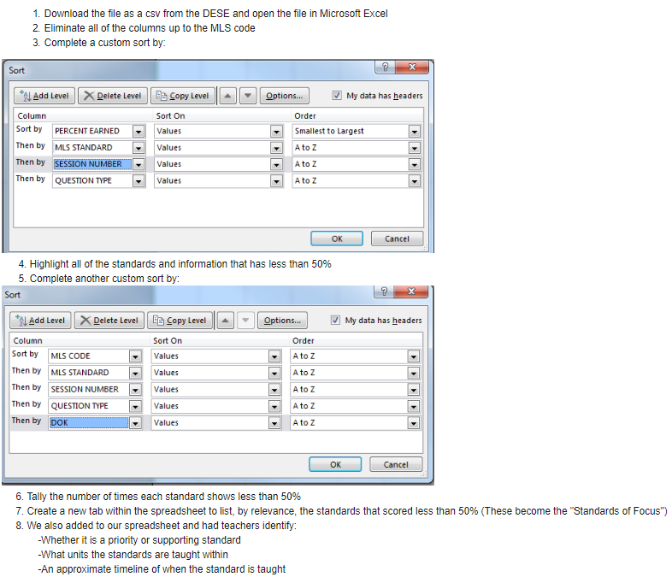
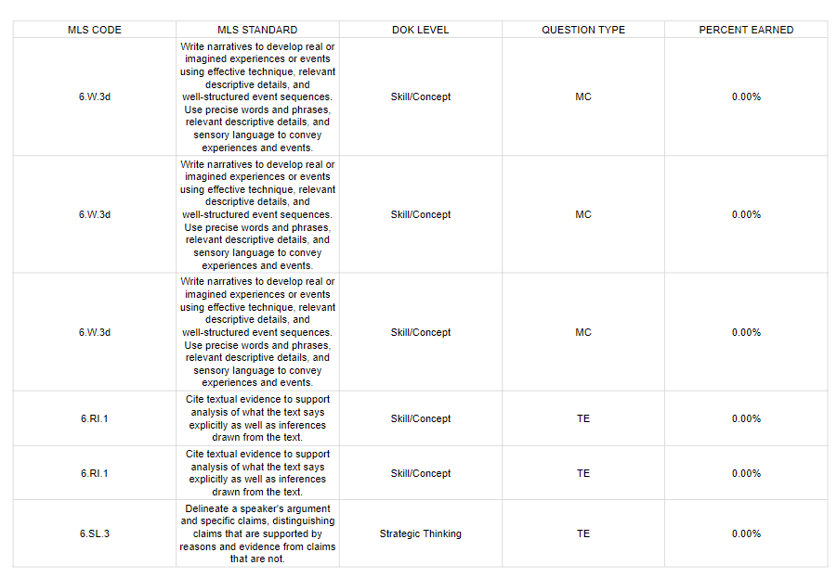
Sorting the MAP Item Analysis Summary

Slide 17
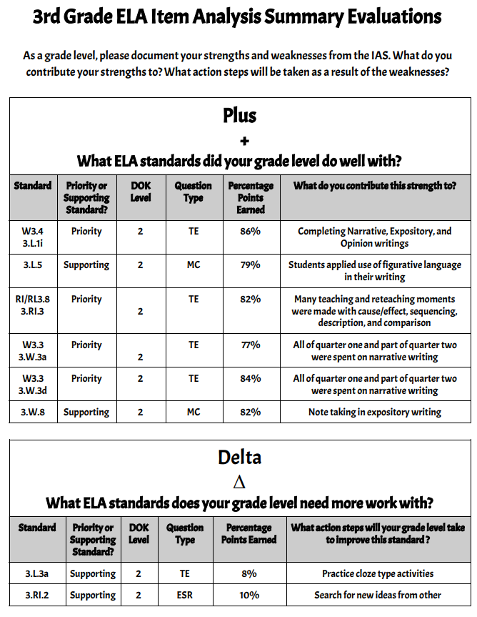
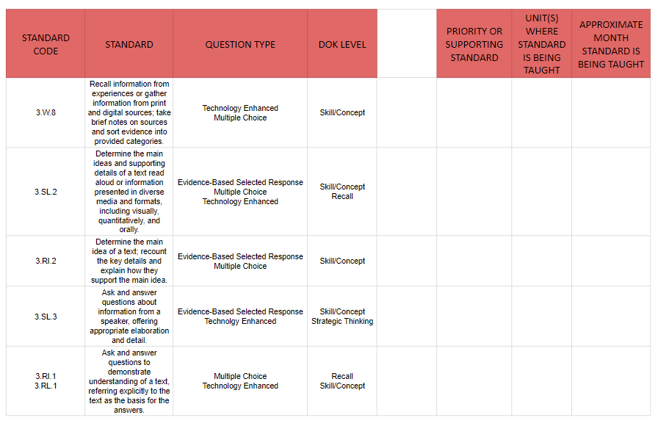
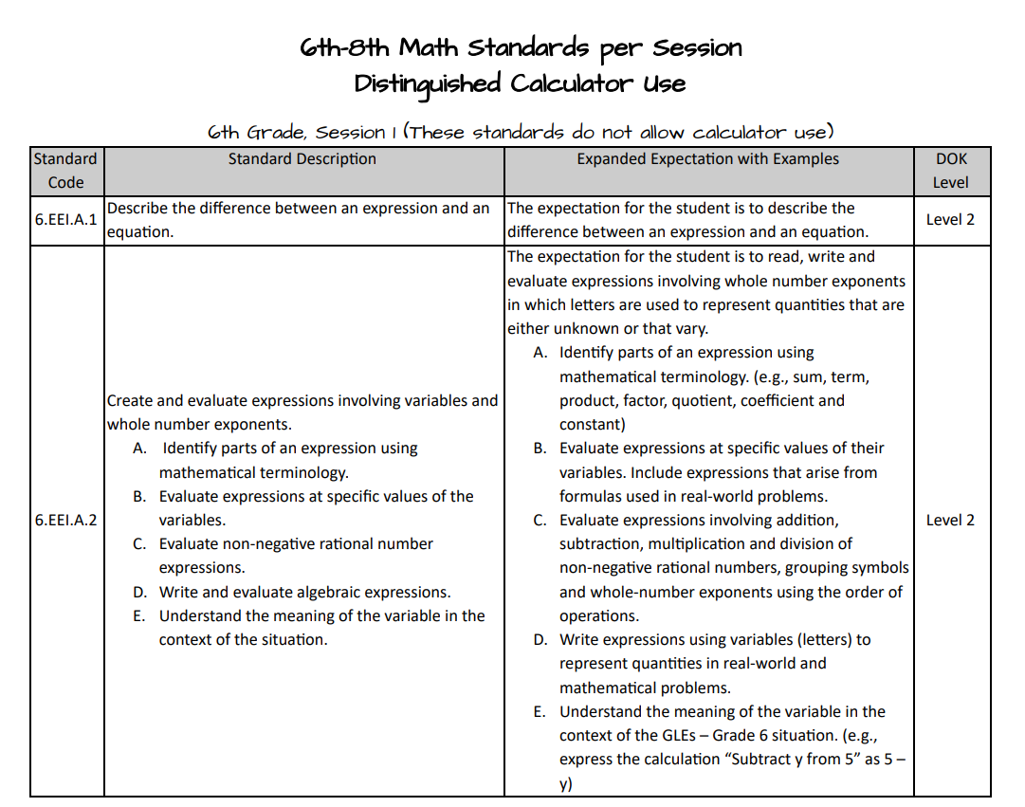
MAP Item Analysis Summary and Evaluation
Where is the information being taught?
Item Analysis Summary
Evaluation
Standards per Session

Slide 18
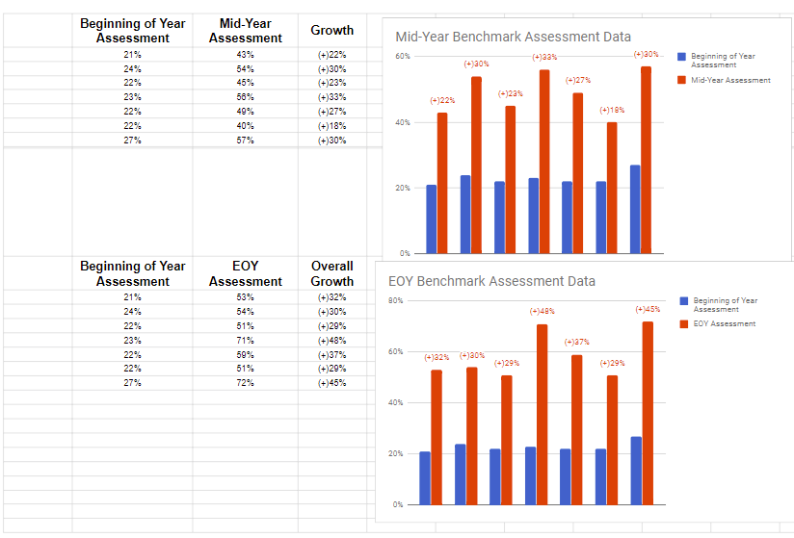
Benchmark Data

Slide 19
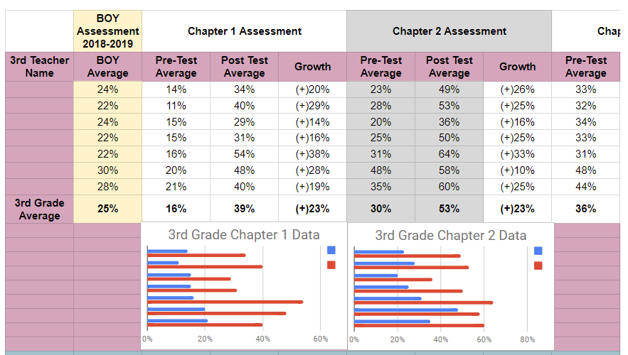
Pre and Post Assessment Data

Slide 20
Who is responsible for this data?
Administrators
Instructional Coaches
Teachers
Students

Slide 21
When does this occur?
Common Plan Times
Early Release Wednesdays

Slide 22
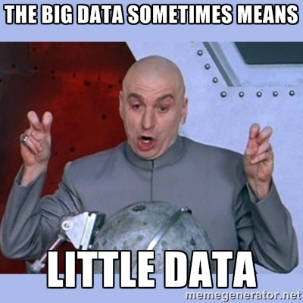
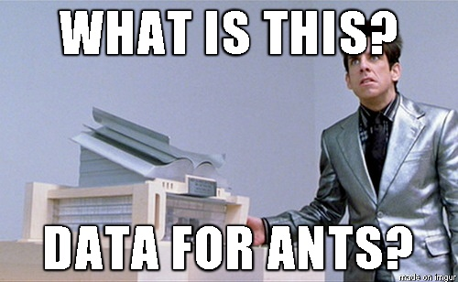
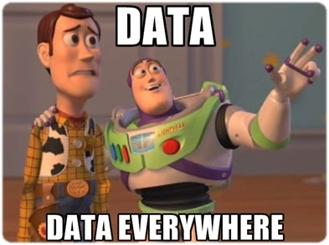
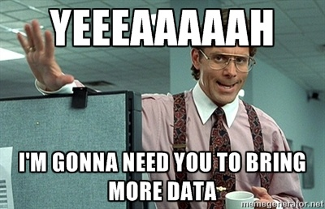
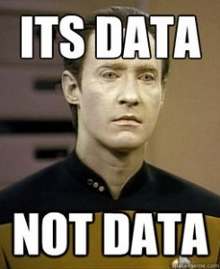
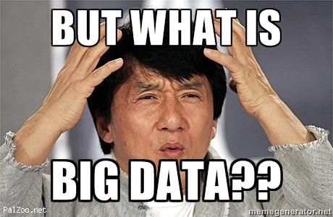
Questions?

