Slide 1
The Four Day School Week
Reflections on the First Year
Dr. Kim Finch, Missouri State University
Dr. Shannon Snow, Stockton R-I Schools
Dr. Jon Turner, Missouri State University

Slide 2
The Four Day School Week In Missouri
Three Options for School Calendar in Missouri
Option 1: Traditional calendar of at least 174 days and 1,044 hours of instruction (171.031.1, RSMo.)
Minimum of 3 hours per day
Maximum of 7 hours per day
Option 2: Less than 174 day and a minimum of at least 1,044 hours of instruction (171.029.1 RSMo.)
Minimum of 4 hours per day
Maximum of 8 hours per day
Option 3: Calendar of 142 days and a minimum of at least 1,044 hours of instruction (171.031.1, RSMo.)
Minimum of 4 hours per day
Maximum of 8 hours per day

Slide 3
Currently 22 Missouri School Districts use the four-day week

Slide 4
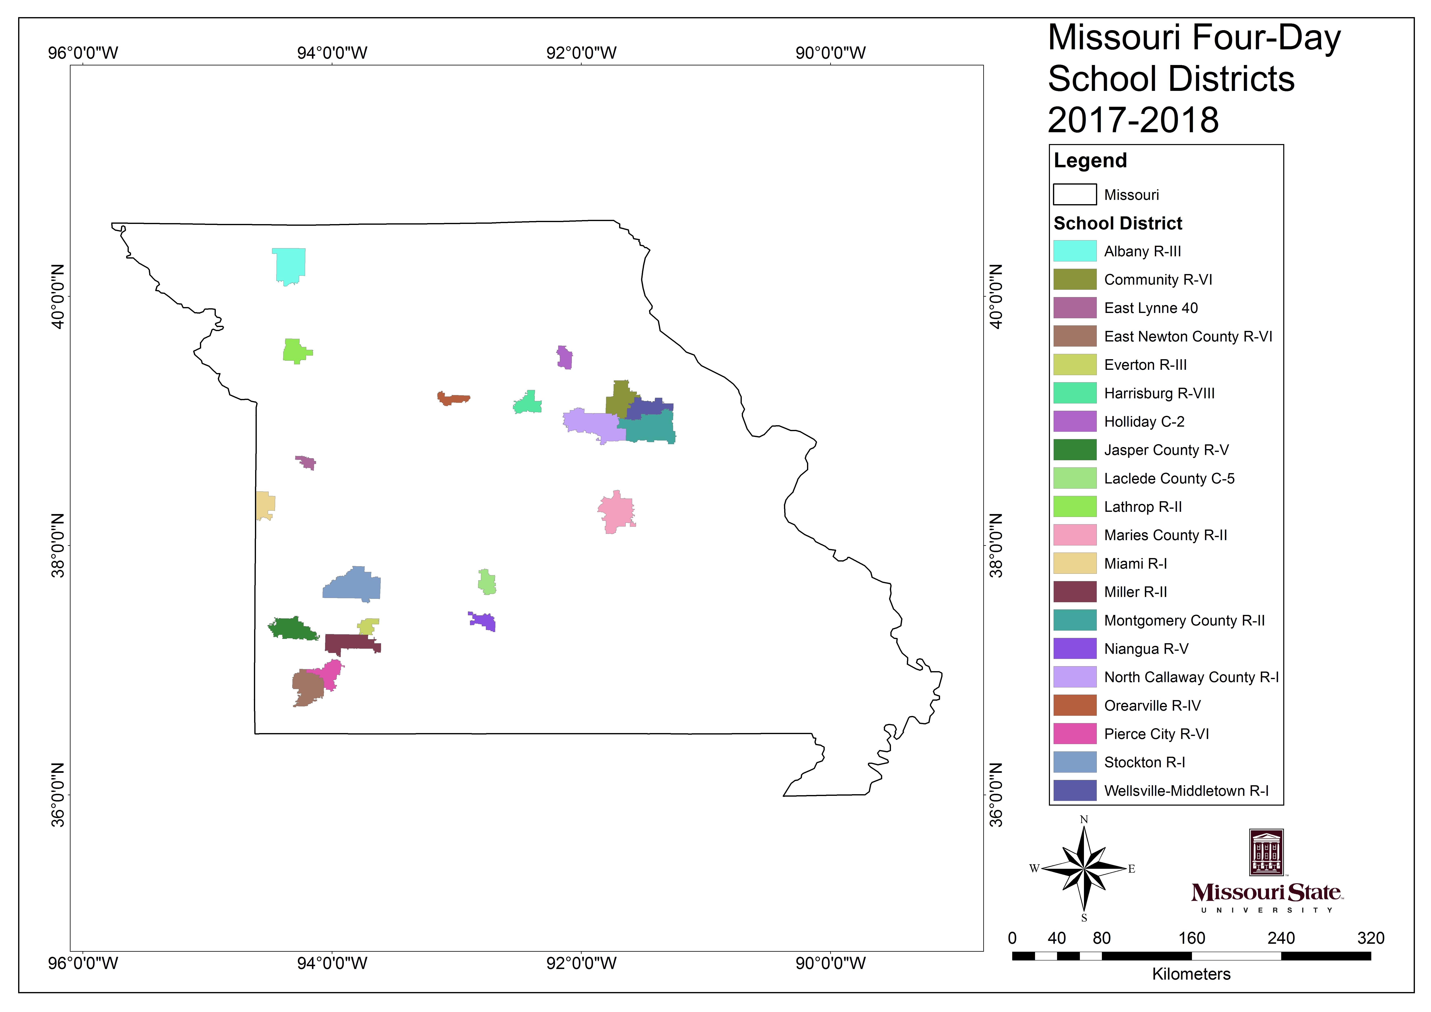

Slide 5
Following three districts during the first year (2015-2016)
Staff Survey
Certified and Classified
Parent Survey
Community/Business Leader Survey

Slide 6
Staff Survey Results (n=136)
Extremely strong support from both Certified and Classified Staff at all three school districts
“I prefer to work in a school district with a four-day school week”
83% agreed and 8% somewhat agreed
“I am as productive or more productive with the four-day week as I was with the five-day school week”
Only 2% somewhat disagreed or disagreed with the statement
”The four-day school week model should be used again next year”
88% agreed and 3% somewhat agreed

Slide 7
Comparing Certified and Classified Responses
No statistical differences between the two groups ON ANY of 15 questions related to the impact on school performance
The four-day school week has had a positive impact on what is being taught in class
Impact on extra-curricular participation
Impact on students with disabilities
Concern about student safety on the additional day off
Public perception of the quality of the school district

Slide 8
Comparing Staff with Kids in School with those with No Kids in School
No significant difference between the groups on any of the 15 questions at any of the three school districts

Slide 9
Certified Staff Recommendations
You’ll be redoing curriculum in order to cut out the “fluff” from lessons
You will focus on quality not quantity in your lessons
Does require additional planning-–”having Monday off helps prepare for the week”
The professional development days are important, but, remember to leave time for teachers to prepare for class and to collaborate
Focus on explaining to the community “why” this is a good thing for kids and the school
Research and visit other schools using the 4 day model prior to making the decision
Concerns about retention of content over 3 day weekends, kids missing meals, is paying for childcare a hardship for families, is it having a negative impact on classified staff

Slide 10
Parent Survey Results (n=159)
All parent groups support the four-day school week and most parent groups support the move very strongly
While all groups support the four-day week----parental support increases with the age of their children
All groups agree that the four-day week has had:
A positive impact on their family
Their children are as successful in school now as they were before
All groups did not feel that the four-day week had:
Increased homework
Jeopardized the safety of their children on the day out of school
No differences between Free or Reduced Lunch Families

Slide 11
Where parents differed
Should the four-day week be used again next year?
Elementary 55% YES, Middle School/High School 68% YES, Student enrolled in both 79% YES
I have struggled to find childcare for the day we’re out of school
Elementary only 26% YES-----Middle School and High School 4.7% YES
I would prefer we return to a five day week
Elementary Only 34% YES, MS/HS Only 18% YES, Both 15% YES

Slide 12
Parents with Children Receiving Special Education Service
While still supportive of the four-day school week, the support is not as strong
While only 12% of parents of children who did not receive special education services would prefer to return to the five day school week-----33% of parents with special education students would prefer to return to the traditional calendar

Slide 13
Parent Perspective Summary
34% of parents with ONLY elementary aged students would prefer to return to the five day school week---twice as high a % with middle or high school only or both elementary and middle school or high school students
33% of parents with special education students would prefer to return to the five day school week

Slide 14
Community/Business Leader Perspective (n=71)
In general, community/business leaders were neutral on the impact of the four-day school week on their businesses
30% felt it had a positive impact on business
33% felt it had no impact (neutral) on business
36% felt it had a negative impact on business
Did it have a positive economic impact on the community?
26% positive impact
44% no impact/neutral
30% negative impact

Slide 15
The key difference between Community/Business perspective?
Did they have kids in school
Community/Business leaders were much more likely to feel that the switch had a positive impact on their business if they had kids enrolled in school
When asked if they would prefer to return to a five day week---community/business leaders with kids in school slightly disagreed and those without kids in school slightly agreed and wanted to return to the traditional school calendar

Slide 16
DR. SHANNON SNOW
SUPERINTENDENT, STOCKTON R-I SCHOOLS

Slide 17
FOR MORE INFORMATION:
JON S. TURNER, ASSISTANT PROFESSOR
MISSOURI STATE UNIVERSITY
901 SOUTH NATIONAL AVENUE
PARK CENTRAL OFFICE BUILDING 133
SPRINGFIELD, MISSOURI 417-836-6518
JONSTURNER@MISSOURISTATE.EDU

