Slide 1
Bridge the Bond Gap: Leveraging Energy Efficiency to Maximize Student Success
Drew Eanes, OpTerra Energy Services
Stephanie Norris, Mexico Public Schools
Notes:
Contact: Drew Eanes Business Development Manager T 913-221-7900 deanes@opterraenergy.com www.opterraenergy.com
Photo: Nuview Union School District, CA

Slide 2
Drew Eanes, Business Development Manager at OpTerra Energy Services Stephanie Norris, Business Manager at Mexico Public Schools

Slide 3
Today’s Agenda
K-12 School Concerns
Consider Your Options
Going Beyond
A Proven Approach: Mexico Public Schools
Questions

Slide 4
K-12 School Concerns
MARE 2017

Slide 5
Good Enough
More than 53% of public schools
need to make investments for repairs,
renovations, & modernization to be
considered in “good” condition.
MARE 2017

Slide 6
The Vicious Cycle
$271 billion to $542 billion
in total deferred maintenance across US schools, depending on a 50- or 25- year life cycle
The 2014 CGCS Report reveals that Deferred Maintenance increases:
Cost of Managing/Operating Facilities
Emergency Repairs
Disruptions to delivering instructional programs
Risk of defaults on warranties of building components
Premature failure of buildings and equipment
MARE 2017
Notes:
Facilities Report 2014

Slide 7
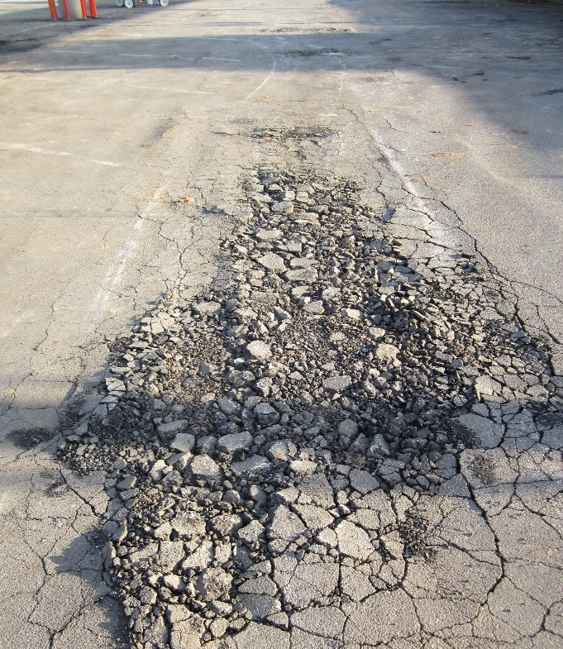
The Effects of Deferred Maintenance
Lower Student Achievement
Decreased
Campus Comfort
Difficulty
Retaining Teachers
Health and Attendance Problems
Impacted
Classroom
Learning
MARE 2017
Notes:
Reasons to Consider implementing a performance contract
Students in deteriorating school buildings score 5 to 11 percentile points lower on measures of student achievement (U.S. Department of Education, 2000)
14.4 million school days are lost in the U.S. due to absences caused by asthma, often attribute to poor ventilation in deteriorating buildings (American Lung Association, 2008).
High levels of noise caused by substandard facilities drops speech recognition to as low as 30 percent, according to the American Federation of Teachers.
Deferred maintenance is just one symptom of our lack of needed funds to enhance and support our schools. In addition to reducing our ability to keep students focused in safe, comfortable classrooms, postponing needed infrastructure upgrades creates a missed learning opportunity for students and teachers. To truly achieve the 21st century classroom, the learning environment needs to be enhanced with real technology that will transform our campuses into learning laboratories.
Picture: Los Angeles Unified SD (pre-construction), CA

Slide 8
Consider Your Options
MARE 2017

Slide 9
Available Methods
Stay in the vicious cycle of deferred maintenance
Self-perform a comprehensive project
Partner with an ESCO to take advantage of ESPC and existing regulations

Slide 10
Choosing a Trusted Partner
Energy Service Companies (ESCOs) are experienced, NAESCO-accredited project developers with extensive experience in retrofit projects, integrating design, financing, installation, and operational elements. Districts can break the “vicious cycle” of deferred maintenance through start-to-finish accountability:
Program Development, Planning & Design
Engineering
Construction
Project Finance Structuring
Operations & Maintenance
Measurement & Verification
MARE 2017
Notes:
Source: http://www.naesco.org/what-is-an-esco
Typical service offerings include:
Provide an Investment Grade Audit
Engineer projects of appropriate size and scope
Arrange project financing and assist the organization in understanding the available financing options.
Procure and install the equipment
Monitor and verify energy savings for as long as the customer wishes often the entire contract term
Provide, if requested, ongoing operations and maintenance savings
Prepare reports for the customer detailing energy savings and a reconciliation plan if energy savings were to fall below projections
Over the last 3 decades, ESCOs have delivered
$45B in projects
$50B savings—guaranteed and delivered
425,000 person-years of direct employment
$30B of infrastructure improvements

Slide 11
Take Advantage of Energy Savings Performance Contracts
MO Statue 8.231
Low-Risk: Qualified ESCO providers will reimburse a district for any shortfall of cost savings
Flexible: Schools can choose from a variety of facility alterations & scope to reduce energy consumption or operating costs and have budget certainty
Affordable: Districts may utilize installment payment contracts to fund energy savings improvements most critical to school campuses
MARE 2017
Notes:
Legislation and procurement process per MO State Law, pursuant to Section 8.231
MO Statute 8.231: Schools can enter a contract for the implementation of one or more energy saving measures that may be applied to an existing school district facility. Missouri Department of Elementary and Secondary Education School Finance: https://dese.mo.gov/sites/default/files/sf-LGuaranteedEnergySavingsPerformanceContracts.pdf
Photo: Westminster School District, CA

Slide 12
Going Beyond the Status Quo
MARE 2017

Slide 13
Stretch Your Bond Dollars Further
General Funds
Bonds
Energy Efficiency Funds
State School Facility Program
Facility Levies
State Deferred Maint. Funds
Developer Fees
Redevelop Pass-Thru Revenues
Energy Driven Capital Replenish
Special Assess. District
Donations & Grants
Lease Unused Space
Decomm./Demo Unused Space
MARE 2017
Notes:
By bundling your funds, you’re able to get more “bang for your buck”.
Financing: TELP, CREB, PPA, Grants, Incentives, Infrastructure Bank etc.

Slide 14
Funding Program Improvements
Generate savings by reducing utility/maintenance costs
Initial capital provided via 3rd Party, alternative financing (lender)
Utilize savings to repay lender and fund mission-critical priorities
Finance programs over 15 years, spreading costs over the life cycle of equipment
Outcomes are guaranteed
Leverage your capital
Facility Operating Expense
Savings
Savings
Savings used to repay lender
Facility Operating Expense
Facility Operating Expense
BEFORE PROGRAM
WHILE PAYING FOR PROGRAM
AFTER PROGRAM IS PAID OFF
MARE 2017
Notes:
Legislation and procurement process per MO State Law, pursuant to Section 8.231
https://dese.mo.gov/sites/default/files/sf-LGuaranteedEnergySavingsPerformanceContracts.pdf

Slide 15
A Proven Approach: Facilities Modernization at Mexico Public Schools
MARE 2017

Slide 16
Mexico Public Schools, MO
PROJECT HIGHLIGHTS
Comprehensive energy upgrades at six schools and the Central Office across three phases
Utilized energy performance contracting to save costs, and then in turn pay for the program with savings from the new energy conservation measures
Notes:
Photo: Mexico Public Schools, MO; Mexico Public Schools website
Stipulated savings guarantee dollars back into the General Fund
Partnered with a qualified provider, per Section 8.231, RSMo, to develop a turnkey facilities modernization project

Slide 17
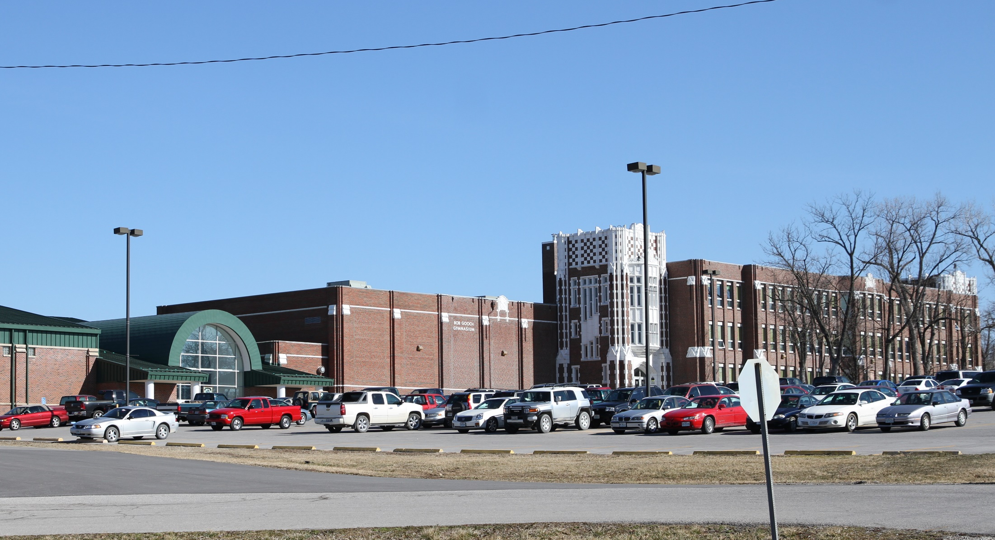
Project Scope
Over $2.3MM in lifetime savings
New windows
New Heat Pumps
Energy Management and Building Automatic Systems
Domestic Water Retrofits
HVAC upgrades and wireless thermostats
MARE 2017
Notes:
Photo: Mexico Senior High School
Phase I
Energy Management Systems (EMS) installed at two sites
New HVAC units and heat pump systems installed at two sites
Over 700 new windows installed across two sites
Energy performance contracting model allowed MPS to use the money saved from reduced energy consumption to pay for ongoing improvements during the next phase of work at other school sites.
Phase II
Building envelope improvements and roof repairs implemented at three sites
New Energy Management Control Systems (EMCS) installed to operate HVAC at two sites
New fluorescent light fixtures installed in three locations
Lighting controls and sensors upgraded at two sites
Phase III
Building automation systems (BAS) installed at six sites
New HVAC system installed at Eugene Field Elementary School
Domestic water retrofits implemented at seven sites
Upgrades in progress will generate consistent savings, allowing MPS to put more dollars to work to directly aid in student learning.

Slide 18
Reduced Carbon Footprint
The project eliminates 753 metric tons of greenhouse gas emissions, the equivalent to removing 159 cars from the road.
Notes:
Source: McMillan Elementary, Mexico Public Schools Website

Slide 19
Demonstrating Fiscal Stewardship
By financing the program over 15 years, savings are utilized to repay the lender and fund mission-critical priorities. Costs are spread over the life cycle of equipment.
Notes:
Source: NuView Union School District, CA

Slide 20
Supporting Your Educational Mission
Energy improvements generate savings that bring funds back to where they’re needed most: improving classrooms, and supporting students and teachers.
Notes:
Source: David Pickering, Mexico Public Schools Website

Slide 21
Mexico Public Schools’ Path to Savings
1
2
3
4
Energy Services Company
Turnkey Project
School District
Results
Improve the Working Environment
Design-Build
Performance Guarantee
Support Student Learning
Bundle of Technologies
Bundle of Technologies
Community Engagement & Economic Development
Engineering Services
Accomplish Performance Goals
Finance Team
Bank
Payback Loan
Environmentally Sustainable
Energy and Water Savings
Save on Operation and Maintenance Costs
MARE 2017

Slide 22
Questions

Slide 23
Contact: Drew Eanes Business Development Manager T 913-221-7900 deanes@opterraenergy.com www.opterraenergy.com
MARE 2017

