Slide 1
Superintendent Search Process Missouri Association of Rural Education
October, 2016
MARE State Conference
Lodge of the Four Seasons

Slide 2
In Comparison…vs. Florida at 76 (20.6).
1. Calif: 1,082 38.8M
2. Texas 1,080 27 M
3. Illinois 905 13M
4. New York 715 20M
5. Ohio 668 11.6M
6. New Jersey 598 9M
7. Michigan 576 10M
8. Oklahoma 550 4M
9. Missouri 534 6.1M
10. Pennsylvania 514 12.M

Slide 3
Overview
In the more than 540 public school districts in Missouri between 15 and 20 percent of the Superintendencies become vacant each year.
Thus, roughly 50 to 100 School Boards are searching for a new Superintendent in any given year.
Two critical tasks for a Board are hiring the best Superintendent possible, and retaining that leader over a long period of time.
Seasonal process: December, January, #’s highest – impacts on employing board, applicants, and other districts.

Slide 4
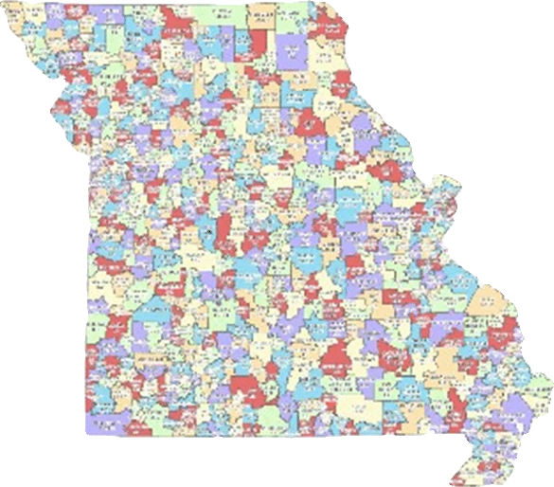
520+ School Districts
.

Slide 5
Trends
Fewer candidates, especially in rural areas
More non-traditional candidates
More women applicants
Impact of social media, internet expanding
Less confidentiality
Compensation: up
Residency requirements: down

Slide 6
Challenges for boards when conducting own search
Time
Managing staff and community involvement.
Lack of external perspective.
Limited access to key
reference sources.
Lack of experience in conducting
detailed reference reviews.
Perception of bias/lack of
objectivity.

Slide 7
Why Use MARE to conduct a Supt Search?
Since 1987, MARE has represented rural schools in Missouri
MARE has a proven record of experience conducting supt searches for rural schools
The sole focus of MARE is on rural schools and communities.
The MARE fee structure is sensitive to the budgetary issues of rural schools
MARE consultants understand and work with rural school leadership –
MARE respects rural schools and communities.
MARE offers comprehensive services for rural schools.
MARE has a proven record of experience conducting supt searches for rural schools

Slide 8
The MARE administrative search service emphasizes merit based employment on the part of the board. The service reduces the issue of community
concerns about
conflict of interest
and board neutrality
during the
employment process.

Slide 9
Recent MARE Superintendent Searches
2015-16 2014-15 2013-14 2012-13
+Santa Fe +Smithton R-VI +Richland R-IV +Verona R-VII
+Clinton Co. R-3 +Pettis Co. R-V +Tarkio R-I +Prairie Home R-V
+Norborne R-8 +Gallatin R-V +Rock Port R-II +Osage Co. R-II
+Renick R-5 +Newtown Harris R-III +North Harrison +Shelby Co. R-IV
+Osage Co. R-2 +Iron Co. C-4 +Blackwater R-II +Chilhowee R-IV
+Plato R-5 +Crest Ridge R-7 +Latham R-V
+Ralls Co. R-2 +Avilla R-13 +Fairfax R-III
+Monroe City R-1
+Crest Ridge R-7
+Avilla R-13
+New Haven

Slide 10
Search Process in Four Segments
1. Recruitment - qualified, well matched pool of applicants
2. Screening- select candidates from applicants
3. Selection- recommend leading candidates pre-screened for board review.
4. Follow-up services

Slide 11
#1 – Recruitment Goal: qualified, well matched pool of applicants
Begins with board dialogue:
+ Facilitate board expectations for successful candidate profile
+ Composition of key elements of vacancy notice : required vs. desired criteria; compensation; residency, etc.
+ Review application process; establish time lines, points of contact, general procedures, outline of vacancy notice, etc

Slide 12
Recruitment
MARE distributes a detailed Vacancy Announcement to:
MARE Website [www.moare.com/]
Joint School Administrators Website [http://moadminjobs.com/]
Moreap [https://www.moreap.net]
E-mailed to all superintendents (500 +/-)
E-mailed to all building administrators (2,500 +/-)
Announced at regional MASA District meetings
E-mailed to Rural Ed Associations in adjacent states
Consultant contacts
See attached current example for Bowling Green

Slide 13
Recruitment
Previous Employment of “new” Superintendent or “Where do new Supt’s come from?”

Slide 14
New jobs = cascading impact
Vacancies have a cascading impact on other positions – when one vacancy is filled there is a potential for disruption in other school districts and within the same district. A succession of positions become available in order to fill the ‘next’ promotion. A newly employed supt often results in an administrative vacancy for another school system – thus, late year changes can be challenging for school districts.

Slide 15
#2: Screening by Consultant Goal: select candidates from applicants
Analysis of application materials
A. Receive and compile files for all applications.
B. Review and analyze content of application materials.
C. Conduct and document reference checks
D. Respond to Q’s and contacts from applicants
E. Present regular updates of recruitment and applicant status to the board president
F. Contact leading candidates
G. Prepare recommendations for board

Slide 16
3: Selection of finalists
*Goal: Assemble a qualified, well matched, pool of candidates pre-screened for board review.
A. Present applicant files to board
B. Review candidates recommended for interview
(from area #1 of applicant materials)
C. Candidate/applicant materials review criteria:
Most closely aligned with, or exceeding, board criteria
Meeting, or closely meeting, board criteria
Meeting few board criteria
D. Suggest interview guides and guidance for process as needed
E. Suggest key elements to avoid in the interview process
F. Set candidate interview dates/times/etc with finalists

Slide 17
#4 – Follow - Up
The MARE Supt Search Service continues after the board and new supt contract has been signed.
Notify interviewed unsuccessful candidates
Provide sample media release announcing new administrator
Provide board with detailed “introduction” plan for new superintendent
Consultation with new superintendent by MARE consultant

Slide 18
MARE Supt Search Fee Structure
MARE fee structure is based on enrollment and is dedicated to understanding the nature of limited rural school budgets. See MARE Superintendent Search Services listing for more complete information.
Enrollment | Charge | Enrollment | Charge
500 and less | $3,000 | 2,501 | $5,500
501-1,000 | $3,500 | 3,001-3,500 | $6,000
1001-1,500 | $4,000 | 3,501-4,000 | $6,500
1,501-2,000 | $4,500 | Above 4,000 | $7,000
2,001-2,500 | $5,000

Slide 19
Common Application Issues
Very competitive process. Oversights can be costly!
Application not submitted on time
Omitting application questions or incomplete answers
Missing required documents
References outdated
Prior and/or existing employment issues not fully explained
Handwritten letter and/or application
Failure to customize letter of application
Old fashioned paper – why??
Non-standard resume – caution on creative formats
Customized entry plan an advantage.

Slide 20
Congratulations, you are on stage and in the spotlight
How to arrive in the
new district – first
impressions last……
Entry plans - a
candidate advantage
Introduction plans –
a board/district
advantage

Slide 21
Who/How to contact for more information
Dr. Ray Patrick, MARE Executive Director,
(660) 747-8050 or rpatric@moare.com
Dr. Michael Jinks, Consultant, (660) 441-7473 or 19mj46@charter.net
Dr. Paul Ricker, Consultant, (573) 365-4703 or paulricker1@charter.net
Dr. Craig Eaton, Consultant, (660) 492 – 0811 or craigdeaton87@gmail.com

Slide 22
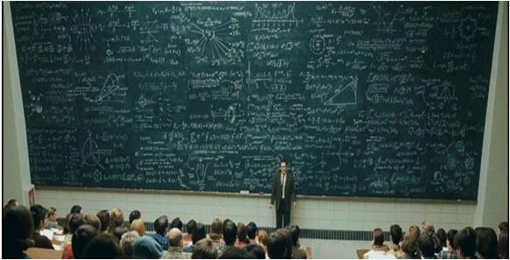
Questions??

